Slide 1

Remote Invigilation (RI)

Slide 2

Background
Covid-19 demonstrated how easily Centre-based on-line testing provision is disrupted
City & Guilds responded quickly with ‘Test at Home’ - creating opportunities for Centres to carry on working with learners
Our new Remote Invigilation Service is a long-term solution
Remote Invigilation offers answers to some of the longstanding challenges (and opportunities) our Centres told us about

Slide 3

We’ve listened to your testing needs
The flexibility of on-line test scheduling and location from which your candidates can take their tests​
Accessibility of on-line tests for all candidates​
On-line testing solutions to compliment the increase in on-line learning programmes​
A solution for scheduling/logistical constraints and difficulties with centre-based facility bookings​
Standardisation of invigilation processes and ensuring your tests are compliant​ with Awarding Organisation requirements
Easy to follow test booking processes and seamless candidate workflows and communications
Responsive support model for centres and candidates having issues with tests​
Growth of testing opportunities and therefore opportunities to scale delivery beyond the constraints of centre-based delivery

Slide 4
What is Remote Invigilation?
A way to invigilate City & Guilds e-volve tests on-line
Candidates take their test from home, or the workplace watched by a remote invigilator
City & Guilds supply invigilators
Invigilation takes place through monitoring video, audio and remote screenshare supported by artificial intelligence (AI) tools

Slide 5







Benefits of Remote Invigilation
Lets candidate fit testing around work (and other commitments) ​
Sit the test at home or in the workplace ​
Continuity of on-line testing offers in the event of location disruptions eg. Covid-19, extreme weather events
Removes bottlenecks at key testing periods ​
  Less pressure on computer-based testing rooms on-site
  More testing opportunities mean responsive delivery and new business opportunities​
Removes cost/time to administer tests (sourcing, booking for on-line tests. Hiring, training and paying for invigilator time​
We take care of more than just the test itself
Drives standardisation of invigilation and provides reviewable evidence of malpractice if required​
Quality control at all times
Eliminates instances of fraud or impersonation during assessments and acts as an effective deterrent to cheating

Slide 6
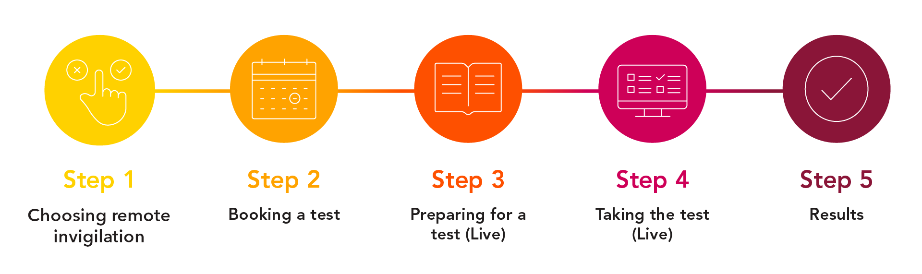
Remote Invigilation service timeline
From 7th June, our Remote Invigilation Service is available for most e-volve tests. You can find a full list of tests on our dedicated Remote Invigilation page cityandguilds.com/remote-invigilation
Book a remote invigilation test through Walled Garden. Test should be booked at least five working days in advance
Within two working days after the booking, the candidate will get an email from noreply@talview.com with the preparatory materials, a link to join the live invigilation session and a verification code. Please check the candidate adds this email to their address book and checks their junk folder if don’t get the email
If a candidate has not read the automated email from Talview, we’ll contact the person who made the booking with a copy to pass on
Results are available in the usual way

Slide 7
How to make a booking for Remote Invigilation
We need a unique email address for every candidate
To add one, please use our new Learner Details Upload Tool. Guidance on how to use it you can find on our Remote Invigilation page. It usually takes 24 hours for changes to take effect. You can contact Customer Services to expedite this update.
At least five days before the test date, book the e-volve and select “Remote Testing: Invigilated”.
You can pick one of three time slots
    For a morning test slot, book an 8am test
    For a mid-day test slot, book a 11.30am test
    For an afternoon test slot, please book a 4pm test
    Your candidate will receive an invitation with a start time on or shortly after the slot start time they are booked for.
The 3 hour slot allows plenty of time for ID/environment checks, the test duration and leaves some buffer time, should a candidate be running late (up to 20 minutes).
You can cancel (free of charge) up until two days before the test start time/date.
Just contact Customer Services.
Any later than two days and we’ll charge the full fee.

Slide 8
Candidate hardware requirements
Hardware
Processor | 1.8GHz or faster x86-compatible processor For tests containing Advanced Question Types, we recommend that Celeron processors are avoided.
Internet connection | Minimum 1Mbps, recommended 2Mbps
Memory (RAM) | 4GB
Video | Single display Screen resolution of 1024x768 Graphics card with at least 128MB of memory
Webcam | Webcam 640 x 480 pixels recording colour at 15fps and a microphone
Peripherals permitted | Two button mouse Keyboard Microphone (can be built into webcam or separate) Speakers
Software
Operating System | Windows 8 (32-bit or 64-bit) Windows 8.1 (32-bit or 64-bit) Windows 10 (32-bit or 64-bit)
Internet Browser | Google Chrome, latest version Surpass Viewer must be installed and allowed to run for the test session (full guidance will be provided)

Slide 9

Preparing candidate for the test: On-line Network Test
Candidates can check their peripherals and network before the test:
https://network-test.talview.com
Only the first three parts of the test are needed to check equipment compatibility
After they complete, the candidate can stop the test
START
Talview network test
Microphone
Camera
Network

Slide 10
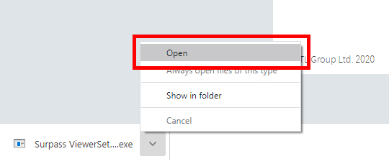
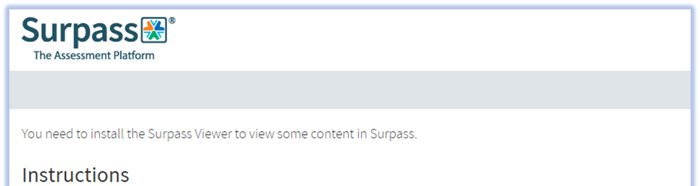
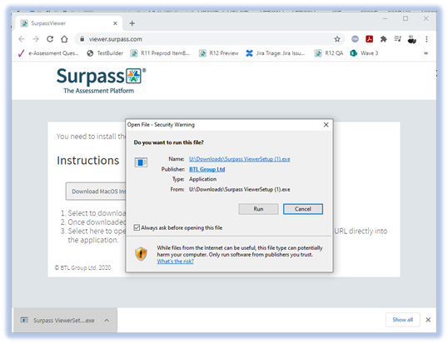
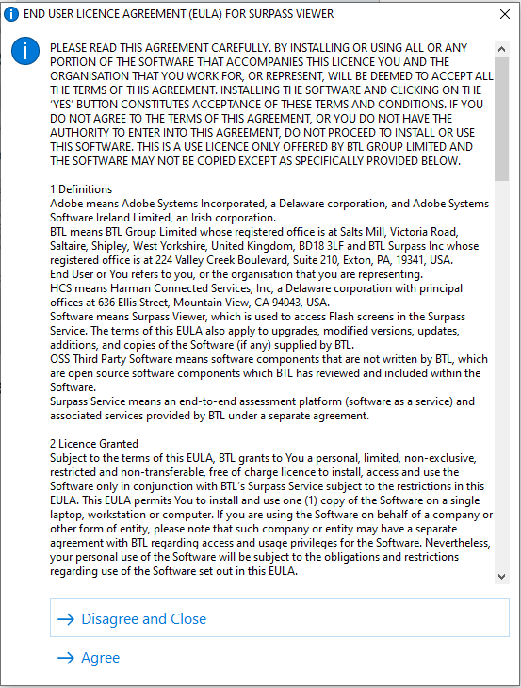
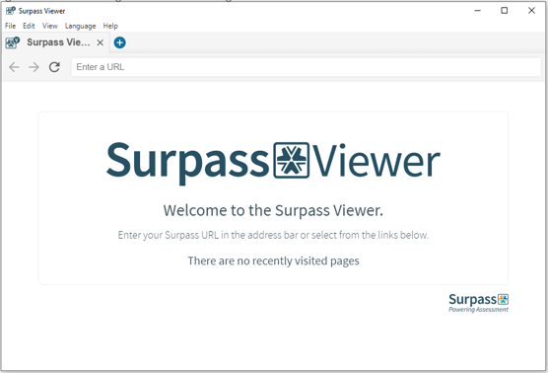
Preparing Candidate for the Test: Surpass Viewer
Candidates need to download Surpass Viewer to access Flash-powered e-volve tests
We send full details in candidate emails along with a link to the download
This won’t be needed when we complete work to make tests available in HTML5 format (late 2021)

Slide 11

The pre-test process: identity check
How do we check the candidate is who they say they are?
The candidate is welcomed to the test by the invigilator through live chat
Name check – confirmation that it is the correct candidate
Photo ID is shown to the invigilator to confirm the identity of the candidate
Jon Doe

Slide 12
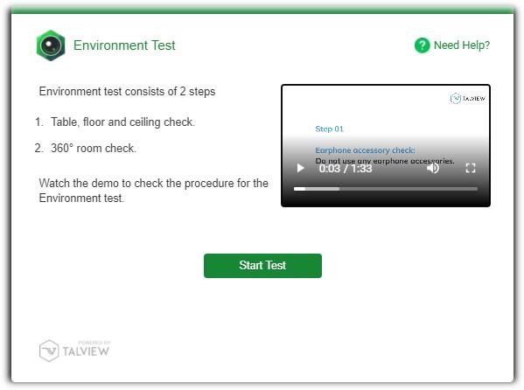
The pre-test process: Environmental scan
Candidates need to record an environment test comprising:
Desk, floor and ceiling
360° video of the assessment room
This makes sure candidates are in a secure environment
Only when the candidate has been authenticated and a successful environment test completes will the invigilator share the test PIN with the candidate

Slide 13
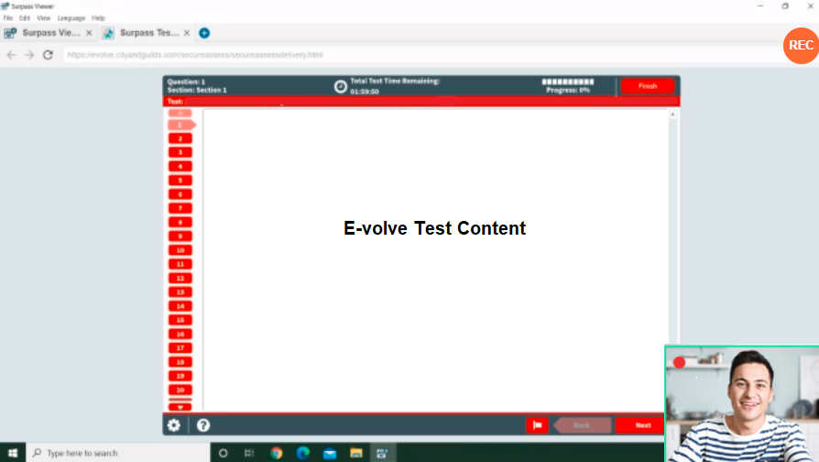
What the candidate sees
[Product Updates] Intuitive Features and Enhancements for Secure Assessments
PUBLISHED: JUNE 01, 2020 IN: CASE STUDIES & PRODUCT UPDATES
With every step forward we bring Secure assessments, better candidate interaction and a great user experience.
Safe Exam Browser for cheat-free and secure exams
Introducing the Safe Exam Browser to conduct your high stake assessments securely.
Safe Exam Browser + Talview Proctoring tool = Extra secure assessments.
With the Safe Exam Browser,
Freeze candidates' screen
Disable shortcuts
Block screen recording
Disable switching of apps
Many more features for secure assessment!
Unobtrusive additions to the on-line testing screen
The candidate sees the view shared with the invigilator and can clearly see they are being recorded

Slide 14



How it works…
Artificial Intelligence (AI)
The test is monitored by in-built AI that creates
a post-test log detailing any suspicious browser activity, with all audio-visual events recorded during the test.
Invigilator (RI Live)
Live participation by a City & Guilds approved invigilator, with real-time audio, video & screen recording of user actions to create a classroom-like experience, with monitoring that allows them to intervene, conduct live chats, provide warnings or terminate the test.
Candidate
Accesses the City & Guilds e-volve test using their own desktop/laptop (Windows only), the system monitors their behaviour within the test and through their webcam and microphone, allowing more flexibility about where they access their test, whilst still ensuring the integrity of the testing process.

Slide 15
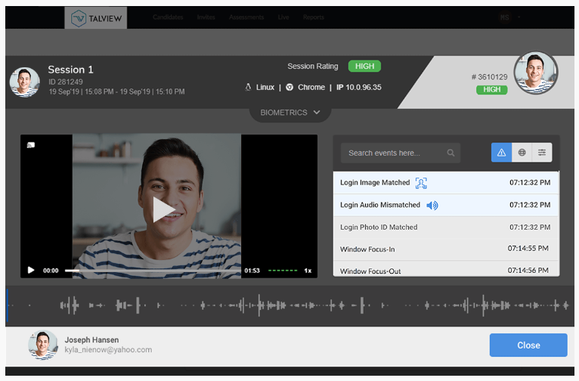
What the invigilator sees…
The invigilation system is completely automated and always monitoring suspicious activity using advanced video and audio analytics
The AI-supported software:
Keeps the candidate focus on the test screen
Monitors light and other factors in the room
Checks for suspicious objects and background voice activity
Watches the browser window to detect changes in navigation and disables copy and paste
16 different checks are performed in the background and any irregularities get flagged live to the invigilator (or for review later)

Slide 16

Getting help with Remote Invigilation
During a live remote invigilation test, candidates can raise any issues with the invigilator through live chat, and they’ll try to fix things
If the issue occurs before the test starts, there’s a support link and phone number in the confirmation email
For help booking RI through Walled Garden or with the e-volve test itself, contact our Customer Service team – details coming up at the end of this deck

Slide 17
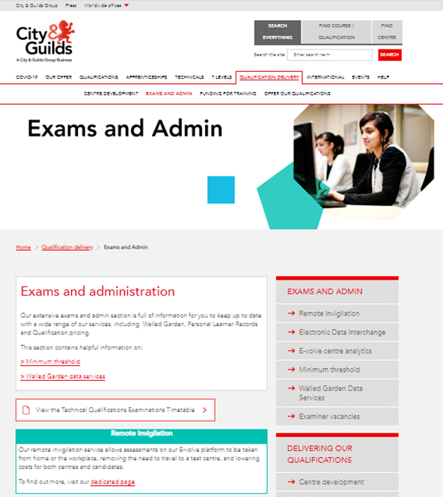
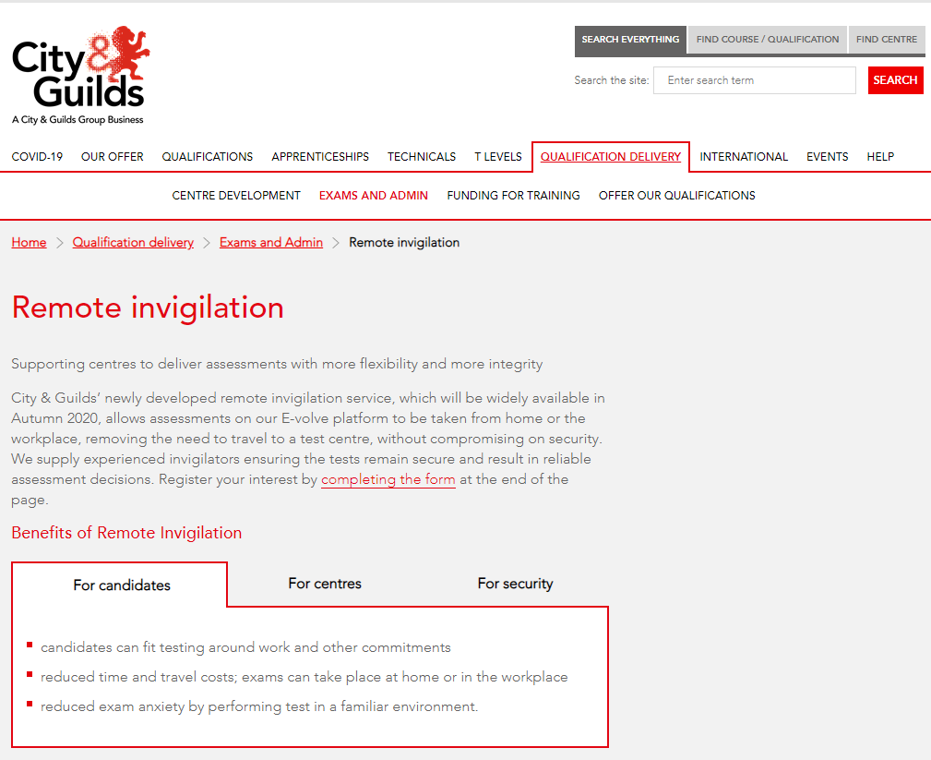
Find information online
We’ve updated the City & Guilds website with lots of extra information about our new Remote Invigilation service.
This is where you’ll find all the guides that help explain what to do when and how the service works.
cityandguilds.com/remote-invigilation

Slide 18
Live Remote Invigilation Service cost
25

Slide 19


Feedback
We’ll collect candidate star rating at the end of each test, to judge their experience of the test
We’d also like to collect more detailed feedback from some of your candidates and/or anecdotal feedback – we’ll share a survey link shortly after launch

Slide 20
Still have questions?
Please contact Customer Services
Tel: 01924 930 800
Email: centresupport@cityandguilds.com
Open: Monday to Friday 08:00h to 18:00h GMT
Calls from landlines to this number are charged at local rates that may vary according
to time of day and your individual calling plan. Charges for calls from mobiles to this number typically will be included in free call packages but this may vary according
to the calling plan chosen an outside of any inclusive minutes you will be charged
as per your plan for local rate calls.
For the latest updates, keep an eye on...
www.cityandguilds.com/remote-invigilation

Slide 21
Thank you

