Slide 1

Transitioning to the new
Hospitality Supervisor and Senior Chef Production
apprenticeship standards
Hospitality & Catering Apprenticeship network meeting
Amelia Bodle Technical Advisor
Monday 11 September 2017, 14.30-15.15
Jason Benn
Industries Manager, Hospitality, Catering, Travel & Tourism
Notes:
Explain new job role.
Open up smart screen to access maths & English
Open up examples of learner manual, game unit

Slide 2
Agenda
Recent Updates
Maths & English
Commis Chef
Team Member
Senior Chef Production
Hospitality Supervisor
Planning your delivery
Delivery and End point assessment support and resources
Q & A and Networking

Slide 3
All Hospitality SASE frameworks will be switched off 31.12.2017 except Food Production at level 2 and Patisserie at level 3 which will be April 2018.
Notes:
Delivery of new standards therefore needs to occur now.

Slide 4
New Funding guidance
Version 4 of the funding guide has now been released with new information about maths and English.
https://www.gov.uk/government/uploads/system/uploads/attachment_data/file/646244/17_18_apprenticeships_funding_and_pm_rules_V4.pdf

Slide 5


How have companies responded to the levy?
Responses range from positive (a bonus for learning and development) to negative (worried about how to convert current learning and development to apprenticeships)
Most employers won’t be able to reclaim the levy on their current apprentice numbers – many would need to double or triple the number of apprentices to reclaim their levy
This is an opportunity for providers BUT many employers also saying they can’t afford the salary for that many apprentices
Many want to reclaim the full levy but don’t want to train for the sake of it.
We’re not taking on apprentices for the sake of it. We want there to be a valid outcome and role for the apprentice at the end of it.
When some of the execs in the USA sit and wonder why we’re paying £3m in a levy that we can claim back very little of, they’ll surely begin to wonder what incentive there is to have a UK part of the business
We want to try to spend every penny of it, but they’ll want to see apprentices created where they’re needed and not just to get our money back.
We wouldn’t look at the sum and think ‘how are we going to spend it?’ It would be the other way round, and looking at what we need.
Public Admin,
1,000-2,999 staff
Wholesale & Retail
3,000-4,999 staff
Health & Social
5,000+ staff
Accommodation & Food
250-499 staff
Notes:
Slow down in apprenticeship vacancies in the short term while employers figure out how they’re going to spend the levy.

Slide 6
End-point assessment (EPA)
EPA costs must be met from within the final negotiated price of the apprenticeship between the employer and provider
If assessment costs are greater than 20% of the funding band, employer and provider must agree how this will be paid – the excess cannot be funded out of the levy
The cost of any potential resits must also be negotiated as part of the final EPA price
Resits cannot be taken to improve grades, only to achieve a pass of the apprenticeship
Resits can only be paid for out of the levy if additional learning takes place
Prices negotiated for EPA must be realistic, ie meet current market cost, as well as achieving a quality end assessment outcome for the learner and employer that gives meaning and currency to the apprenticeship
Providers must log the value of the EPA via their ILR return and keep all receipts and invoices for audit by the ESFA
Example of costs using Band 9 (£9k funding)
Funding available for EPA (max 20% of £9k) | £1,800
City & Guilds price for EPA | £1,250
Funding available for resits if needed | £550 (£1,800 - £1,250)
Any resit costs above £550 must be met by the employer and/or provider and cannot come out of the levy funds.
Notes:
Some of the early information we have been giving you on pricing –has now changed. So you need to park and understand next two slides.
in the Government’s “Apprenticeship funding and performance-management rules for training providers” para117.”We expect that the cost of end-point assessment should not usually exceed 20% of the funding band maximum. This does not mean that end-point assessment must cost 20%; the cost that individual employers will pay for assessment varies between standards and we expect where total costs are higher than the funding band maximum the difference must be paid by the employer.”
It also says (para 120) “You must keep evidence of payments made to the apprentice assessment organisation for conducting the end-point assessment.”
Providers must not try to charge the employer for the full 20%, attempt to get discounts from awarding organisations and to keep the difference. The evidence will be used during audit to ensure payment to the AAO’s is fair and reflects what is negotiated in the written agreement between all three parties, and also what is included in ILR returns – but mostly that the employer agrees the cost. We don’t expect many employers to think it’s acceptable for their provider to make money out of the EPA that the employer pays for. ESFA audit will identify this type anomaly very quickly and the provider will have excess funding clawed back and potentially sanctions imposed, such as removal from RoATP.
Under the ILR return rules, providers must include the actual amount charged for EPA. So, keeping in mind that the provider will have to record costs and keep evidence of invoices for EPA. If the ESFA sees that providers charge the employer full costs for EPA, but only invoicing the EPA organisation for say 70% of that amount, they will claw back the excess funding the provider is trying to keep.

Slide 7
Maths and English - policy context
Literacy and numeracy skills development a consistent presence in all apprenticeship standards
– recognising these are crucial to success in any job role.
Aligns with broader expectation from Government , Funding Agency and Ofsted that all post-16 learners should continue to study maths and English until they achieve at least Level 2.
Minimum levels of qualification attainment in maths and English (and ICT, where standard requires):
  Level 1 for a Level 2 standard
  Level 2 for a Level 3 (or above) standard.
Some standards may set higher requirements, or mandate particular qualifications (eg GCSE).
All apprentices expected to be supported to improve their maths and English
– important not to see minimum qualifications as a ‘benchmark’.
Common Inspection Framework expects maths and English to be developed across
whole curriculum
– important not to see them as a ‘bolt on’.

Slide 8
Maths and English – programme and funding expectations
Maths and English training funded discretely
(not part of employer contribution)
  where apprentice has not already attained Level 2 qualifications in each subject.
Not counted towards 20% off-the-job minimum
  but employer must facilitate during working hours.
Even where standard only requires Level 1 maths and English, apprentices required to ‘start, continue to study and take the test* for Level 2’.
Maths and English requirements must be met before progressing to End-Point Assessment.
* There’s so far no guidance from ESFA as to how they would expect this to be evidenced
(eg whether this would require attempts in all three component of Functional Skills English).
Apprentices can be funded to work towards either Functional Skills qualifications or GCSE
  so-called ‘stepping stone’ qualifications (eg our 3847/3844 suites) may also be funded in some cases
Addendum to ESFA funding rules lists other maths and English qualifications accepted if achieved prior to starting apprenticeship
  eg relevant qualifications from NI,
  Scotland and Wales).
SASE Transferable Skills list
(July 2017 or later) likewise
includes similar list.
Notes:
Spirit of what lies behind ‘take the test’ is that learners should be supported to continue developing their M&E skills.
Even through rule has been clumsily drafted, it puts an onus on providers to focus on progression. The old ‘reductive’ approach to M&E will no longer do!

Slide 9
Maths and English – what does City & Guilds have to offer?
Qualifications
Full suite of Functional Skills qualifications (3748).
‘Bite-sized’ maths and English qualifications (3847 and 3844) – to support progression towards Functional Skills or GCSE.
Learning resources
e-Functional Skills.
Maths and English e-Toolkit.
Workforce support
Qualifications for Literacy/Numeracy practitioners.
Specialist support, especially with maths and English integration.
Discover more:
cityandguilds.com/
mathsandenglish

Slide 10
Maths and English
Smart screen resources
EmployabilityProfessional cookery
E1–4English skills in the professional kitchen
M1–12Maths skills in the professional kitchen
Notes:
Show smart screen also useful for the commis chef.

Slide 11
Embedding maths and English
City & Guilds maths and English e toolkit
http://www.cityandguilds.com/what-we-offer/centres/maths-and-english/maths-and-english-etoolkit/try-before-you-buy.
Education and training foundation
http://www.et-foundation.co.uk/supporting/support-practitioners/maths-and-english-pipeline/ - what’s available
Excellence gateway
https://www.excellencegateway.org.uk/content/etf2743 - maths and English in voc and tech education - flyers
Bbc skillswise
http://www.bbc.co.uk/skillswise/English.
My maths
https://www.mymaths.co.uk/secondary.html.

Slide 12
On programme offer

Slide 13
Apprenticeship manual key features
Tasks for the learner to complete to ensure coverage of the Commis chef/team member standards.
Each one contains:
Key terms and their definitions.
Preparatory activities to check leaner understanding.
Practical tasks to allow the learner to apply their knowledge to their own role and organisation.
Reflective practice for learners to consider what they’ve learnt, what they need to improve and how to do it.
Learner journal will provide a great evidence log
A progress tracker and a list of key milestones as well as information on how
to use the manual as part of the programme.
Notes:
Manual has tasks which have know it, show it and live it.

Slide 14
Commis chef standard
Notes:
Essentially assessment of learning is split into three sections covering knowledge, skills and behaviours/attitude.
Culinary, food safety, business and people
Open up game unit for culinary
Task 23 understanding behaviours for people
Business costings task
Food safety

Slide 15
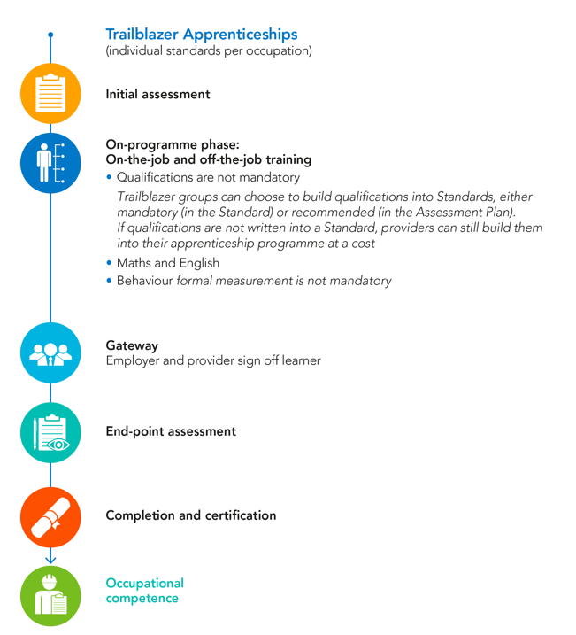
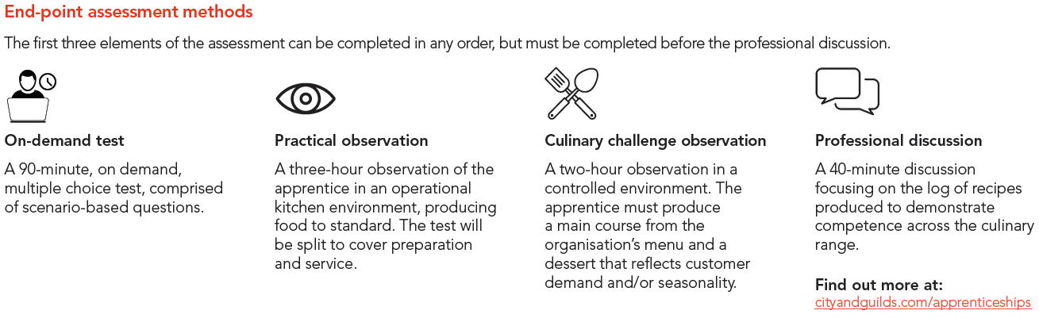
Commis chef occupation standards
Notes:
conducted remotely and at this point you will agree a plan for the assessment activities which must be completed, and present their log of dishes to be prepared in the workplace and completion is within 2 months.
The on demand test, practical observation and culinary challenge must be completed prior to the professional discussion taking place.
On demand test
The on demand test is 90 minutes multiple choice and scenario based, it is externally set and marked by C&G, it can be undertaken on the employers’ premises or off site.
Practical Observation
The practical observation is a 3 hour observation covering both preparation and service in the workplace, this enables the apprentice to demonstrate their working in an operational kitchen environment
Apprentice must cover criteria and range highlighted in Annex D of the assessment plan.
You must consider the best time to carry out the assessment, how best the apprentice can carry out the practical and a synoptic approach will be given when observing competence.
Culinary Challenge
The culinary challenge is a two hour observation in a controlled environment and may be off site in an appropriate facility and closed off during assessment, this assessment is an opportunity for the apprentice to demonstrate precision and creativity producing a 2 course meal for two people. See Annex E of the assessment plan
Once the on demand test, practical observation and culinary challenge are complete the learner can then complete the professional discussion
This is a 40 minute discussion between the apprentice and the independent end point assessor.
The review will also include a review of the apprentice recipe log from dishes prepared in the workplace
The purpose of the professional discussion is to:
Clarify any questions the Independent Assessor has from their assessment of the learner journey and practical observation;
Confirm and validate judgements about the quality of work;
Explore aspects of the work, including how it was carried out, in more detail;
Discuss how the apprentice would behave in specific scenarios, should they not have occurred within the practical observation;
Ask questions in relation to personal development and reflection;
Provide a basis for the Independent Assessor to make a decision about the grade to be awarded.
Further details of the structure to this can be found in Annex F of the assessment plan

Slide 16
Grading Commis chef
Grading is covered in the occupational brief and graded as below:
 | Pass | Score | Distinction | Score
On demand test | 70% | 1 | 85% | 2
Professional discussion | Competence | 1 | Excellence | 2
Practical observation | Competence | 1 | Excellence | 3
Culinary challenge | Competence | 1 | Excellence | 3
Overall grade | 4 - 8 |  | 9+
Notes:
For the on demand test the grading for a pass is 70% - 84% (1 point) or 85% or above is a distinction (2 points)
For both the practical observation and the culinary challenge the assessor will be looking at competence to pass worth 1 point and excellence for a distinction worth 3 points
For the professional discussion competence will provide the apprentice with 1 point and excellence 2 points
For an overall pass the learner must achieve 4 points or for a distinction 9 points.

Slide 17
Commis chef mapping
Knowledge | Apprenticeship: what is required | City & Guilds qualification units and learning outcomes Level 2 Diploma in Professional Cookery (7132-08)
Culinary | Recognise the importance of checking food stocks and keeping the storage areas in good order, know the procedures to carry out and how to deal with identified shortages and food close to expiry date. | This has only been partially met by optional units and these are not widely used and only cover food storage. Unit 271 would cover stock usage reports and temperature records . -Unit 203 covers the first two points in Employer brief -Use 203 and 271 to support this standard -Know what checks need to be made on deliveries according to food safety legislation and organisational procedures and why this is important. -Knowledge of all types of storage conditions including temperature and conditions (chilled, frozen, ambient). -Know consequences of not checking in terms of self- others and the business.
Notes:
We have carried out a mapping exercise with the existing standards 7132-08 to the new Commis Chef Standard.
Feedback from the majority of employers I have spoken with prefer not to have a qualification running alongside the occupational standards and focus on preparing a learner to be fully competent and achieve EPA.
An example of the mapping will be available to centres by the use of a password. You will see that there are occasions where the existing qualification does not quite map across and these gaps and this information will be provided.

Slide 18

About the certification
- The first and only global certification for the culinary industry
- Developed in partnership by Worldchefs and City & Guilds
- Recognises the skills and experience of culinary professionals working in the industry
- Uses new technology (digital credentialing) as the delivery platform
About Worldchefs
- The global ‘voice’ for the culinary industry
- Represents over ten million chefs in 105 countries around the world

Slide 19









Worldchefs certification: part of the new apprenticeships
9
8
7
Career progression stepping stones
6
4
5
3
2
1
Levels to be aligned to the apprenticeship standards (two levels for now)
Workforce
Workforce development

Slide 20
Team Member standard
Routes include:
Food and beverage service
Alcoholic beverage – 3 sub routes
Food production
Barista
Concierge and guest services
Housekeeping
Reception
Reservations
Conference and events
Notes:
Have also referenced F&B NVQ to F&B team member standard.
There range is split into three sections covering knowledge, skills and behaviours/attitude before your specialist function closely looking at people skills, customers and understanding the business.
The range to be covered can be found in the Team member occupational standard which is a stand-alone document outlining each module. However more detail can be found in the assessment plan which outlines the modules, pass and distinction requirements and the method of assessment.
The following specialist functions are available for apprentices to follow:
Food and beverage service
Alcoholic beverage – 3 sub routes Wine, Mixology or cask
Barista
Food production
Concierge and guest services
Housekeeping
Reception
Reservations
Conference and events
Initially we are offering on programme and EPA for Food and beverage service, Alcoholic beverage and Food production, the others will follow.

Slide 21
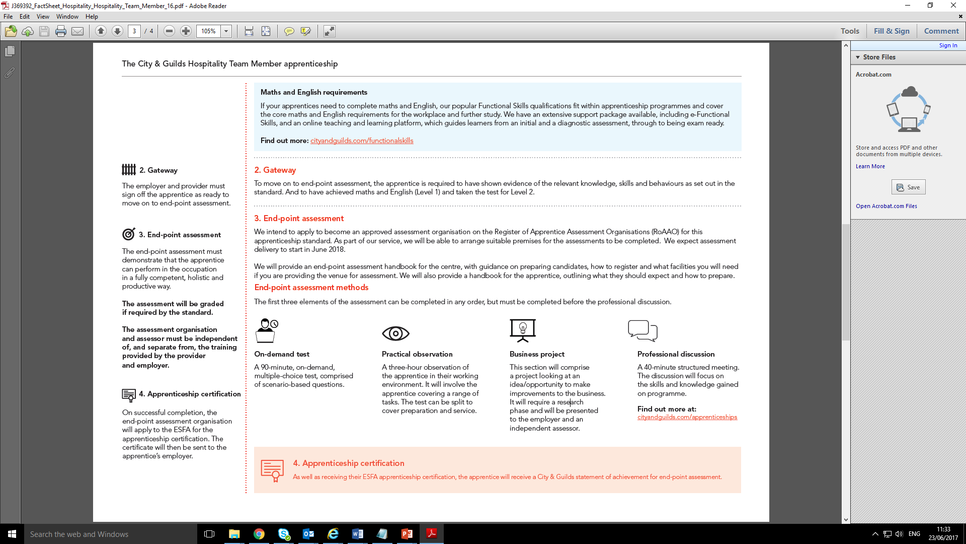
Team member occupation standards
Notes:
Just concentrating on EPA
The end-point assessment is once again synoptic and takes place at the end of the apprentice’s learning and development, after a minimum of 12 month’s on programme learning and complete within 2 months.
The on demand test practical observation and culinary challenge must be completed prior to the professional discussion taking place.
On demand test
The on demand test is 90 minutes multiple choice and scenario based covering the core and specialist function, it is externally set and marked by C&G, and it can be undertaken on the employers’ premises or off site.
Practical Observation
The practical observation is a 2 hour observation covering both preparation and service in the workplace, this enables the apprentice to demonstrate their working in an operational environment
Apprentice must cover criteria and range highlighted in Annex C of the assessment plan.
You must consider the best time to carry out the assessment, how best the apprentice can carry out the practical and a synoptic approach will be given when observing competence.
Business project is an 800 to 1200 words project focusing on the opportunity/challenge and ideas the apprentice may have to improve the business they work in and give the apprentice a wider understanding of the business, the apprentice must first submit a 200 – 300 word proposal for discussion and approval.
The project will confirm that the apprentice understands the business, maintains an up to date understanding of trends and developments in the industry, identifying the needs for a project, gathering information and able to make recommendations. See annex D
Once the on demand test, practical observation and business project are complete the learner can then complete the professional discussion
This is a 40 minute discussion between the apprentice and the independent end point assessor. For further details see Annex E of the assessment document

Slide 22
Grading
Grading is covered in the occupational brief and graded as below:
 | Pass | Score | Distinction | Score
On demand test | 70% | 1 | 85% | 2
Professional discussion | Competence | 1 | Excellence | 2
Practical observation | Competence | 1 | Excellence | 3
Business project | Competence | 1 | Excellence | 3
Overall grade | 4 - 8 |  | 9+
Notes:
Slide 19 – Grading
The grading for team member has the same structure as commis chef.

Slide 23
Senior Chef Production standard
Notes:
A Senior Chef Production will be a very possible progression from a level 2 chef apprentice and ideal for a chef working towards supervisory in a large production kitchen. The primary objective for a Senior Chef in production is to have a real focus on kitchen supervision/management.
As a Senior Chef they will be expected to develop a rounded experience of people skills, food safety, and the business whilst developing the culinary skills required.
Essentially assessment of learning is split into three sections covering knowledge, skills and behaviours/attitude. Covering culinary, food safety, business and people.
Show tasks people, food safety, business, culinary

Slide 24
Senior Chef Production EPA
Gateway requirements
The first three elements of the assessment can be completed in any order, but must be completed before the professional discussion.
On-demand test
A two-hour, on-demand, multiple choice test, comprised of scenario based questions.
Practical observation
A four-hour practical observation of the apprentice in an operational kitchen environment, producing food to standard. The test will be split to cover preparation and service.
Business project
This is a research piece that should be written-up within two months and presented to an employer and Independent End-point Assessor in a formal 30-minute presentation with a question and answer session.
This may include looking at opportunities and challenges of the business, providing ideas to make an improvement to the food production operation; this may be based around efficiency, improved ways of working, reducing wastage etc.
Professional discussion
A 90-minute professional discussion with a focus on the apprentices understanding of the business.
Notes:
At this point a further meeting is arranged to include the end point assessor who must be provided with the completed readiness for end point assessment record at least one week in advance. The meeting can be conducted remotely and at this point you will agree a plan for the assessment activities which must be completed, and present their log of dishes to be prepared in the workplace and completion is within 2 months.
The on demand test, practical observation and culinary challenge must be completed prior to the professional discussion taking place.
On demand test
The on demand test is 2 hrs multiple choice and scenario based, it is externally set and marked by C&G, it can be undertaken on the employers’ premises or off site.
Practical Observation
The practical observation is a 4 hour observation covering both preparation and service in the workplace, this enables the apprentice to demonstrate their working in an operational kitchen environment
Apprentice must cover criteria and range highlighted in Annex D of the assessment plan.
You must consider the best time to carry out the assessment, how best the apprentice can carry out the practical and a synoptic approach will be given when observing competence.
Business Project
The project allow the apprentice to look at opportunities and challenges that they have had/seen during the apprenticeship, they can present ideas for improvement to the food operation, for example efficiencies, reducing food cost/wastage etc. This must be researched and written up within two months and presented to both the employer and the EPA with a 30 minute presentation followed by a question and answer session.
Once the on demand test, practical observation and business project are complete the learner can then complete the professional discussion this is a 40 minute discussion between the apprentice and the independent end point assessor.
The purpose of the professional discussion is to:
Clarify any questions the Independent Assessor has from their assessment of the learner journey and practical observation;
Confirm and validate judgements about the quality of work;
Explore aspects of the work, including how it was carried out, in more detail;
Discuss how the apprentice would behave in specific scenarios, should they not have occurred within the practical observation;
Ask questions in relation to personal development and reflection;
Provide a basis for the Independent Assessor to make a decision about the grade to be awarded.
Further details are available in the assessment plan
A Senior Chef Production will be a very possible progression from a level 2 chef apprentice and ideal for a chef working towards supervisory in a large production kitchen. The primary objective for a Senior Chef in production is to have a real focus on kitchen supervision/management.
As a Senior Chef they will be expected to develop a rounded experience of people skills, food safety, and the business whilst developing the culinary skills required.
Essentially assessment of learning is split into three sections covering knowledge, skills and behaviours/attitude.
The criteria to be covered are found in the senior chef production occupational standards which a stand-alone document outlining the criteria to be covered. However more detail can be found in the assessment plan which outlines the modules, pass and distinction requirements and the method of assessment.
EPA for this occupation include an on demand test, practical observation, business project and a professional discussion
The period of learning, development and continuous assessment is managed by the employer, in most cases with the support of a training provider. The on-programme pace will be driven by
Individuals as well as by the breadth of experience an employer can offer prior to the minimum of 12 months, it is expected to be 18 months after which end-point assessment will take place.
Employers should work closely with any training provider to plan and deliver support and training appropriately. This working closely will add value to the employer as it centres on real work competencies demonstrated in a real work environment.
To drive quality and consistency through on-programme learning employers may wish to consider the following:
Use of their normal performance management processes to monitor the progress of the apprentice, provide feedback and guide development.
Training providers may support ensuring the requirements of the apprenticeship standard are reflected in the above processes, and by filling any gaps through their work with apprentices.
Employers and training providers must carry out joint reviews of progress at regular intervals, involving apprentices, line managers and others with a direct relationship, e.g. mentors, workplace coaches, etc. They should agree how any issues are to be resolved together.
Apprentices may develop and maintain examples of their work throughout their apprenticeship that cover the full standard. This could be in the form of a portfolio or other tracking method to be reviewed on-programme at intervals agreed by the employer and training provider, for example at 2, 4 and 6 months etc.
The end-point assessment is synoptic and takes place at the end of the apprentice’s learning and development, after a minimum of 12 month’s on programme learning.
A structured meeting will be held with the apprentice, the employer, and in conjunction with the Training Provider, EPA must only take place when the employer is confident that the apprentice has developed the knowledge, skills and behaviours defined in the standards.
Maths and English must be completed at this stage.
A discussion must then take place with the apprentice discussing the highs and lows, achievements and challenges of the apprenticeship journey.
Once complete the apprentice can then be formally sign-off that the minimum requirements in regards to knowledge, skills and behaviours within the standard have been met and confirm they are ready to move on to the end assessment.
This will happen during a meeting involving the apprentice, their line manager and the trainer.

Slide 25
Hospitality Supervisor standard
Routes include:
food and beverage supervisor
bar supervisor
events supervisor
housekeeping supervisor
front office supervisor
hospitality outlet supervisor
concierge supervisor.
Notes:
There range is split into three sections covering knowledge, skills and behaviours/attitude before your specialist function closely looking at people skills, customers and understanding the business.
The range to be covered can be found in the Hospitality Supervisor occupational standard which is a stand-alone document outlining each module. However more detail can be found in the assessment plan which outlines the modules, pass and distinction requirements and the method of assessment.
We are only offering EPA for the top 3
Show people, business, leadership, customers tasks

Slide 26
Hospitality Supervisor EPA
Practical observation
A four-hour practical observation of the apprentice in the working environment. The test may be split to cover preparation and service.
On-demand test
A-two hour, on-demand, multiple choice test, comprised of scenario based questions.
Business Project
Looking at the opportunities and challenges of the business, providing ideas to make an improvement to the customer experience around efficiency, improved ways of working, reducing wastage etc. This will be a research piece that can be written up within two months and then presented to employer and independent end-assessor in formal 30-minute presentation with question and answer session.
Professional discussion
A 90-minute professional discussion with a focus on the understanding of the business.
Notes:
Test has 30 mins reading time

Slide 27
Grading
Hospitality Supervisor, Senior chef Production
Grading is covered in the occupational brief and graded as below:
 | Pass | Score | Distinction | Score
On demand test | 70% | 1 | 85% | 2
Professional discussion | Competence | 1 | Excellence | 2
Practical observation | Competence | 1 | Excellence | 3
Business project | Competence | 1 | Excellence | 3
Overall grade | 4 - 8 |  | 9+
Refer to criteria set in assessment plan for greater detail/understanding of grading.
Notes:
The on demand test the grading for a pass is 70% - 84% (1 point) or 85% or above is a distinction (2 points)
For both the practical observation and the business project the assessor will be looking at competence to pass worth 1 point and excellence for a distinction worth 3 points
For the professional discussion competence will provide the apprentice with 1 point and excellence 2 points
For an overall pass the learner must achieve 4 points or for a distinction 9 points.

Slide 28
Planning your delivery what are you considering?
Notes:
Formative assessment?
Preparing learners for EPA
Understanding EPA requirements- exams, mocks?, culinary challenges, skills, tests, environment,
Can the employer cover all formative learning required?

Slide 30











Off-the-job training – the vital 20%
Off-the-job training must be directly relevant to the apprenticeship standard and must take place within the apprentice’s normal working hours. It can include:
Teaching of theory - lectures
Simulated exercises and role play
Attendance at competitions
Manufacturer training
eg new equipment or technologies
Learning support provided by employer or the provider
Some online learning
eg webinars or blended learning
Shadowing or being mentored
Practical training
Visiting the employer’s other departments
Time spent by the apprentice writing
assessments/assignments
Industry visits or visiting other companies
or suppliers
Notes:
This is your chance to sell our products that help complete and track the 20%

Slide 31
EPA Process

Slide 32









The end-point assessment journey, step-by-step
1
Recruit and induct
the apprentice
2
Provider registers
apprentice on ILR, Apprenticeship Service* and
fees agreed with employer**
3
Provider registers
apprentice on Walled Garden to access learning materials
4
Learner completes
on-programme
activity (at least 12 months)
8
The EPA
7
Provider gives EPA team
evidence for gateway
and signs off apprentice as
ready with employer
6
EPA team contacts
customer to confirm dates
5
Provider makes reservation request (90 days before EPA)Ɨ
Apprenticeship
achieved and
certificate issued direct
to employer
9
EPA results
processed and grade
confirmed
10
City & Guilds statement of achievement issued to provider
11
EPA team uploads evidence to ESFA for apprenticeship
certificate
* Can also be done by employer ** Where known; if not known the EPA cost and awarding organisation can be added later Ɨ Ideally done alongside stage 4
Notes:
Complete end-to-end journey from when the apprentice is recruited by the provider then registered onto the ILR. The flow chart shows the lead-in time required to choose your AO and then book in for the date to ensure the apprentice can achieve during the required period. Failure to book timely EPA will result in the apprenticeship period being extended which will impact of your cost of delivery.
Re EPA info to be input to the ILR return – If the provider/employer have not yet agreed who will carry out EPA, or if no assessment organisation (AO) has yet been approved for the standard, the provider can leave the EPA field in the ILR blank until they know who EPA AO will be. Once this information is known and agreed with the employer, the provider must input the negotiated cost of the EPA and the AO information into the ILR. ESFA will audit cost of EPA and expect a financial audit trail of evidence to support costs.
To ensure the Provider can draw down funding for the apprenticeship and cost of EPA, the employer also has to input the apprenticeship info into The Apprenticeship Service (TAS). Once the ILR information and the TAS information match this ‘double lock’ releases the funding to the provider. There is a facility for employers to agree that the provider inputs the apprentices info into TAS. To ensure confidentiality and confidence for the employer, the only information the provider can see on TAS is the apprentices info. They cannot see any financial transactions or employer levy information.

Slide 33
Can customers book EPA with us?
Do we have an EPA booking system?
  Yes we do! It’s called the end-point assessment reservation system and it works through Walled Garden
How does it work?
  Customer applies to offer a EPA standard
  The customer makes an EPA registration which gives them access to our EPA preparation tool
  Once registered, the customer reserves an EPA for the month they want their apprentice to take the EPA event
  Someone from the City & Guilds EPA team will contact the customer and walk them through the process and be there at each stage to provide support and guidance.
    Collecting information to allow the apprenticeship certificate to be issued on successful completion
    Arranging a date time and location
    Scheduling when any appropriate assessment information will be required from the apprentice before the EPA
The apprentice turns up at the right place at the right time ready for EPA and we do the rest
  Carry out EPA
  Provide the EPA results
  Provide the City & Guilds statement of achievement to the provider to issue to the employer/apprentice
  Submit the application for the Apprenticeship Certificate

Slide 34
What is the Guide to End-point Assessment?
It is the document for any customer with apprentices enrolled on an apprenticeship wishing to use the City & Guilds end-point assessment service (EPA).
What it covers | What it doesn’t cover
Application process | Prices
The registration, reservation and booking process | Details relating to on-programme
The end-point assessment | Copies of the application forms
Results (including resits) | Funding information
Administration (charging points, quality assurance)
More importantly, the guide includes the General Terms and Conditions which a customer must abide to, when using the EPA Service.

Slide 35
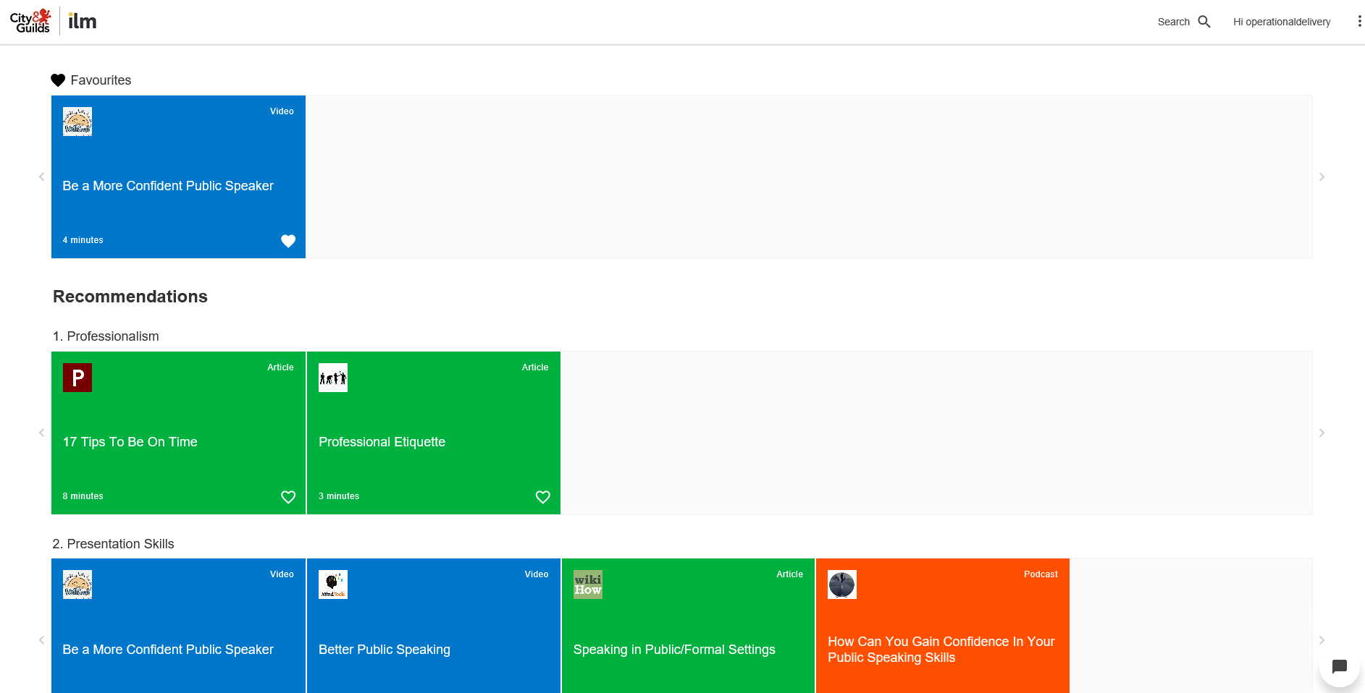
Preparing for end-point assessment
Assess
Useful learning resources relevant to the standard
HI, BENJAMIN
Relevant to assessment method
Organised by assessment skills most relevant to that individual and standard
Notes:
The user is immediately presented with standard-relevant and useful, appealing learning resources: verified to be applicable and instructionally relevant to the assessment method.
Presented in and ordered by the assessment skills most relevant to that individual

Slide 36
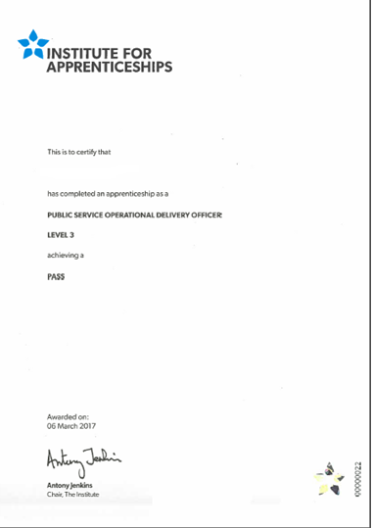


Slide 37



Colleges and providers have three ways to work with us
Direct
A simple transactional relationship where you buy products/services from us
Direct plus Supplier
Consortium
Two transactional relationships:
You buy products/services from us
We hire your venue(s) and/or pay for your skilled staff to be independent assessors ( they would act on our behalf, with our training and development)
The relationships are independent and managed by separate contracts
Consortium acts as a central, management body – they supply the right person, right venue and the team from our spec and we contract with them.
We also have independent, direct relationships with each college that buys products from us

Slide 38
SASE Framework being withdrawn | Standard Replacement | On Programme |  |  | EPA live date
 |  | OP components ready for sale now | OP components in development | Live date
Level 2: Apprenticeship in Hospitality- Food & Beverage Service Hospitality Service Housekeeping Front of House reception | Hospitality team member Level 2 | Interim Learner Manual | Mock Test paper Learner manual Smart screen LA | Feb 18 Jan 18 Quarter 4 May 18 | Mar 18 First EPA Jun 18
Level 3: Apprenticeship in Hospitality Supervision and Leadership | Hospitality Supervision and Leadership Level 3 | Interim Learner Manual | Mock Test paper Learner manual LA | Feb 18 April 18 May 18 | Mar 18 First EPA Jun 18

Slide 39
SASE Framework being withdrawn | Standard Replacement | On Programme |  |  | EPA live date
 |  | OP components ready for sale now | OP components in development | Live date
Level 2: Apprenticeship in Catering and Professional Chefs – Professional Cookery | Commis Chef Level 2 | Interim Learner Manual | Mock Test paper Learner manual Smart screen LA | Feb 18 Jan 18 TBC Feb 18 | Mar 18 First EPA Jun 18
Level 3: Apprenticeship in Catering and Professional Chefs Professional Cookery Patisserie and Confectionary | Chef de Partie Level 3 |  | Mock Test paper Learner manual LA | October 18 April 18 May 18 | Jan 19 First EPA TBC
 | Senior Chef Production Level 3 | Interim Learner Manual | Mock Test paper Learner manual LA | Feb 18 April 18 May 18 | Mar 18 First EPA Jun 18

Slide 40

Being Part Of The Decisions
We welcome applications for Independent Assessors to join our team for assessing and grading end-point assessment for Customer Service Practitioner
Typical requirements
ideally hold an assessor qualification (Level 3 Award in Assessing Competence in the Work Environment, Level 3 Certificate in Assessing Vocational Achievement, A1 or D32/D33) undertake relevant training have no connections with the assessment centre and/or Apprentice in order to maintain objectivity relevant technical/occupational understanding in areas being assessed be fully conversant with the standards and criteria being assessed occupationally competent, hold a relevant qualification at the Level or above for related area/s being assessed or have a minimum of 5 years industry experience in the area be employed in a role relevant to the Apprenticeship Programme they are assessing have experience in interviewing techniques or working toward gaining competence in this area
http://www.cityandguilds.com/apprenticeships/emerging-standards/independent-end-assessor

Slide 41
CPD Events
Preparing your apprentices for End Point Assessment (EPA) – 1 Day CPD workshop
Supporting the Apprenticeship Journey - Enhancing Teaching, Learning and Assessment Practice for the New Apprenticeship Standards (England) – 1 Day CPD workshop
Improving IQA practices – 1 Day CPD workshop
Innovation through Technology – Teaching, Learning and Assessment – 1 Day CPD workshop
Employer Engagement and Commercialisation ‐ 1 Day CPD workshop
Notes:
Book through advance.
Explain EPA days.

Slide 42
How you and your team can stay up to date
Register for email updates: cityandguilds.com/what-weoffer/centres/email-updates to hear about new standards, free webinars on the changes, regional networking sessions and other events
Get involved in the developments of new apprenticeship standards by emailing our product team through apprenticeships@cityandguilds.com
Watch our webinar on digital learning materials https://attendee.gotowebinar.com/recording/12333258740 02209283 or email directsales@cityandguilds.com to request a demo
For more information on end-point assessment email the team on epa@cityandguilds.com
Notes:
Webinars can = CPD. KB

Slide 43
More useful resources
Provider/ employer apprenticeship funding rules 2017/18
Apprenticeship funding policy and funding bands sheets
Register of Apprenticeship Training Providers
Apprenticeship funding from May 2017 – policy paper
Technical Funding Guidance
Apprenticeship standards
Becoming an Employer/Training Provider Guidance

Slide 44
Any Questions?
Amelia Bodle Technical Advisor-Hospitality & Catering amelia.bodle@cityandguilds.com
07710 095989

