Slide 1

City & Guilds and ILM
Are you ready for EPA

Slide 2
Agenda
Operational Overview for EPA Martin Newman
Do you know all the steps?
Are you familiar with all the systems?
Do you know when to make your Reservation (booking) to secure the date you want?
Do you know who you can call for help and support?
Gateway and EPA Ready Emma Kite
Lessons Learnt and Good Practice
FAQ’s for hair EPA
Resources
Time for your Questions All

Slide 3
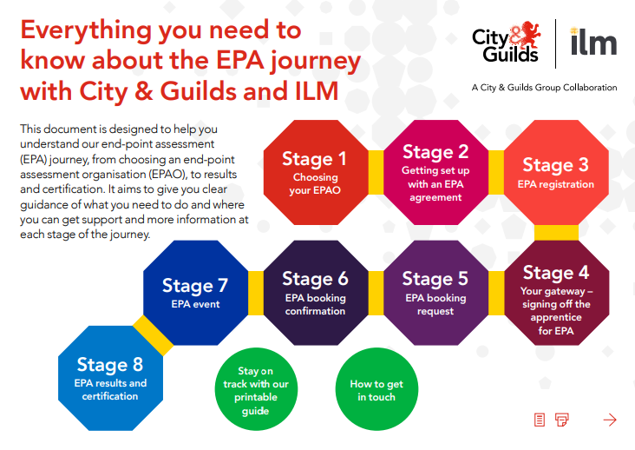
The 8 Steps of EPA
https://www.cityandguilds.com/-/media/cityandguilds-site/documents/apprenticeships/city-and-guilds-and-ilm-the-8-step-guide-to-your-epa-journey-pdf.ashx?la=en&hash=AD39898AA25742E504CFFBD3D5B2CD24CA53C330

Slide 4
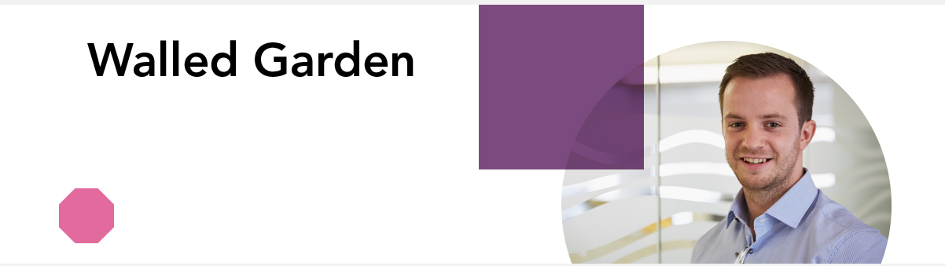
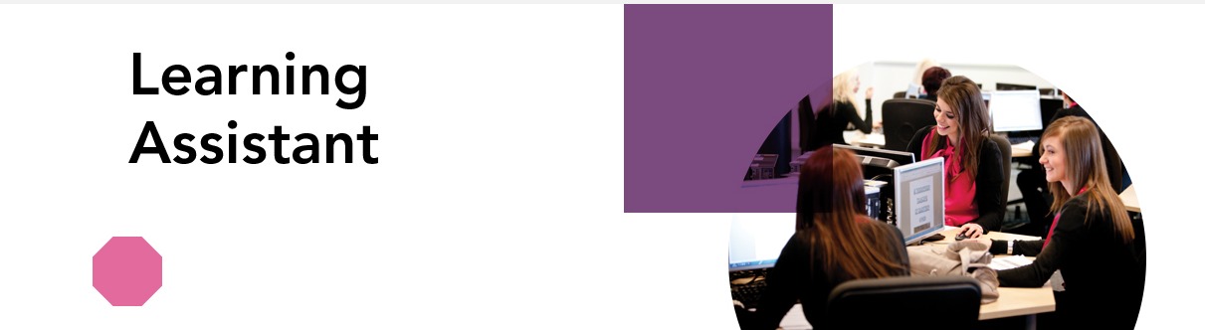
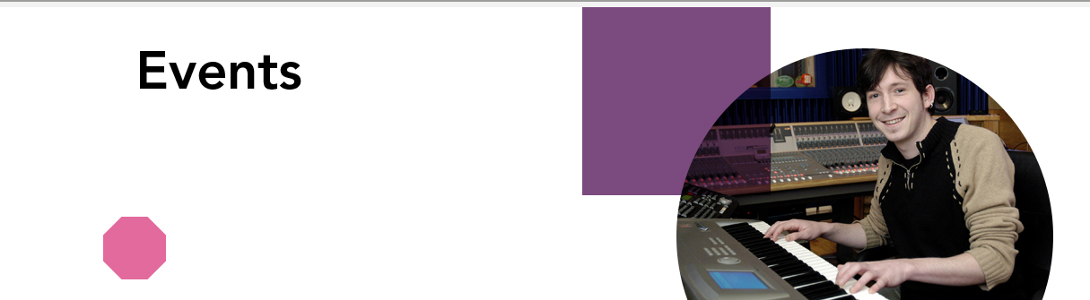
The Different Systems
Validate Evidence for ESFA certificate – set up apprentice on EPA Portal
Evidence Validated and sent to booking team to confirm and schedule a date
EPA Portal
Input all you apprentice details. Request your preferred date and time
EPA Date Confirmed
Once you have access upload all Gateway evidence

Slide 5
EPA Timescales
We need a minimum of 7 weeks notice (56 days)
If you make a reservation today, you will be booking for the very end of July early August
You must have all your evidence uploaded and we will validate before we release a confirmed date
Preferred dates for IEPA’s will go on a first come first served basis

Slide 6
EPA Gateway Evidence
Maths and English at Level 1 – Achieved
Maths and English at level 2 – Attempted
Myth busting – Yes, we do need to see all aspects of the English qualification as Gateway evidence this includes the Speaking and Listening and the test.
We will accept Walled Garden evidence of achievement this does not have to be the certification
On-Programme evidence of the Mandatory Hair Qualification – unit achievement statement from Walled Garden.
Myth Busting – No, you don’t need to have had an EQA visit before you submit this evidence. This qualification was a low risk and DCS was transferred from the old Hair qualification – you MUST have applied for the approval of the new qualification through Walled Garden

Slide 7
Yes – we are ready!
NEW - EPA Customer Success Team are here to support and offer guidance to customers who are new or unfamiliar with the EPA journey.
There are 3 in our team to support you - Jo Howell (Team Leader),
Jo Satherley (Customer Co-ordinator) and Jeff Bray (Customer Co-ordinator)
and you can email them on:
epasupport@cityandguilds.com or
Jo H is the lead for the Hair and Barbering Industry, but the other Team members
can support with any queries in her absence.
EPA Partnership Managers
Martin Newman For the South
M 07776 094894
martin.newman@cityandguilds.com
Rebecca Hollamby for the Midlands
M: 07876 448 147
Rebecca.Hollamby@cityandguilds.com
Charlotte (Charlie) Freeman for the North
M: 07872463157
charlotte.freeman@cityandguilds.com

Slide 8
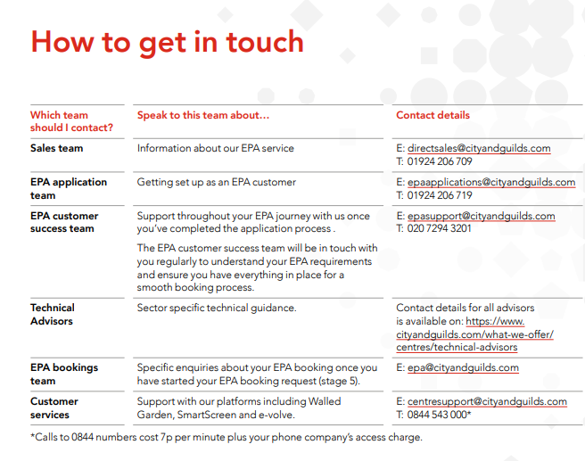

Slide 9
Hairdressing/Barbering
Lead IEPA feedback and lessons learnt

Slide 10


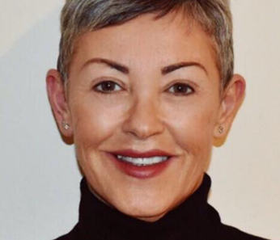
Introducing our City & Guilds Hair, Beauty & Retail Team
Emma Mackay
Industry Manager – Hair, Beauty & Retail
emma.mackay@cityandguilds.com
Emma Kite
Technical Advisor– Hair, Beauty & Retail standards
emma.kite@cityandguilds.com
Sarah Fillaudeau
Technical Advisor– Hair, Beauty & Retail standards
sarah.fillaudeau@cityandguilds.com

Slide 11
Overall Performance - From September 2017 – May 2019
Results:
      Pass 79%
      Distinction 14%
What mark does an apprentice have to get to achieve a “Distinction” grade overall?
To achieve a “Distinction” the apprentice has to achieve each component and achieve an overall score of 90% or higher for the end-point assessment.
What mark does an apprentice have to get to achieve a “Pass” grade overall?
To achieve a “Pass” the apprentice has to achieve each component and achieve an overall
score of 70% or higher for the end-point assessment.
This criteria has been set by the “Employer group”

Slide 12
Areas of good performance
Most apprentices showed that they could work in a methodical manner, which led to the completion of all services required.
They communicated well with their clients, keeping the clients fully informed throughout the service and demonstrated a professional manner throughout.
Majority of apprentices have shown good practice where they have performed in line with commercial working patterns and demonstrated the ability to work within realistic service times.
Apprentices who achieved a Distinction in “Customer Service” imbedded their aftercare advice throughout the services, rather than solely giving it at the end of the service.
This showed the apprentice was constantly interacting with the client and demonstrates they are confident in giving aftercare advice.

Slide 13
Areas of good performance
Hairdressing - for the practical observation aspect of the EPA, the apprentices that carried out the required services on two clients, (combining the two colouring services/techniques on the one client), completed this within the time allocation.
Hairdressing - the more prepared apprentices demonstrated confidence in most practical skills and showed a consistent approach to the personalisation of each finished look.
Hairdressing - where the apprentices achieved an overall “Distinction” they demonstrated consistent levels of skill across the all the services. The finished looks were accurate, balanced and showed a good level of finesse and polish.
Barbering - good standard of hair cutting skills has been observed.

Slide 14
Areas for development – Hairdressing
The apprentices need to be able to select the correct clients to meet the requirements of the EPA.
Some apprentices because they knew their client and what they were having done, failed to carry out all necessary test and checks on the hair and scalp.
Apprentices who achieved a pass in “Customer Service” gave aftercare advice, but this was limited to mainly products, rather than how to manage their hair at home and when the next service should be etc.

Slide 15
Areas for development
Hairdressing - for the practical observation aspect of the EPA, the apprentices that carried out the required services on 3 clients, ended up rushing, which then affected their final grade, or in some cases caused the apprentice to run over the allocate time.
Hairdressing - apprentices who were not so well prepared showed an attempt at being creative, however the end result lacked precision and personalisation in some of the services especially the hair up, this then then showed a lack of confidence in their ability.
Hairdressing - In some cases, there was little evidence of attention to detail, which meant that opportunities for gaining distinction was missed.
Hairdressing - for the re-style and finish service, some apprentices didn’t change of length and shape of the client’s hair.

Slide 16
Areas for development
Hairdressing - when working with long hair, some apprentices failed to prepare the hair correctly, which then caused the finished look not to have a good level of finesse and polish.
Hairdressing - some apprentices lacked attention to detail, perfecting and refining across all services, staying focused and working meticulously, so were unable to meet the required standard to get a Distinction grade.
Hairdressing - Apprentices need to remember to check the finish for balance and to personalise the finished looks.
Barbering - when cutting facial hair some apprentices only cut the outside edge of the beard and did not blend the internal layers.

Slide 17
Recommendations and advice for employers/providers
Choice of models/clients – this is key for the apprentice to perform well on the day.
As the apprentice is allowed to choose their models, the employer/provider needs to make sure that the chosen models are going to give the apprentice the best opportunity to showcase their skills.
The employer/provider needs to check that the models are suitable to meet the requirement of the assessment brief.
Style and finish hair using a range of techniques to create a variety of looks
  one blow dry which must create volume, movement and curl - a round brush needs to be used to create curl and movement, this cannot be achieved with tongs/wands etc.
  the apprentice must style and finish both above and below shoulder hair
Frequently asked questions – please familarise yourself with the latest FAQs.

Slide 18
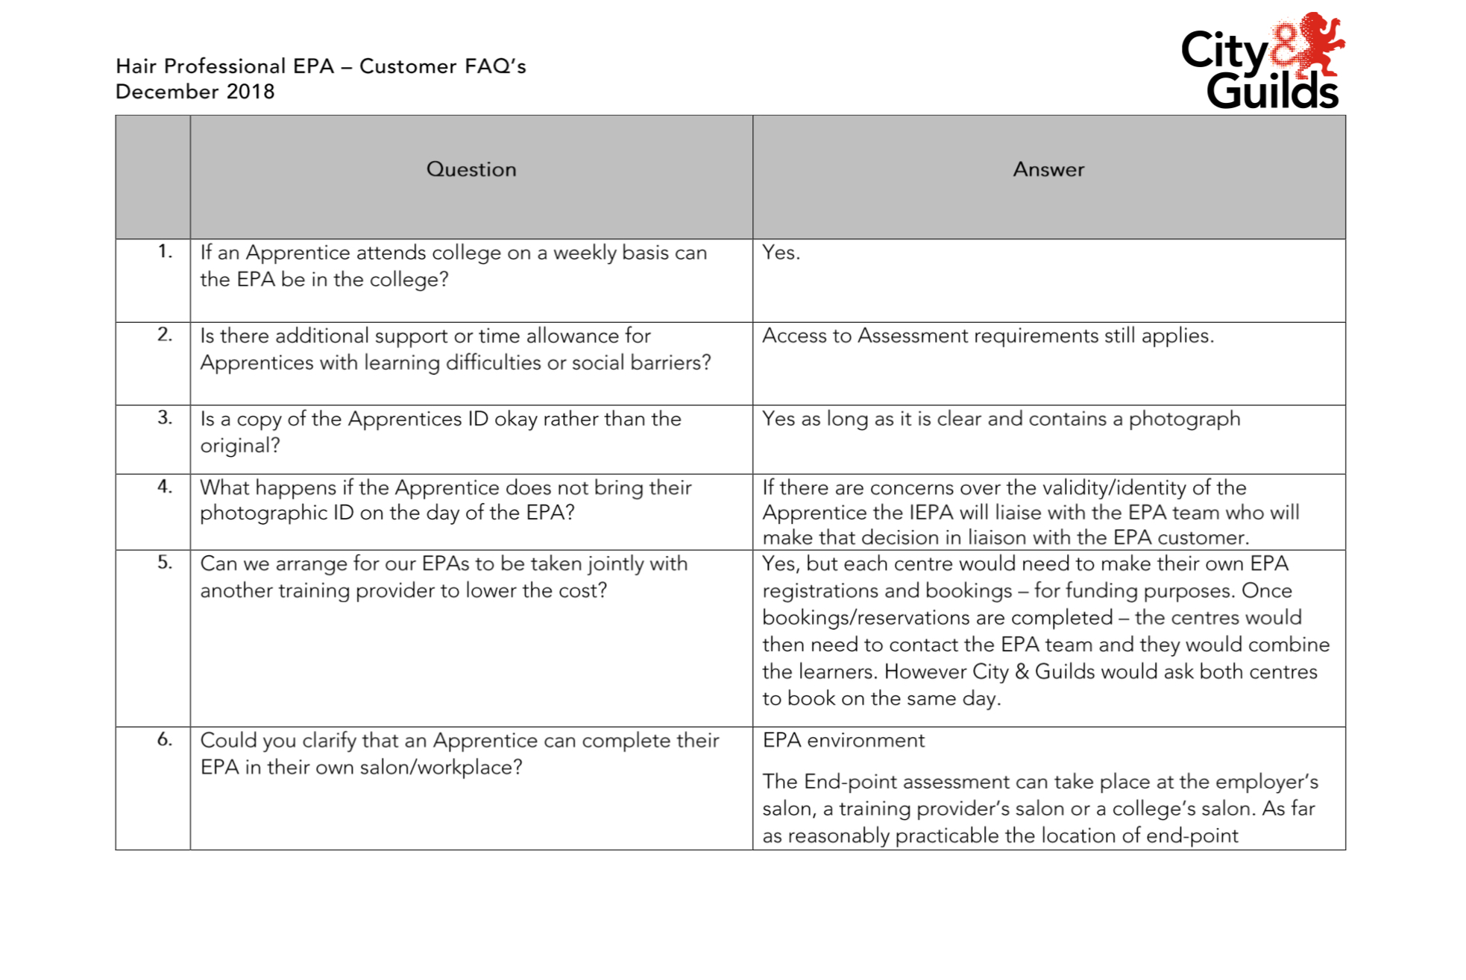
FAQs – 7002
https://www.cityandguilds.com/qualifications-and-apprenticeships/hairdressing/hairdressing/7002-diplomas-for-the-hair-professionalshairdressing-and-barbering#tab=documents

Slide 19
Technical FAQs – 7002
Does it matter how an Apprentice holds a hair-dryer?
The hairdryer should be held as per the purpose it has been designed for,
otherwise they will fail under “Ways of Working”.
Can added hair be used when doing hair up?
Yes, as long as it is prepared on the day of the EPA within the 6 hours
allocated time.
What is classed as a “creative restyle”
A creative restyle must change length and shape and incorporate a range of
different cutting techniques
Do gloves have to worn when carrying out the colour service?
Yes, if the apprentice gets any colour product on their skin when applying,
during or removing the colour, then they have failed under “Ways of Working”.

Slide 20
Technical FAQs – 7002
Do the apprentices need to do a strand test before removing all colours?
Yes – a “strand test” is carried out during the colouring service to see if the
colour result has been achieved.
Does an Incompatibility test or pre colour test have to be carried out
on the day of the EPA?
No, if required this would be done prior to the day of the EPA.
Could the two colouring services be carried out on the same client?
Yes, the two techniques could be combined on the same client or could be on
two separate clients, but a minimum of two different products must be used,
one woven highlights (needs to be woven to the roots) and one other colouring
technique.

Slide 21
Technical FAQs – 7002
The Apprentice has no evidence that their client has been skin tested,
can the assessment still take place?
No, there needs to be evidence in place that the IEPA can verify prior to
EPA commencing.
What evidence will the apprentice need of a skin test?
Client record card/details. (This can be a photocopy)
Do sponges have to be used during the shaving service?
This is currently under review, concerns have been raised with the
Employer group
Do hot and cold towels need to be used during the shaving service?
Yes, this is part of the mandatory range that needs to be covered.

Slide 22
Technical FAQs – 7002
Can the Apprentice leave the brushes in the hair to cool when doing
the round brush blow dry? Yes.
If a round brush blow dry is dried with a brush, then pinned to cool.
Is this still a blow dry or is it now a set with pin curls?
If the hair is blow dried and pin curls are added and cooled in the hair then
this would cover both the curly blow dry and set requirements.
Are heat styling techniques such as curling irons secured into
pin-curls classed as a setting technique? Yes.
If a round brush is used to blow-dry a bob could this cover the
"curl" requirement for EPA?
No, the apprentice must create a well-defined curl with the blow-dry and
the curl must be achieved with a round brush and not with tongs or a wand.

Slide 23
Getting ready to SHINE like a STAR….

Slide 24
Getting ready to SHINE like a STAR….
TIP 1: Put in the effort!
Take a time to look at the skills required to be demonstrated as part of your
“End-point assessment” (EPA), practice, practice and practice some more.
(Remember all range must be covered)
TIP 2: Get ready to shine like a star!
When preparing, write a list of questions that you think you could be asked by the
independent end-point assessor (IEPA). Once you feel ready, it may help to ask your employer
or tutor to test you and provide some feedback. By practicing a few common examples,
your responses will flow more naturally and you will feel more confident during the EPA.
In order for the apprentices to meet the distinction grade for “understanding” they need to
be able to give full explanations of the service procedures and products and techniques used
on their clients and to be able to justify their product choices to the IEPA.

Slide 25
Getting ready to SHINE like a STAR….
TIP 3: Preparing for the practical observation
There are some important details you need to know prior to arriving for your practical test
so that you can make sure you are prepared to give a star performance:
Make sure you have the answers to the following questions:
What will the practical test consist of and how long will it take?
What you need to take with you.
Do you have all of the products, tools and equipment you will need?
TIP 4: Timings
Time yourself when you practise or when you do a mock assessment.
Did you complete your assessment within the time allocated when practising?
If not, ask yourself the following questions:
  Did you carry out the task in the most logical order?
  Were you fully prepared before starting the task?
  Did you have all of your equipment and products ready?

Slide 26
Getting ready to SHINE like a STAR…. Continued
TIP 5: Working on models
The EPA for Hair Professional requires working with 2 or 3 models, make sure those
models are going to give you the best opportunity to showcase your skills…..
Don’t try something new on the day that you haven’t already practised and perfected.
When working with models, check they are aware of the expectations and importance
of this end point assessment.
KEY!!!!
MUST have reliable models, that will not let you down on the day and which meet the
FULL requirements of the EPA
Choice of models/clients – this is key for the apprentice to perform well on the day.
The apprentice is allowed to choose their models, but the employer/provider needs to make
sure that the chosen models are going to give the apprentice the best opportunity to showcase their skills.

Slide 27
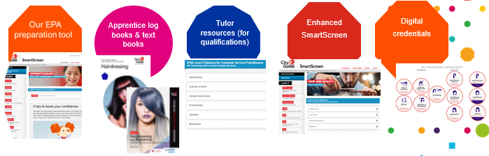
Support resources……..
Our experience delivering the new EPA service has shown that apprentices can have the competence to pass assessment but lack the confidence to show it. Preparation is key to overcoming this.
https://www.cityandguilds.com/qualifications-and-apprenticeships/hairdressing/hairdressing/7002-diplomas-for-the-hair-professionalshairdressing-and-barbering#tab=information
Notes:
Speak to DLR for information on performance and revenues.

Slide 28


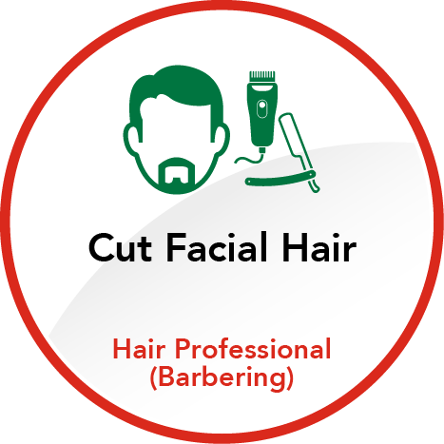










Hair Professional (Barbering) Digital Credential Framework
https://youtu.be/eavOxoIO3v0
ON PROGRAMME ASSESSMENT
QUALIFICATION
END-POINT ASSESSMENT
ACHIEVE ANY TIME BEFORE END-POINT ASSSESSMENT…

Slide 29
Technical Questions
What is a lightener?
A Bleach
Do I have to use a lightener during the colouring service?
No - the IEPA will observe a colouring and or lightening technique.
The colour and or lightening techniques must change depth & tone and must show that you have:
used a minimum of two types of products
semi-permanent
quasi-permanent
permanent
lighteners
toners
Breaks?
The clock stops when learners take breaks, it is up to the apprentice to decide on their breaks.

Slide 30
Technical Questions
Are you allowed to use the end of a tint brush to section the hair when colouring
Yes
Define T- section
This should cover the top and the sides of the head.
How many foils as different from salon to salon?
It is not defined by amount but buy T-Section the amount of foils would be different from head to head.
Bun rings & added hair?
Hair must be prepared on the day and yes you could use padding and bun rings to support the look.
How long before we are informed of the result?
20 Days
Are apprentices allowed to use Meche instead of foils?
Yes

Slide 31
Technical Questions
Different salons have different sectioning patterns for a T-section. What is accepted for EPA?
This should cover the top and the sides of the head
Can the student bring a plan in the salon with them?
Yes they can.
Does City and Guilds have a consent form for clients regarding takings images for EPA?
Yes the IEPA will supply on the day
What is defined by precision?
A precision haircut is a style using techniques that create straight, dramatic lines and clean angles
Is Hi-lift tint classes as a lightener?
No it is a hi – lift permanent colour

Slide 32
Technical Questions
In the EPA check list it state that the learner may have to tie their hair up for health & safety?
Remember that professional image will be observed and safety reasons. Is it good practice for the apprentices with long hair to tie their hair up
Learners are very nervous if they drop the comb will they fail
No, its how they handle the situation
Is changing depth and tone ok on a t section for changing depth and tone of does it need to be full head.
Two colour and/or lightened hair services using a minimum of two products:
• One woven highlights
• One other colouring technique

Slide 33
Frameworks
When is framework switched off for registrations ?
Summer 2020
Can you still move from a Standard to a Framework?
Yes al the time the Framework is available
When will the Advance Professional be ready?
No further updates at this time, updates will come out in alert
Can you clarify what Level 3 qualification we can over the apprentices once passed their EPA?
Currently only the Framework is available

Slide 34
Thank you

