Slide 1
City & Guilds
Technical Qualifications
On-boarding 2019
Notes:
Hello and welcome to your recorded technical qualification support training presentation from City & Guilds
I am David Pye and I'm joined by my colleague Alison Whittle.
The aim of this presentation is to provide you with initial support when delivering technical qualifications, lets have a look at the agenda

Slide 2
On-boarding
Important information for centres delivering Technical qualifications level 2 and 3 - 2019/20
Contents
What's available, progressing to HE, new for 2019 and UCAS information
Key information on delivery
Marking and moderation
Learning support
Over to you
Hints and tips – consider pausing the recording at key stages to carry out activities or to repeat and confirm understanding
Notes:
AW Talk through the agenda

Slide 3

How to stay updated
To stay updated with exam dates, moderation updates etc. please complete and return the centre update form
Activity 1 – Complete contact update form and return
Notes:
Throughout this presentation you will see various methods of staying in touch, one important task is to complete the centre update form, this can be found on the technicals and TechBac webpage or by using the link on the accompanying slides as shown.
The update form will ensure we have your contact details and we will keep you updated with all important aspects of delivering the technical qualification.

Slide 4
Technical Advisor Contact Details
Industry Area | Technical Advisor | Email
Post 16 and HEI | Alison Whittle | alison.whittle@cityandguilds.com
Land & Animal | Bee Esdaile | bee.esdaile@cityandguilds.com
 | John Wray | john.wray@cityandguilds.com
Hair & Beauty | Sarah Fillaudeau | sarah.fillaudeau@cityandguilds.com
 | Emma Kite | emma.kite@cityandguilds.com
Hospitality & Catering | Amelia Bodle | amelia.bodle@cityandguilds.com
Health & Social Care & Early Years | Paul Robottom | paul.robottom@cityandguilds.com
 | Suzi Gray | suzi.gray@cityandguilds.com
Business | Dominic Green | dominic.green@cityandguilds.com
BSE | Robert Mallender | robert.mallender@cityandguilds.com
 | David Pye | david.pye@cityandguilds.com
Construction | Ian Roberts | ian.roberts@cityandguilds.com
 | Paul Brown | paul.brown@cityandguilds.com
Automotive | Paul Tunnicliffe | paul.tunnicliffe@cityandguilds.com
Engineering | Simon Yorke | simon.yorke@cityandguilds.com
Digital | Ken Gaines | ken.gaines@cityandguilds.com
Maths & English | Katherine Cooper Paul Sceeny | katherine.cooper@cityandguilds.com Paul.Sceeny@cityandguilds.com
Leadership and management | Brett Keegan | Brett.Keegan@cityandguilds.com
Notes:
Please make a note of the technical advisor for your sector. Following this presentation you will need to make contact with your TA to discuss specific differences for each sector. This presentation covers all generic and main points to guide you through delivery, however many sectors have slight differences so please contact your TA to discuss

Slide 5
Technical on-boarding
What’s available, progressing to Higher Education,
new for 2019 and UCAS information.
Notes:
Section 1, What’s available, progressing to Higher Education,
new for 2019 and UCAS information

Slide 6
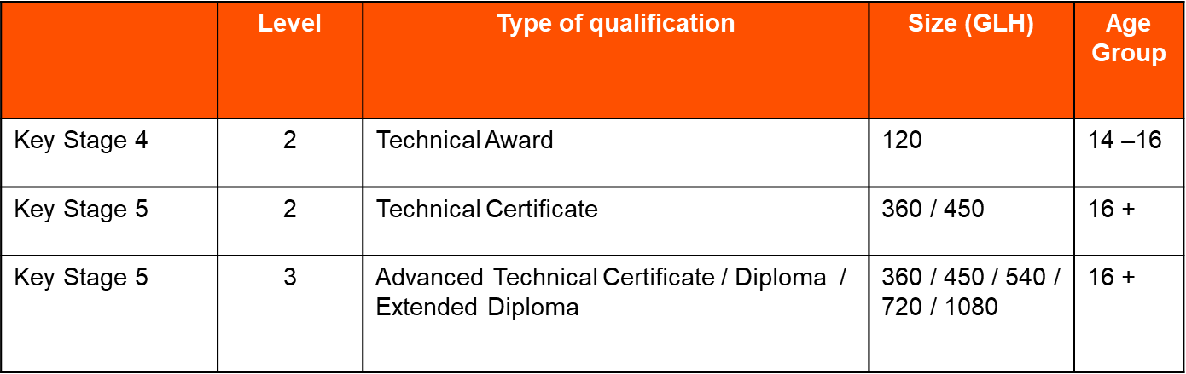

Technical Qualifications overview
For KS5 only:
Available at Levels 2 and 3, delivered over one or two years. *Sizes and levels vary
per subject area
Activity 2 – Identify GLH and qualification title of your sector
Approved by the DfE to appear on Performance Tables
for information visit: cityandguilds.com

Slide 7
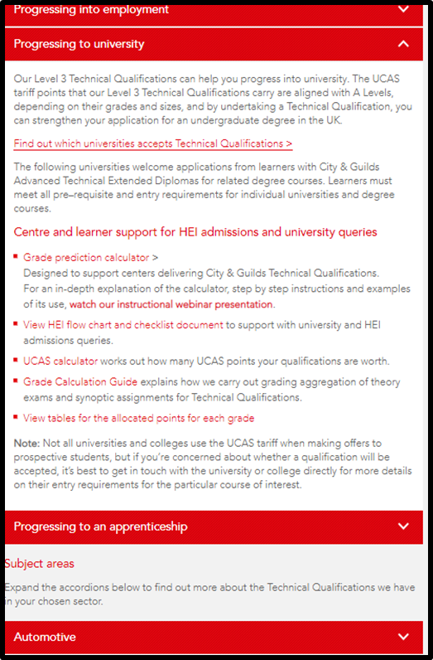
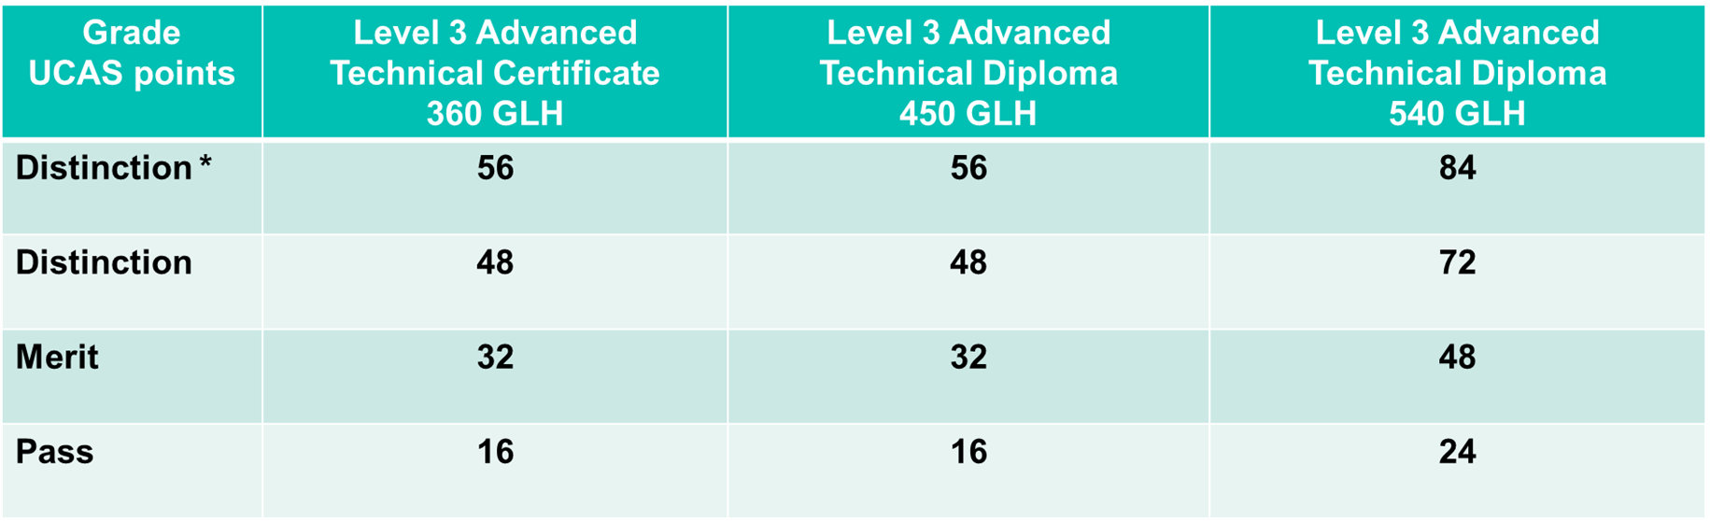
Progression to university
City & Guilds Technical Qualifications
^{A level grade} | ^{UCAS points}
A* | 56
A | 48
B | 40
C | 32
D | 24
E | 16

Slide 8

Granularity of Grading
New grade scales will be applied for learners completing 720 and 1080 Guided Learning Hours (GLH) Technical Qualifications from summer 2019.
Double grading for the Advanced Technical Extended Diplomas (720 GLH)
Triple grading for the Level 3 Advanced Technical Extended Diplomas (1080 GLH).
The 360, 450 and 540 GLH Technical Qualifications are not affected and will retain the existing pass/merit/distinction/distinction* grade scale.
To work out how many UCAS points a learner's qualifications are worth, please refer to the updated UCAS tariff calculator.
We’ve put together useful frequently asked questions about the changes to our new grade scales.
Providing a clearer message
to learners, parents and universities on their achievements

Slide 9
720 GLH Advanced Technical Extended Diplomas-double grading
Sectors that have Advanced Technical Extended Diplomas 720 GLH are:
Digital Technologies
Engineering
Construction and the Built Environment
Land-based
Automotive
Qualification | Grade | Size GLH | UCAS tariff Points
City & Guilds Level 3 Advanced Technical Extended Diploma (720 - double grading) | D*D* | 720 | 112
City & Guilds Level 3 Advanced Technical Extended Diploma (720 - double grading) | D*D | 720 | 104
City & Guilds Level 3 Advanced Technical Extended Diploma (720 - double grading) | DD | 720 | 96
City & Guilds Level 3 Advanced Technical Extended Diploma (720 - double grading) | DM | 720 | 80
City & Guilds Level 3 Advanced Technical Extended Diploma (720 - double grading) | MM | 720 | 64
City & Guilds Level 3 Advanced Technical Extended Diploma (720 - double grading) | MP | 720 | 48
City & Guilds Level 3 Advanced Technical Extended Diploma (720 - double grading) | PP | 720 | 32

Slide 10
1080 GLH Advanced Technical Extended Diplomas-triple grading
Sectors that have Advanced Technical Extended Diplomas 1080 GLH are:
Land-based, Construction and the Built Environment, Health & Care
Qualification | Grade | Size GLH | UCAS tariff Points
City & Guilds Level 3 Advanced Technical Extended Diploma (1080 - triple grading) | D*D*D* | 1080 | 168
City & Guilds Level 3 Advanced Technical Extended Diploma (1080 - triple grading) | D*D*D | 1080 | 160
City & Guilds Level 3 Advanced Technical Extended Diploma (1080 - triple grading) | D*DD | 1080 | 152
City & Guilds Level 3 Advanced Technical Extended Diploma (1080 - triple grading) | DDD | 1080 | 144
City & Guilds Level 3 Advanced Technical Extended Diploma (1080 - triple grading) | DDM | 1080 | 128
City & Guilds Level 3 Advanced Technical Extended Diploma (1080 - triple grading) | DMM | 1080 | 112
City & Guilds Level 3 Advanced Technical Extended Diploma (1080 - triple grading) | MMM | 1080 | 96
City & Guilds Level 3 Advanced Technical Extended Diploma (1080 - triple grading) | MMP | 1080 | 80
City & Guilds Level 3 Advanced Technical Extended Diploma (1080 - triple grading) | MPP | 1080 | 64
City & Guilds Level 3 Advanced Technical Extended Diploma (1080 - triple grading) | PPP | 1080 | 48

Slide 11
Technical Qualifications
2. Key information for delivery

Slide 12

Where would I find supporting documentation?
From the homepage click ‘Technicals and TechBac’
Notes:
To deliver the technical qualification you will need to become familiar with the documentation, we share various links but the majority of document you will require can be found from the homepage by clicking technicals and techbac as shown
If you have access to a computer or device you may wish to follow along as we work through, if you need time to find a certain webpage or document please pause this video and resume when you are ready

Slide 13
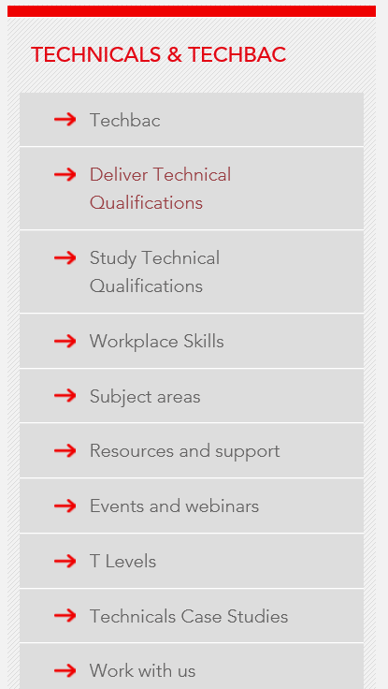
Where would I find supporting documentation?
Then from the menu on the right hand side click ‘Resources and support’
Notes:
From the next page you will see a column on the right hand side, there are various links to different sections, the one we will become most familiar with will be the resources and support section.

Slide 14
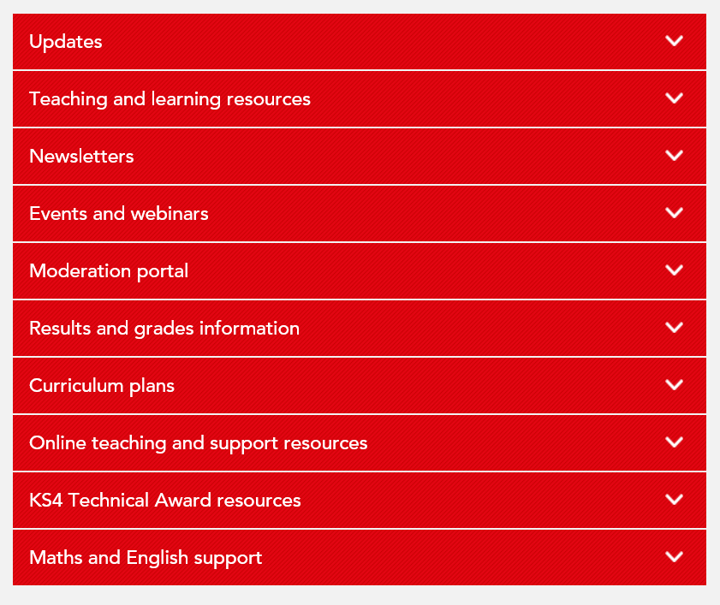
Where would I find supporting documentation?
This page will give you a host of drop down menus to various areas of support.
You may wish to familiarise yourself with the menu and various contents, much of which we will discuss throughout this presentation
Notes:
Here is how the resources and support section looks like, you will find the latest newsletters, events, recorded webinars from quality that we will mention later, curriculum planners which you can adapt to support your own delivery and various others, we will start with teaching and learning resources.

Slide 15
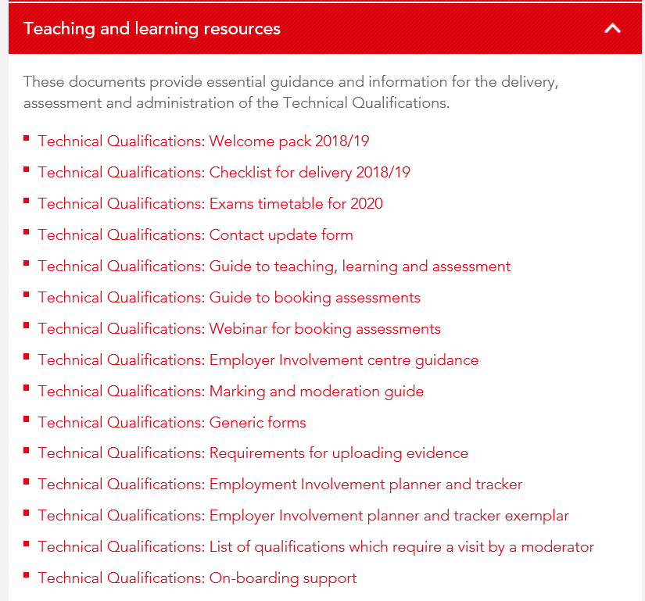

Where would I find supporting documentation?
Example of the drop down menu showing various support information resources
Notes:
Here is an example of the drop down menu, all these documents will be fully updated in August 2019 for delivery in 2019/2020, the current snip on screen is an example of where you will find various resources. Take a moment to look at the document list, if you have access to a computer or device you may wish to take some time to download and print some of these resources

Slide 16

Free resources to support effective delivery
updated for 2019/2020
Notes:
Following on from the previous screen you can see here how each document will look. Each booklets is reviewed and updated if necessary for 2019/20

Slide 17

Booking Assessments
All assessments including examinations must be booked through the walled garden by the deadline date specified. If this is not completed by the deadline, a centre risks delay or even disqualification from assessment.
Technical Qualifications: Guide to booking assessments - this guide will assist exams teams or the relevant centre staff to book the assessment
Exam timetable 2020
Notes:
All assessments including examinations must be booked through the walled garden by the deadline date specified. If this is not completed by the deadline, risk delay or even disqualification from assessment. So its really important to use your curriculum planner to reduce the likelihood of any mistakes or ommissions
The latest 2020 exam time table is linked in the presentation

Slide 18
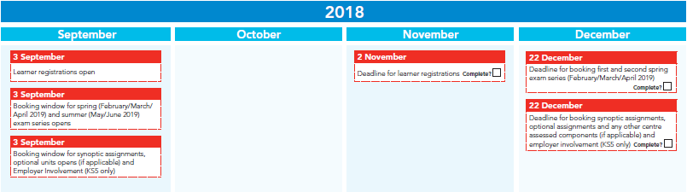
Technicals Checklist
Technicals checklist - the checklist will assist in ensuring nothing is missed. The checklist shows keys dates for registrations, booking dates for exams, employer involvement and booking window for synoptic assessments along with the deadlines.
Sample below from 2018 but the checklist is fully updated for 2019/2020 available from our website
Notes:
Your Technicals checklist - the checklist shows keys dates for registrations, booking dates for exams, employer involvement and the booking window for synoptic assessments along with associated deadlines. A fully updated version will be available for 2020, a sample from last year is shown here in the presentation

Slide 19
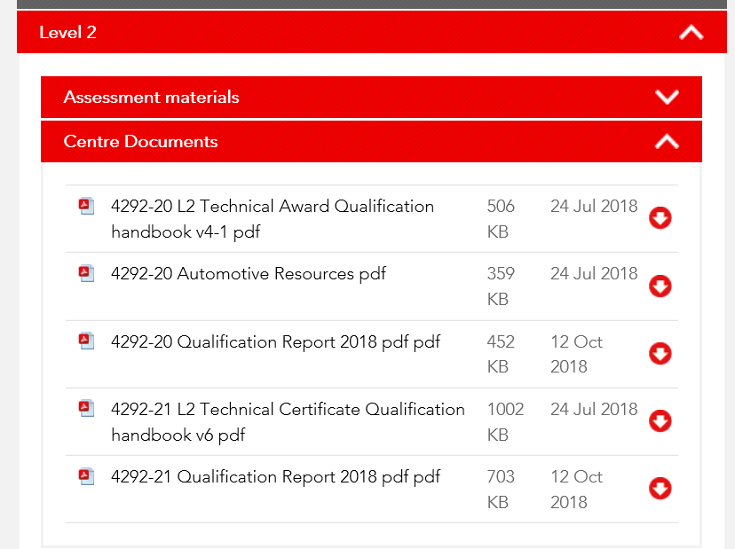
Key information for delivery - Website
Where do I find key information on delivery?
Most of the information you need will be on the qualification handbooks available on the website.
How do I find this? Search using title or the 4 digit code
Notes:
So where do we find this information? A key source of information is the qualification handbook, it gives key information on the content to be delivered, the units, assessment specification and other key information, prior to completing your curriculum planner please access and review the qualification handbooks by searching the four digit code or title of the qualification from the search function on the city and guilds website, alternatively search the sector area, if you have any issues finding the content please contact your technical advisor

Slide 20
Technical Qualifications - key components
These are the components that make up Technical Qualifications.
All components must be completed to achieve the qualification.
Synoptic Assignment
Contributes to 60% of overall grade
- Externally set (City & Guilds)
- Internally marked (Centre)
- Externally moderated (City & Guilds)
- Contributes to final Technical Qualification grade
Theory exam(s)
Contributes to 40% of overall grade
- Externally set (City & Guilds)
- Externally marked (City & Guilds)
- Contributes to final Technical Qualification grade
Technical Qualifications
- Centres develop programme of activities
- Evidence submitted (Centre)
- External review and approval (City & Guilds)
- Requirement for Technical Qualification
Employer involvement
(KS5 qualifications L2 and L3 only)
Centre-assessed components
(e.g. optional units)
Does not apply to all Technicals
- Externally set (City & Guilds)
- Centres select which units to deliver
- Internally marked (Centre)
- Samples externally moderated (City & Guilds)
There is no direct claim status (DCS) for Technical Qualifications. Results are issued by City & Guilds
Notes:
Our qualifications have two forms of assessment theory examination and synoptic assignment and employer involvement.
The exam is externally set and externally marked, and can be taken either online through City & Guilds’ computer‐based testing platform, or as a paper based exam. Electrical Level 3 is paper based only. Each examination is sat on the same date for all candidates who are completing the qualification.
The synoptic assignment is externally set, internally marked and externally moderated. The assignment requires candidates to identify and use effectively, in an integrated way, an appropriate selection of skills, techniques, concepts, theories, and knowledge from across the whole content area. Candidates will be judged against the Assessment Objectives ( we will discuss this later in the presentation)
In addition to the above assessment candidates must also complete employer involvement before a grade is awarded. This is claimed as a separate unit on walled garden
What are the components of a technical qualification?
Dated Theory Exam – where do I find this information?
Synoptic Assessment – when is this run and how is it marked?
Optional Units - In some technical qualifications there is a requirement to complete a number of optional units which are determined by specific pathways. The qualification handbooks provide a list of the optional units.
Employer involvement – how is this recorded?
Lets look at these more closely

Slide 21
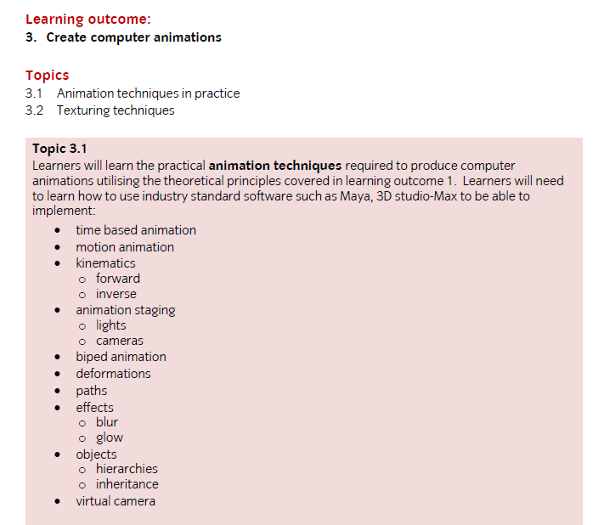
Key information for delivery
Handbook (QHB)
The course handbook outlines all detail of delivery and assessment.
Ensure all topics and range items are covered to ensure coverage and preparation for assessment.

Slide 22
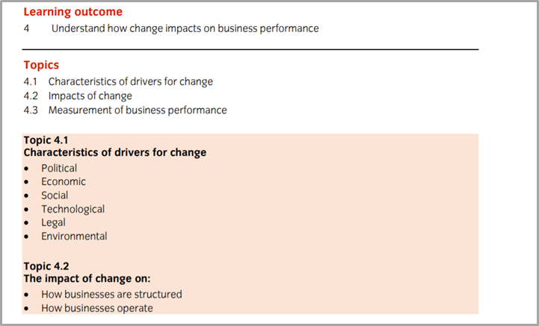
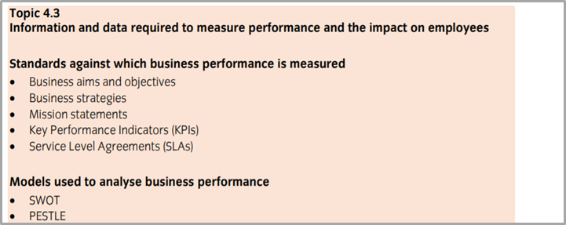
Key information for delivery
The course handbook outlines all detail of delivery and assessment.
Ensure all topics and range items are covered to ensure coverage and preparation for assessment.
Example from business support 4406

Slide 23
Support for learning - understanding command verbs
14-19-teaching-learning-assessment-guide
Command Verbs
Analyse
Describe
Explain
Evaluate
Identify
Label
List
State
Compare
Discuss

Slide 24
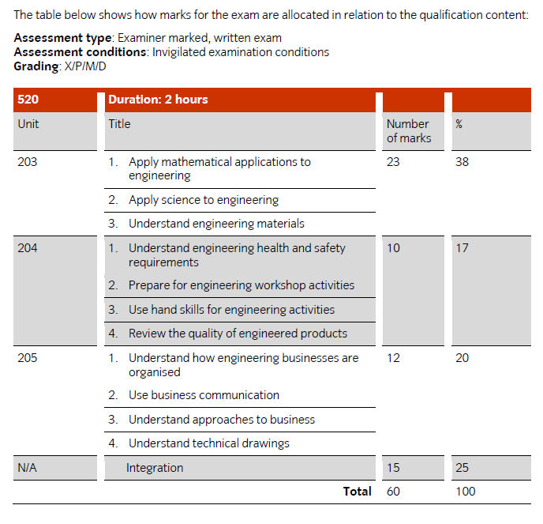
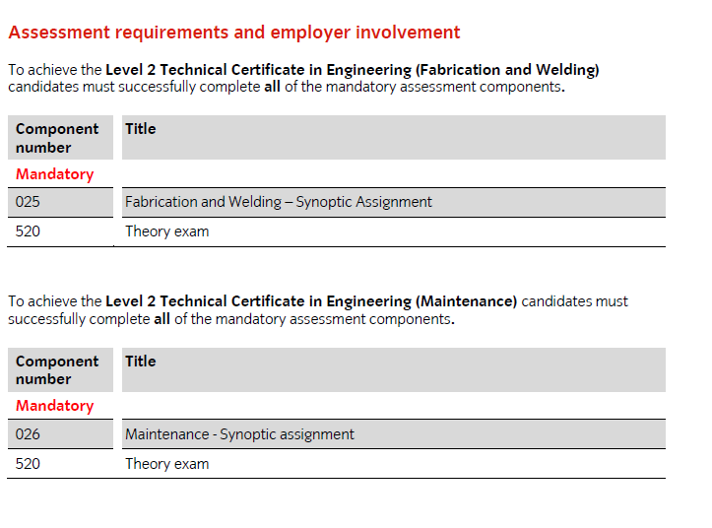
Key information for delivery
The course handbook also outlines details and codes for assessments to assist with delivery and helpful areas to assist with assessment such as test specifications and grading criteria.
Notes:
Mention codes for assessment
Mention exam specification
Mention past papers

Slide 25
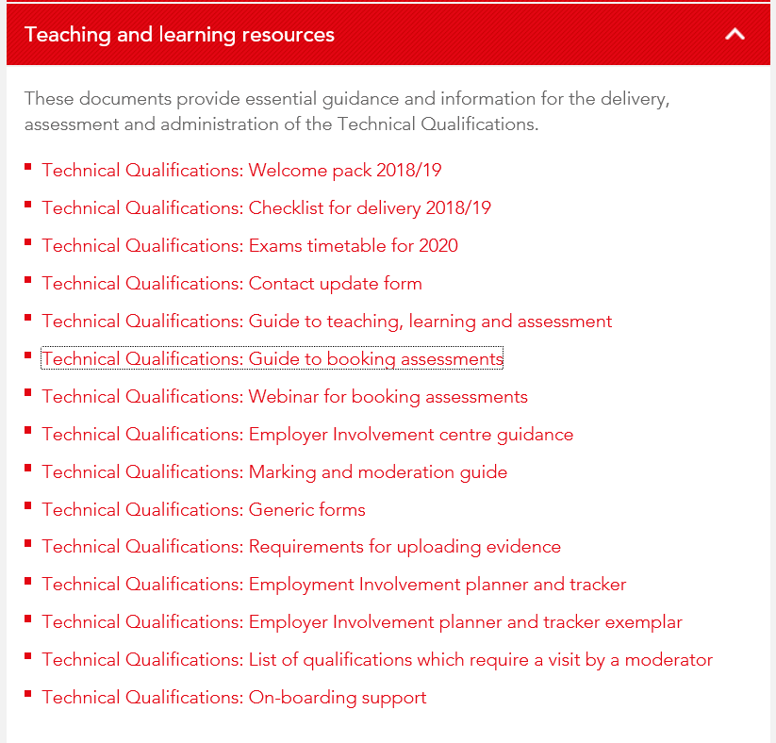
Key information for delivery – Employer Involvement
Supporting documentation for employer involvement

Slide 26
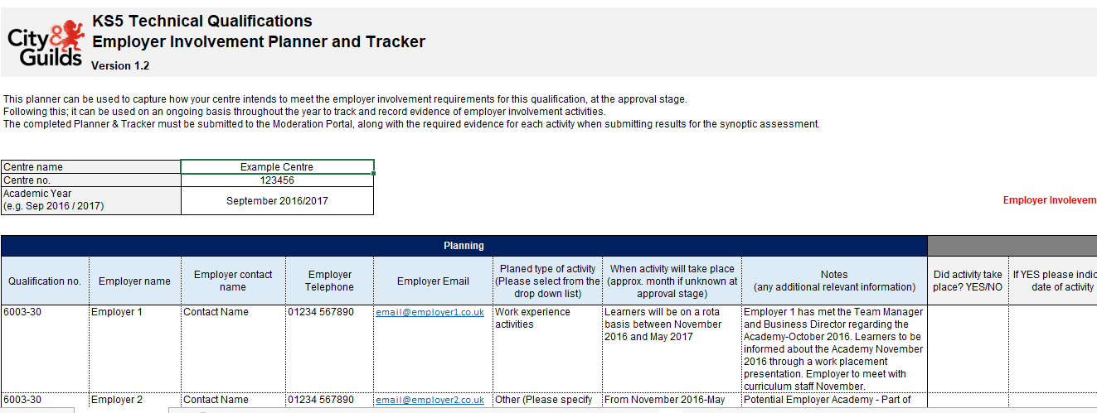
Key information for delivery – Employer Involvement
sample tracker

Slide 27
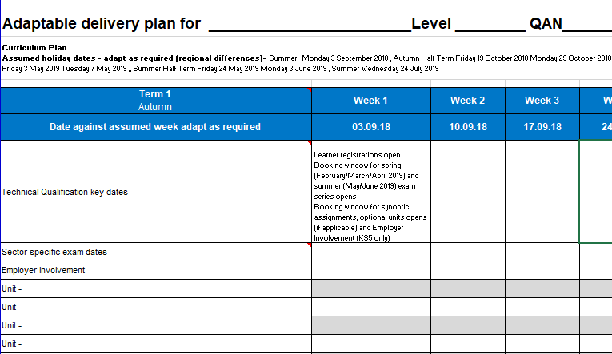
Key information for delivery - Curriculum Planners
What are curriculum planners?
These are adaptable plans to aid delivery. They show key dates and are adaptable so tutors can plan delivery of each unit, revision sessions, employer involvement and keep an eye on those important exam dates.
Available under our technical resources section of the website
Activity 3 – Within your teaching group using the handbook and exam dates consider delivery of your programme and complete the planner – contact your TA for support
Notes:
Explain how CP is set out. Holiday dates removed from Teaching weeks there will be regional differences which is why the CP is completely editable. However please remember all of the key dates for exams and dates for submitting evidence etc must not be changed.

Slide 28
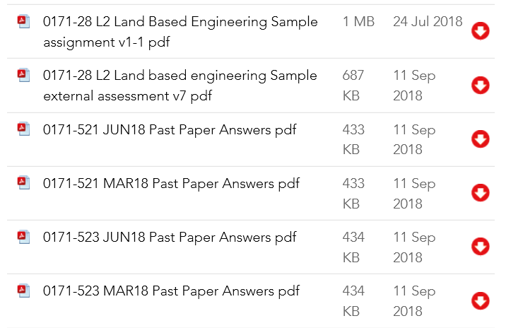
Key information - formative assessment
To help prepare learners for assessments it is advised you carry out periodic formative assessment and mock assessments (using sample papers)
Sample assessments – available on the website
Past papers
Moderator reports
Hints and tips - questions change each year!
Activity 4 – Using sample papers create your own additional formative/practice assessments

Slide 29

Key information events and webinars

Slide 30
Technical Qualifications
3. Marking and moderation
Notes:
Just going to hand back to David who will talk you through the moderation and marking process in detail.

Slide 31

Marking and moderation
All requirements of marking and moderation can be found in this guide on our website
We have included a specific link to the guide here.
Notes:
Thank you Alison, before we look at an approach to marking the synoptic, please ensure you have access to the marking and moderation guide

Slide 32
Marking of Synoptic Assessments
Flow Chart - sample
Candidate Record Form/ Declaration of authenticity – complete notes
Desk based task - Marked work (Task 1)
Practical Observation Record
(Task 2&3)
This is your evidence
Standardise as a group/declaration form
Candidate Record Form - complete marks
Notes:
Marking of the technical synoptic is likely to be very different to your approach to assessing previously if you are only used to NVQ or VRQ style qualifications
We will take you through a synoptic assessment to support with this assessing model, but its worth a quick recap.
With NVQ style qualifications we work from a set of assessment criteria often referred to as ACs, the assessor works through aligned assessments and checks off the AC as the candidate achieves. This may require multiple assessments with various opportunities for feedback.
With a technical qualification we grade candidates and as such require a score or mark which is then graded. Evidence is produced to support the grade the assessor gives the assessment. That’s a slightly different purpose to NVQ/VRQs as its supporting the judgement with evidence rather than providing direct evidence against an AC. We will touch on this later but its good to note that we need to provide specifically the evidence requested in the synoptic, rather than provide multiple pieces of random evidence as often supports NVQs
If we take the current slide, we are going to consider a full synoptic assessment, each section is assessed but the whole synoptic is marked with a score. Please not there are some sector differences so please review your own synoptics and contact your TA for specific differences and support, this is an example for the purposes of providing guidance.
In this example there are 3 parts to the synoptic, a desk based activity Task 1, and two practical activities, Task 2 and 3
When these are completed the desk based activity is marked but not scored, the practical assessments are assessed and an observation record completed. When you have all of this documented candidate work and assessor evidence the assessor will complete the candidate record form, please note these are often updated so actuals may look slightly different to our examples. These will then be given a score, standardized and the candidate record completed, lets have a look in more detail

Slide 33
Marking desk based activity Task 1
Desk based task - Marked work (Task 1)
Points to note
Activity will require marking
You may not need to include this in your observation report
You will need to consider this when marking up the candidate form
Notes:
The desk based activity, this will require marking but not scoring, often this isn't required as part of the observation report as the evidence is already produced by the learner. To pick up a frequently asked question "does this mean assessor doesn’t do anything with this work"? No, it means the assessor will mark but not apply a score and may not need to apply to the observation report which is for the practical activity only, again please check your sectors synoptic assessment for sector differences, its important you read the evidence requirements

Slide 34
Completing Practical Observation Record
Practical Observation Record
(Task 2&3)
This is your evidence
Points to note
Usually relates to a practical product or observation of activity
Requires the assessor to make notes relating to the tasks
Notes:
In this example there are 2 practical assessments, these will need to be observed, recorded and kept available as evidence of the task and to support the assessor scoring that follows

Slide 35
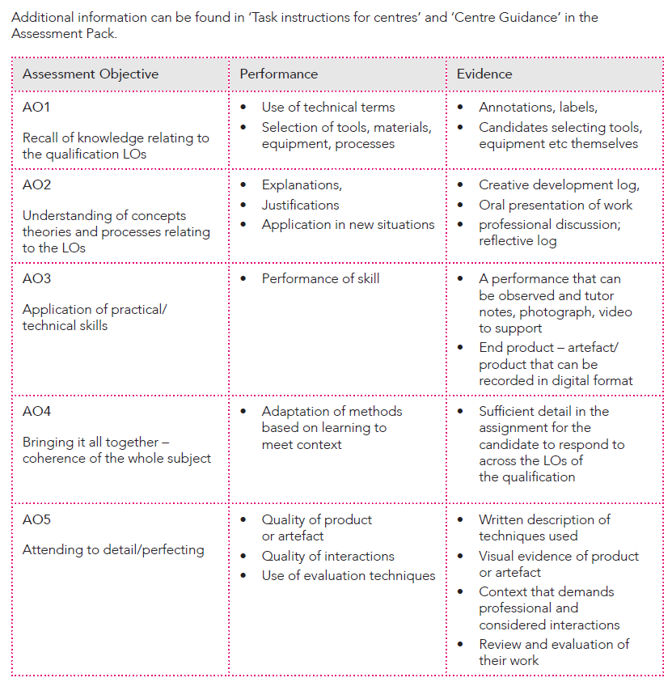
Marking and moderation
Assessment objectives are related to candidate performance and assessors will be marking in relation to these
Notes:
In your centre guidance assessment packs you will see AOs which stands for assessment objectives.
Once we have completed the assessments we are ready to score them.
Please familiarise yourselves with the AOs prior to scoring

Slide 36
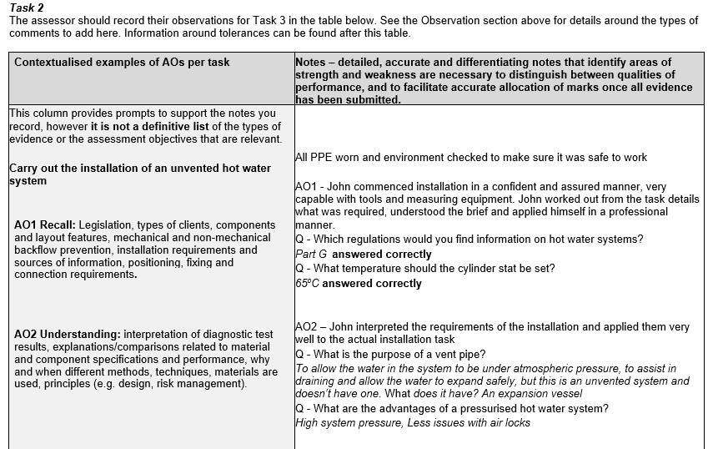
Marking and moderation (2)
Sample of practical observation record
We are using an example from the 8202 to demonstrate good practice recording
Notes:
Here we have an example from one of our technical qualifications, we are going to assume a candidate has completed a plumbing task
Task 1 is desk based and completed by the learner, this is task 2 and the candidate has installed an unvented cylinder, the actual task isn't important for the purposes of guidance, we will aim to pick out some important trends as we work through, please consider how these may apply to your own sectors. You can practice in your own teams by assuming an assessment has taken place and writing some samples up
In this example of an observation record the assessor isn't marking but responding to the assessment and taking notes. The notes are placed next to the AOs to support marking and evidence requirements at a later stage
AO1 is recall, notice there are some prompts to help, legislation, types of client etc. The assessor in this example has made notes against the AAO and supported that with some oral questions

Slide 37
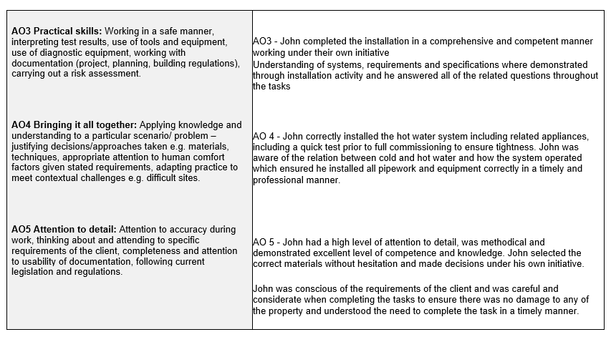
Marking and moderation (3)
Notes:
On this slide you can see further notes against further Assessment objectives.
Notice some of the wording, "John completed the installation in a comprehensive and confident manner" This will help when scoring the assessment as the wording will support high achievement. During moderation, moderators will aim to support your judgement by reviewing the evidence, a poor example of scoring would be to apply high score to an observation record that doesn't support a high grade when the wording is considered.
Against AO4 the assessor has again used words such as "professional manner" which can help when scoring

Slide 38
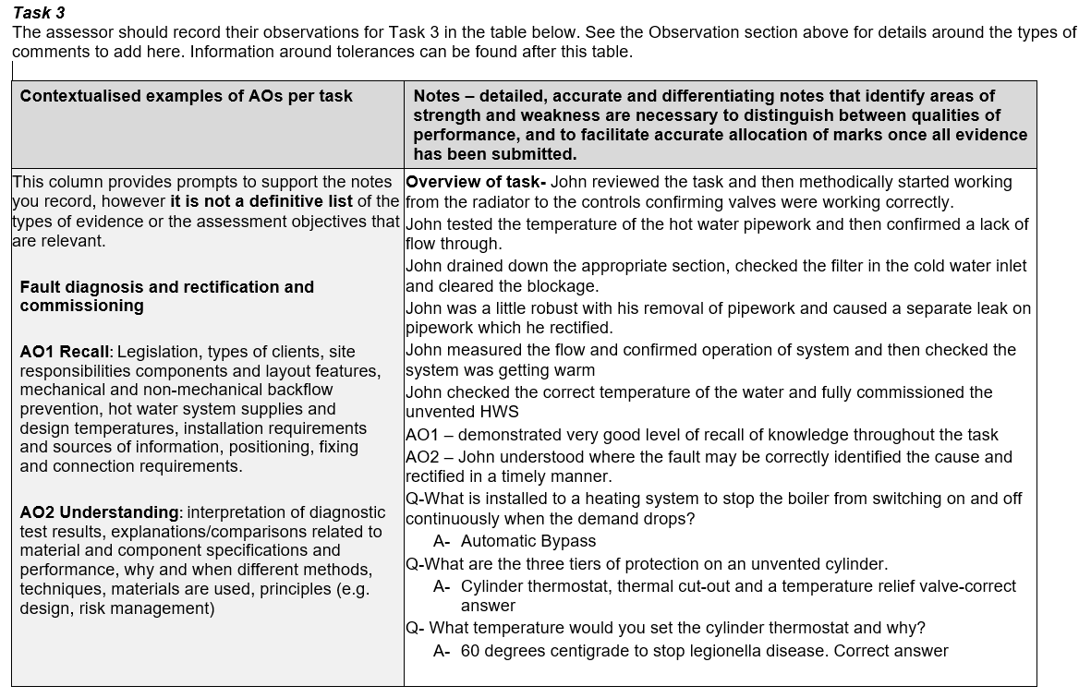
Marking and moderation (4)
Notes:
In this slide we can see the same assessment objectives but now against task 3, the assessor has started with an overview and then made specific notes against the AO. Notice the assessor paying attention to the prompts to support their written evidence.

Slide 39
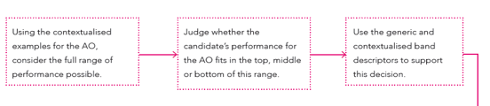
Completing practical observation record
Candidate Record Form/ Declaration of authenticity – complete notes
Notes:
Now the tasks are complete, the assessor must ensure the candidate declaration form is signed
Then, using contextualized documented evidence for each AO consider the full range of performance, so we are applying a score against all 3 activities at once, we don’t apply 3 separate scores.
This is again probably different to how we have assessed in the past, we have to now bring all the assessments together and apply single marks against AOs
There are 3 bands, these are not pass, merit or distinction, but three bands to support standardized marking, using band descriptors we now consider our scores.

Slide 40
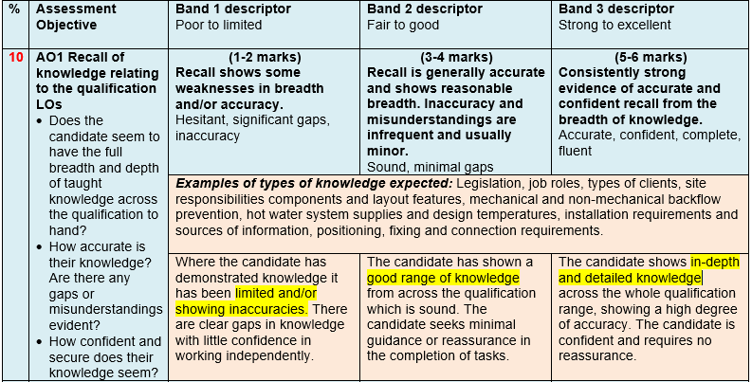
Assessment record (1)
Notes:
Here is the first example of the band descriptors
We have highlighted key words to help the assessor in scoring
Our first task is to consider which band the candidate falls into based on all 3 tasks, did they show limited knowledge, a good range of knowledge or in depth knowledge? If you feel they fall into band 3, does the previous desk based and assessor observation record support this judgement? If not it would be difficult to demonstrate how you judged the candidate to be in that band

Slide 41
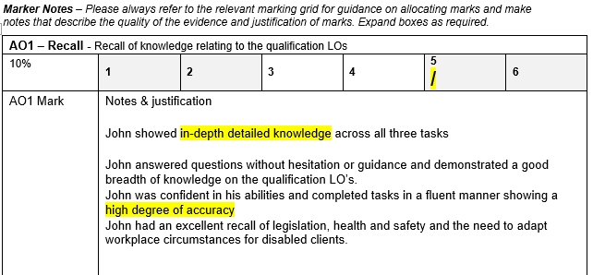
Assessment record (2)
Notes:
Once you have identified the band, do they sit near the top, bottom or middle of that band? Again, make a judgement based on the evidence and you knowledge and skills as an assessor and apply a score
To justify your score you will need to record some notes by considering all 3 previous assessments and using terminology that supports that band. After completing this, its good practice to consider the score again, to make sure you are comfortable with this judgement

Slide 42
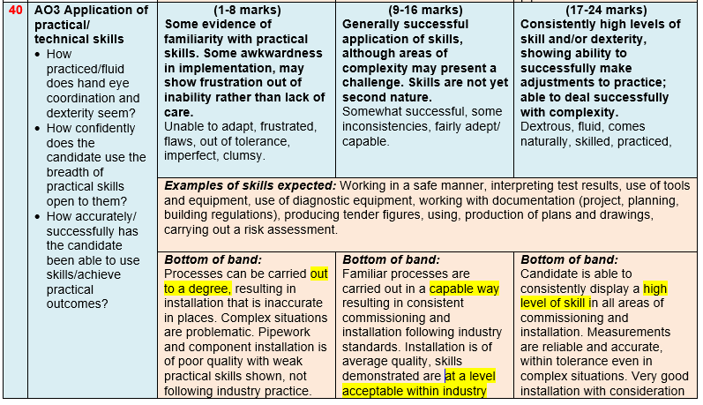
Assessment record (3)
Notes:
Moving onto assessment objective 3, you can see that the bands are the same but the scores are much higher, this means we can apply weighting to the AOs we consider most important in this sector. In this example there are higher scores for the practical application
Again we have picked out some key words that are there to support and help when considering which band, such as "acceptable level in industry" and "high level of skill"
The process is the same, consider the band, then consider if the candidate is at the higher or lower end of that band

Slide 43
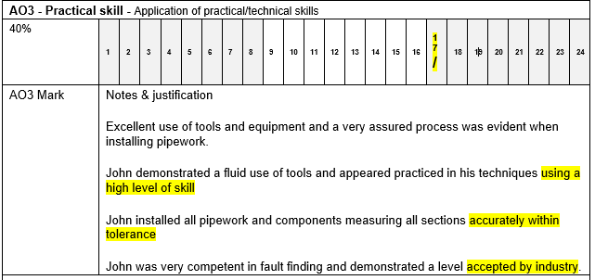
Assessment record (4)
Notes:
Here we can see on the assessment record that in this example the assessor judges the candidate to have a high level of skill, but fault finding was at an accepted level by industry, these comments cross two bands, so some careful consideration is required. The assessor makes the judgement that overall for all three tasks the candidate is in the top band but at the lower end of that band, and score the candidate at 17

Slide 44
Assessment record (5)
Notes:
This is a copy of the slide before, to remind ourselves of the wording seen in the documentation and used by the assessor

Slide 45
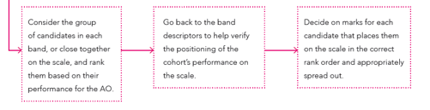
Standardisation
Standardise as a group/declaration form
Notes:
Once the assessor has completed all the marking you will need to standardise.
If we consider a group of 15, line up all 15 pieces of marked work from the highest score to the lowest, consider the scores again, does it seem right? After marking 15, you may consider you were to harsh with the first few, and may wish to review the scores, in a room with other assessors and experienced tutors justify your scores and demonstrate how you judged that score based on the evidence and wording in the various observation reports and desk based activity

Slide 46
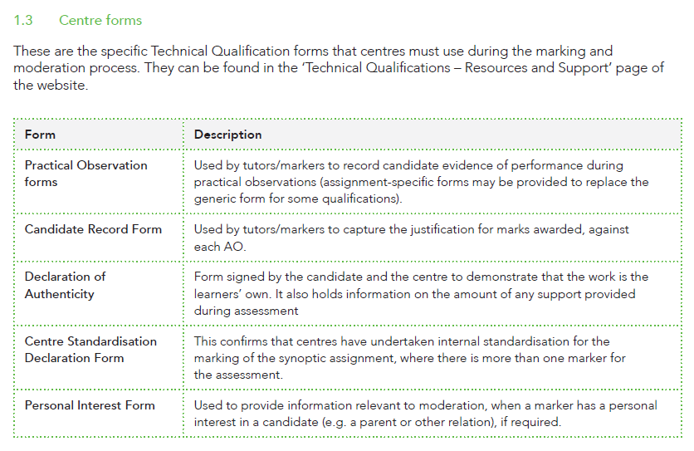
Marking and moderation – centre forms
Note - It is important to be aware of these forms.
Activity 5 - Print off your sector forms and run some examples with colleagues so you become familiar with the marking process
Notes:
Once the standarisation has been completed, please complete the standardisation declaration form
As you can see from this slide there are various forms for you to be aware of
Activity - print off your sector forms and run some examples with colleagues so you become familiar with the marking process

Slide 47
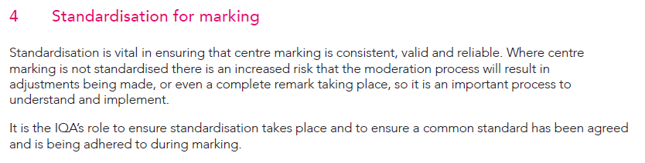
Marking and moderation – standardisation for marking
Note – check the assignment brief for the evidence requirements – ensure you cover the correct range of evidence and correct type of photos
Notes:
Standarisation is vital to ensure consistency of marking, worth noting that where marking is not standarised there is an increased risk the adjustments to scores will be made following the moderation process
Another reminder when uploading evidence, please sure you only include the evidence requested, poor practice has been observed where providers upload multiple pieces of evidence not required, this often slows down the moderation process as it can be difficult to identify the correct evidence, sometimes the correct evidence is missed completely
The evidence is there to support your assessors decision, if the evidence doesn’t match the decision there's an increased risk of adjustments being made

Slide 48

Moderation
Our Requirements for uploading evidence for Technical Qualifications document contains clear guidance on the recommended way of labeling documents, as well as useful hints and tips.
There are two types of moderation
Visiting moderation - will be an observation of assessment practice by an external moderator.
Sampling - will require evidence uploaded to the portal for moderators.
Note – all centres require sampling, sample size as shown. Please check requirements here visiting moderation
No of candidates | Sample size
12 or fewer | All candidates
13 – 100 | 12
101- 200 | 15
More than 200 | 20
Notes:
There are two types of moderation, theres visiting moderation, that is a moderator who comes out during the synoptics, known as external moderation
There is also sampling, this requires the evidence to be uploaded to the moderation portal, sample sizes are shown on the slide
To support with uploading evidence please see our guide linked in the presentation

Slide 49
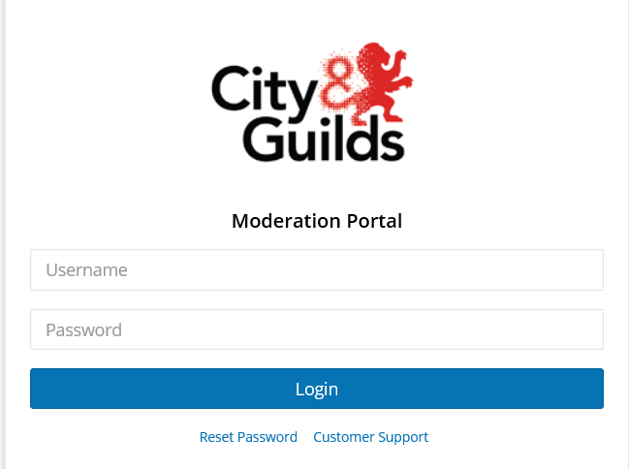
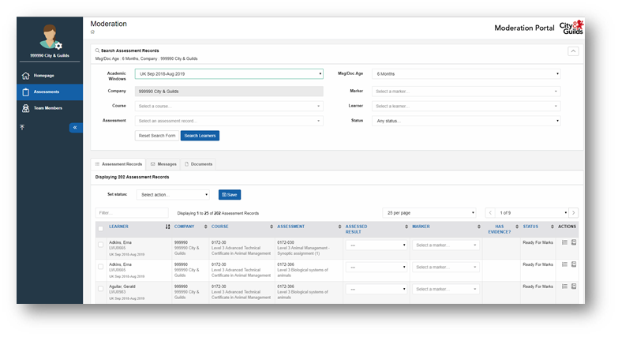
Marking and moderation- do you have access to the portal?
The moderation portal is required for the uploading of candidate evidence
Further guidance on the website
Notes:
This is how the moderation portal looks, every provider will have a super user who can then give access to internal staff, so you may have somebody in your team, or in your exams department who will ensure all the evidence requirements are uplaoded

Slide 50

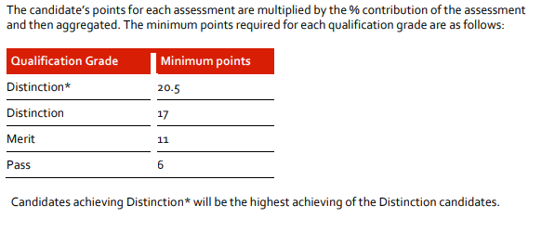
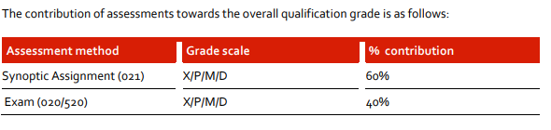
Grading
Each assessment mark is converted to a certain amount of points by City and Guilds anywhere between the below boundaries
Further detail on the grading structure can be found on this grade calculation guide document
Grade Prediction Calculator
Watch the Instructional presentation on how to use the Grading Prediction Calculator

Slide 51
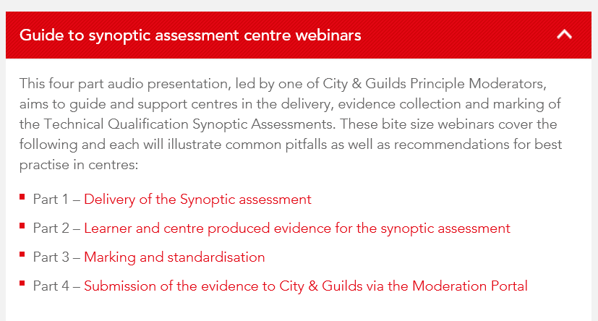
Further Support for synoptic assessment
You can find further dedicated support for assessment and standardisation on the events link we shared earlier
Link here
Notes:
Explain –On the website there are 4 short webinars led by one of C&G principle moderators to support centres

Slide 52
Moderation Support
Technicals Quality Team
Our Technical Quality team are on hand to advise and guide you through the various processes, the team are available Monday to Friday 9am to 5pm and provide advice and guidance on:
Where you can find the right documents and information you need
Timelines for registrations, bookings, exams and the moderation process
Technical Qualification Approvals (QAPs)
Support and guidance for the Moderation Portal.
Email: Technicals.quality@cityandguilds.com
Phone: 0300 303 5352. The Technicals Quality team can be contacted on this number by selection option 2 and then option 3.
Notes:
Our Technical Quality team are on hand to advise and guide you through the various processes, the team are available Monday to Friday 9am to 5pm and provide advice and guidance on various areas such as documents, booking, evidence etc. Please see their contact details on this slide

Slide 53
Technical Qualifications
4. Learner Support

Slide 54



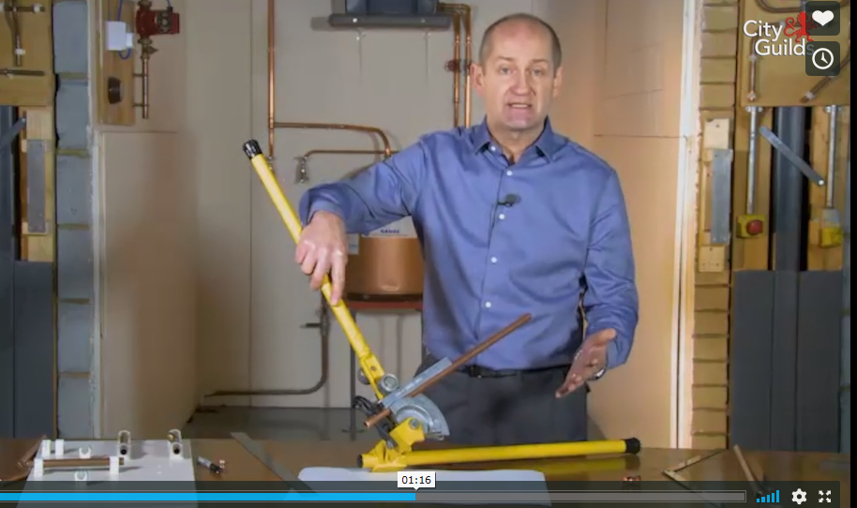
Learning Support
Is there support for learning?
Yes, we have the following;
Textbooks and training manuals
E-learning
Smartscreen

Slide 55
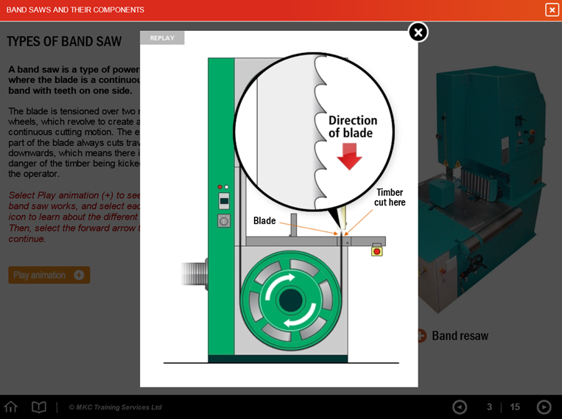
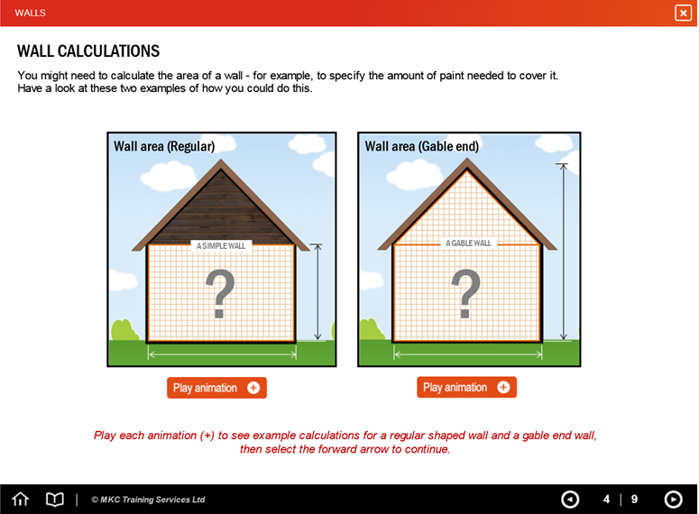

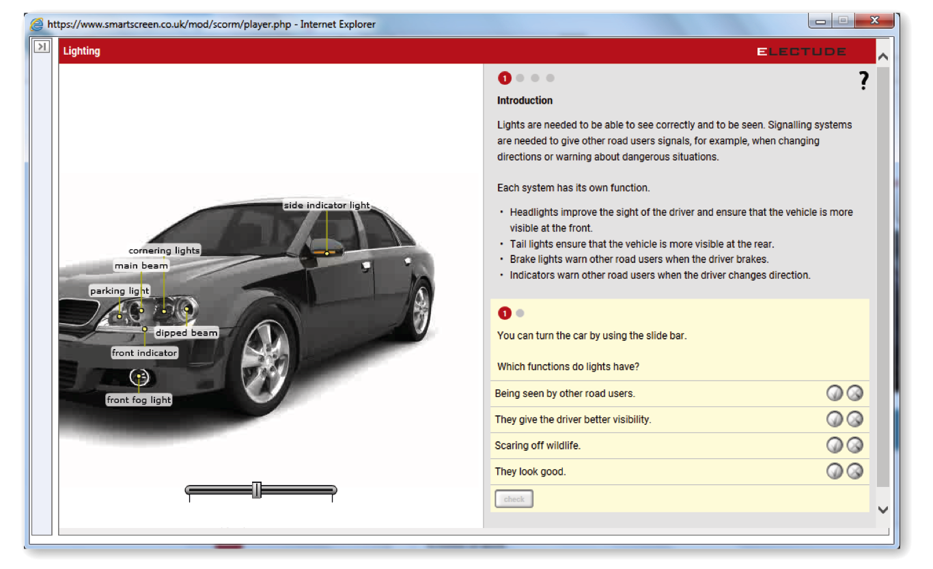
Engaging e-learning content
Interactive materials:
A number of qualifications have comprehensive, dedicated interactive e-learning resources (either video or animation based) to help bring the learning to life.
Materials available for:
• Professional Cookery
• Plumbing and Electrotech
• Carpentry and Joinery,
• Bricklaying
• Beauty Therapy.
(Hairdressing coming
Autumn 18)
Contact your business manager or directsales@cityandguilds.com for further information

Slide 56
Support for learning - recap
Resources
Qualification handbooks – teaching syllabus
Synoptic assignment packs – when released *
2017/2018 qualification reports – insight into last years national picture
Principal moderator reports – insight into synoptic assignments from last year (national picture)
Chief examiner reports – insight into exam series from last year (national picture)
Past papers & marking guides – can be used as exam preparation resources
Sample synoptic assignments - can be used as formative assignments
Example sample exam question types – preparation resources for learners
Activity 6 – Identify the location and access the above documents
Notes:
Add point about released to centres to enable centres to feedback and request points of clarification. The window for providing feedback is open from CHECK FORM IS PROVIDED

Slide 57
Technical Qualifications
5. Over to you
Notes:
Handover to David who will talk you through this last section.

Slide 58
Technical Advisors
Note: Please be aware that there may be special considerations for each sector
Activity 7 – Contact your Technical Adviser who will be able to support with this presentation and further support with specific sector requirements
A list can be found here but we have included the TA list again on the next slide

Slide 59
Technical Advisors
Industry Area | Technical Advisor | Email
Post 16 and HEI | Alison Whittle | alison.whittle@cityandguilds.com
Land & Animal | Bee Esdaile | bee.esdaile@cityandguilds.com
 | John Wray | john.wray@cityandguilds.com
Hair & Beauty | Sarah Fillaudeau | sarah.fillaudeau@cityandguilds.com
 | Emma Kite | emma.kite@cityandguilds.com
Hospitality & Catering | Amelia Bodle | amelia.bodle@cityandguilds.com
Health & Social Care & Early Years | Paul Robottom | paul.robottom@cityandguilds.com
 | Suzi Gray | suzi.gray@cityandguilds.com
Business | Dominic Green | dominic.green@cityandguilds.com
BSE | Robert Mallender | robert.mallender@cityandguilds.com
 | David Pye | david.pye@cityandguilds.com
Construction | Ian Roberts | ian.roberts@cityandguilds.com
 | Paul Brown | paul.brown@cityandguilds.com
Automotive | Paul Tunnicliffe | paul.tunnicliffe@cityandguilds.com
Engineering | Simon Yorke | simon.yorke@cityandguilds.com
Digital | Ken Gaines | ken.gaines@cityandguilds.com
Maths & English | Katherine Cooper Paul Sceeny | katherine.cooper@cityandguilds.com Paul.Sceeny@cityandguilds.com
Leadership and management | Brett Keegan | Brett.Keegan@cityandguilds.com

Slide 60
Next Steps
Meet up with the team and reflect on this presentation – record as CPD for your IQA file
As a team, complete the seven activities to help your preparation for delivery
      Activity 1 – Contact update form
      Activity 2 – Identify qualification details
      Activity 3 – Complete the Curriculum planner
      Activity 4 – Create your own additional formative/practice assessments
      Activity 5 - Practice marking synoptics
      Activity 6 – Locate all relevant documentation
      Activity 7 – Contact your Technical Adviser

Slide 61
Quality Delivery Teams
Quality Delivery Team | Email
Quality Team 1 (formerly known as the North Quality team) | Qualityteam1@cityandguilds.com
Quality Team 2 (Formerly part of the Direct Quality team) | Qualityteam2@cityandguilds.com
Quality Team 3 (including Assured) (Formerly part of the Direct Quality team) | Qualityteam3@cityandguilds.com
Quality Team 4 (Formerly known as the Midlands/South Quality team) | Qualityteam4@cityandguilds.com
Nations & RoI | nations@cityandguilds.com
ILM | QualityILM@i-l-m.com
Land Based Services (NPTC) | QAsupport@cityandguilds.com
Technicals & Moderation Support | moderationsupport@cityandguilds.com
Prisons & MoJ | prisons@cityandguilds.com
High Priority Qualifications | highpriorityqualifications@cityandguilds.com

Slide 62



Support with
Technical Qualifications
Online support:
.
Technicals Quality Team
Support by telephone and email:
To
Where you have specific queries about the qualification(s) you are delivering you should consult the qualification handbook and guidance on the specific qualification pages here.
Technical Advisors
Alternatively contact your Technical advisor, you can find their details on our website here.
Technical Qualifications: Resources and Support
Technicals.quality@cityandguilds.com
0300 303 5352 option 2 then option 3

Slide 63
Thank you

