Slide 1
City & Guilds Traineeships

Slide 2
Maths and English

Slide 3
Vital work and life skills, a crucial part of every traineeship
Maths and English are vital skills we all need to develop and keep using throughout life.
Almost every job and career path requires the ability to communicate and use numbers confidently, along with information literacy and the capacity to solve problems.
Key points
All traineeships need to include opportunities for learners to improve their numeracy and literacy.
Learners must be supported to work towards relevant maths and English qualifications if they do not already hold these at Level 2.
Funding rules/arrangements for maths and English differ between 16-18 and 19-24 provision; programme length can also affect requirements.
traineeships
Notes:
Maths and English will need to be addressed in some way as part of every traineeship programme. There are particular expectations where learners haven’t already achieved Level 2 qualifications – for example GCSE at grade 4 or above, or Functional Skills at Level 2 – but in reality any job or career path is going to require people to be able to communicate effectively, be fluent with numbers and able to solve problems; and in a world where digital is largely the default, information literacy is also an increasingly vital life skill.
The exact rules around working towards qualifications vary subtly depending on whether learners are 16-18 or 19+; programme length and duration can also be significant here – particularly if the traineeship as a whole exceeds 120 hours.

Slide 4
Our range of Maths and English qualifications
Functional Skills (4748)
Mathematics/English Skills (3847)
Principles of Mathematics/English (3844)
ESOL Skills for Life (4692)
Entry levels 1-3
Levels 1 and 2
Level 3
Using and Applying Mathematics (Level 3 Core Maths) (3849)
traineeships
Notes:
These are the main groups of qualifications we offer that can potentially be used to support maths and English within traineeships.
Functional Skills tends to be the suite of qualifications that gets the most attention here, but it’s important too to consider the various bite-sized and other qualifications that we also offer that can be used to help develop and recognise learners’ numeracy and literacy capabilities. We’ll say more about Mathematics/English Skills and the Principles of Mathematics/English in a moment, but both of these are designed to help provide a more flexible, focused and personalised framework – that can complement more ‘high stakes’ qualifications such as Functional Skills and GCSE.
Also important not to disregard ESOL qualifications where these might be a better fit than qualifications designed for first-language speakers of English; and the Level 3 Core Maths qualification might be appropriate where learners already have a Level 2 qualification but are looking to take their use and application of maths to the next level.

Slide 5
Entry 1 to Level 2: how it fits together
Functional Skills
Focused on ability to apply maths and English in different contexts, as well as underpinning principles.
Summative assessment.
Bite-sized qualifications
Flexible, focused and personalised framework for developing/recognising numeracy and literacy capabilities.
ESOL Skills for Life
Framework of English languages qualifications designed specifically for speakers of other languages.
We’ve been supporting people and organisations to improve numeracy and literacy levels for over 50 years.
SmartScreen Maths and English content
Huge repository of online resources to support teaching of numeracy and literacy.
Resource guides to support use with particular qualifications.
e-Functional Skills
Digital learning platform and resources to support Functional Skills learners on whole journey from initial assessment to being ‘exam-ready’.
traineeships
Notes:
Functional Skills is the ‘high stakes’ qualification where learners are ultimately expected to be able to apply their knowledge in different contexts.
Alongside Functional Skills, the Mathematics/English Skills bite-sized qualifications provide a more flexible and focused framework for developing and recognising specific aspects of numeracy and literacy. Because they recognise advancement and achievement in a more incremental way, they can help to build learners’ confidence; they also enable learning to focus on specific areas of the curriculum and facilitate a deeper dive into any particular gaps in knowledge and understanding learners might have.
Our ESOL qualifications are designed specifically for speakers of other languages, but with a highly flexible assessment model that in most cases is centre-assessed and available at any time. Within 16-18 Traineeships in particular, ESOL can potentially be counted towards the Condition of Funding study programme rules for English.
We have two main packages of digital resources to support maths and English teaching and learning:
SmartScreen is our own platform, and contains a wealth of materials that have been accumulated over several years. They’re not, in themselves, specific to any particular qualification – although they come with a series of resource guides that pinpoint any content of particular relevance to the Functional Skills Subject Content statements and Adult Numeracy/Literacy core curriculum that underpins the bite-sized qualifications.
e-Functional Skills, meanwhile, is a holistic solution designed to take learners on a journey towards achieving a Functional Skills qualification.
We’ve been supporting people and organisations to improve their levels of numeracy and literacy for over 50 years. It’s a core part of what we do.

Slide 6
Understanding more about the ‘Bite-Sized’ offer
Mathematics/English Skills (3847)
Collection of small (10-20 hour) units, each of which focuses on a specific area of the adult numeracy and literacy national standards.
100 units in total (55 maths, 45 English), covering Entry 1 to Level 2
Each unit is a qualification in its own right; can also be combined into larger ‘themed’ awards and certificates.
Portfolio-assessed – with no externally set assignments or exams.
Principles of Mathematics/English (3844)
Covers substantive parts of the adult numeracy and literacy standards, with a particular focus on receptive skills, knowledge and understanding.
Assessment through a one-off on-screen test – available on-demand with instant results.
Enables learners to demonstrate a solid grasp of the key principles of maths and English, as well as the resilience to operate effectively in a test environment.
Available at Entry 3 to Level 2.
traineeships
Notes:
There are two suites of bite-sized qualifications, both of which were first introduced in 2013. Each has a subtly different purpose, as you can see here. Both could potentially be put to good use within a Traineeship programme.

Slide 7
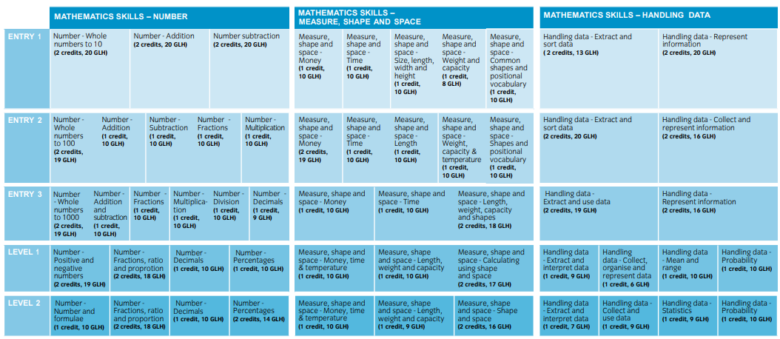
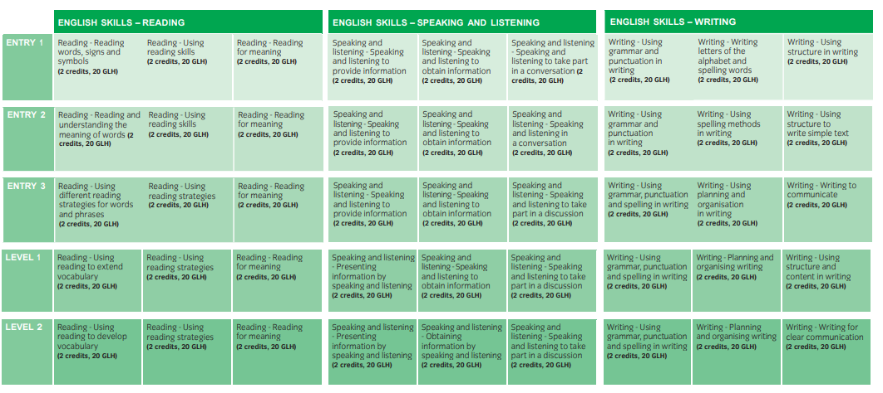
Mathematics Skills and English Skills (3847)
THEMED
CERTIFICATE
THEMED
CERTIFICATE
traineeships
Notes:
This is the structure of our Mathematics and English Skills. Each of these boxes is a unit covering a specific area of the adult numeracy or adult literacy curriculum – a 10 or 20-hour chunk of learning that can either be recognised as a qualification in its own right, or combined into [CLICK] larger themed awards (eg in Reading, or in Measure/Shape/Space) or [CLICK] certificates.
There are 140 units in total across 5 levels: – 55 for Maths and 45 for English.

Slide 8
How can we understand what’s fundable?
Maths and English funding guides
Each lists all of our maths and English qualifications eligible for public funding in England.
Separate editions covering
16-18 study programmes
Adult Education Budget.
Contains links to each qualification/unit’s actual listing on LARS Hub.
cityandguilds.com/delivering-our-qualifications/funding/maths-english
traineeships

Slide 9
e-Functional Skills Reloaded
An end-to-end online solution.
Initial assessment available separately.
Supports Entry 3, Level 1 and Level 2.
Diagnostic to identify skills gaps and direct the learner to the appropriate resources.
Uniquely designed to complement City & Guilds’ Functional Skills qualifications.
Reporting tools and individual learning plan to track and tailor learning.
Tutors can customise their delivery by adding own content their lessons.
Exam preparation resources (sample papers/exam scenarios).
traineeships
Notes:
e-Functional Skills has been around for a number of years, but has recently been updated – reloaded - to incorporate the 2019 Functional Skills reforms.
It’s an end-to-end solution that takes Functional Skills learners on a journey though initial assessment, onto a deeper diagnostic, then creates an individualised learning plan that they can work through whilst being monitored, tracked and supported. The system will suggest content to help address gaps identified through the initial and diagnostic assessment process, but tutors are able to supplement and amend this as they wish.
It also incorporates some assessment preparation activities that can be used to help determine learners’ readiness for their live Functional Skills assessment.

Slide 10
For colleges, employers and training providers, e-Functional Skills Reloaded is a learner-facing web-based solution. A tutor ‘back end’ lets those teaching functional skills track and tailor learning.

Slide 11
Maths and English resource hub
Information about our complete range of maths and English products and services, including:
our monthly webinar updates
our practice-sharing networks
our CPD programme
SmartScreen Maths and English content
e-Functional Skills
cityandguilds.com/mathsandenglish
traineeships
Notes:
Our resource hub contains a wealth of information – including details of our networks and regular update webinars, as well as demo versions and links to further information about SmartScreen and e-Functional Skills.
Go to cityandguilds.com/mathsandenglish – and follow the links to either ‘Functional Skills’ or ‘England’

Slide 12
Digital skills units - suggested uses within traineeships
Learning Aim Reference | Unit title | GLH | Suggested use and context | City & Guilds unit number
Entry level 3
T/502/0166 | IT user fundamentals | 15 | Administration - save and retrieve files in folders on a computer or network. | 4249-001
J/502/0172 | Using e-mail | 10 | Manage incoming e-mail from, compose and send messages to customers and suppliers. | 4249-006
A/502/0167 | Word processing software | 15 | Input text, edit and format internal reports and letter letters to customers and suppliers. | 4249-011
L/502/0190 | The Internet and World Wide Web (based on Microsoft Digital Literacy) | 5 | How to connect to the Internet, browse web pages, navigate web sites, use search engines and exchange e-mail with others. | 4249-092
traineeships

Slide 13
Digital skills units - suggested uses within traineeships
Learning Aim Reference | Unit title | GLH | Suggested use and context | City & Guilds unit number
Level 1
F/502/4558 | Data management software | 15 | Adding or amending customer details into a company CRM system or database; booking client appointments for a hairdresser, dentist etc. | 7574-118
H/502/4553 | Database software | 20 | Enter names and addresses into a customer database; update stock control data. | 7574-119
Y/502/4565 | Desktop publishing software | 20 | Typical documents may include – invitation, poster, menu, greetings card, business card. | 7574-122
J/502/4609 | 2D drawing and planning software | 15 | A plan of an office or garden layout, a mind map of key points discussed in a meeting. | 7574-123
K/502/4618 | Project management software | 20 | Updating project calendar with staff holiday information; editing tasks to update status during project progress. | 7574-126
A/502/4624 | Spreadsheet software | 20 | Produce a duty rota for staff or a work sheet for keeping track of expenses. | 7574-127
L/502/4630 | Website software | 20 | Create webpages, blogs for social networking, learning or retail sites; information pages created within web or content management system. | 7574-128
traineeships

Slide 14
Digital skills units - suggested uses within traineeships
Learning Aim Reference | Unit title | GLH | Suggested use and context | City & Guilds unit number
Level 2
Y/502/4257 | Security for IT Users | 15 | Run anti-virus software to scan a system and maintain a security log. | 7574-205
M/502/4300 | Using e-mail | 20 | Adding a signature to emails; changing settings to deal with junk mail effectively. | 7574-208
F/502/4379 | Using collaborative technologies | 30 | Setting up a group on a social networking site for a work team; inviting people to join an online conference. | 7574-209
M/502/4393 | Video software | 20 | Recording video footage, downloading the footage to a computer, editing and adding background music, adding the to a file of another application. | 7574-214
M/502/4555 | Database software | 20 | Generate reports on sales activities, order details or project management activities. | 7574-219
M/506/6384 | 3D drawing and planning software | 30 | Create, modify and layout 3D designs for eg buildings, products or components. | 7574-237
traineeships

Slide 15
Approval process and next steps

Slide 16
Example approval cost
Hospitality and
catering
Workplace
skills
Young leaders
English
and
maths
IT
user
£200
FREE
FREE
FREE
FREE
traineeships
Notes:
Saving of £900 if all bolt-ons selected
All bolt-on approvals will be completed remotely
Main qualification approval will be completed remotely where possible

Slide 17
Approval and support
New Customer
Existing
Customer
Contact Direct Sales
01924 206709
email directsales@cityandguilds.com
Go to Walled Garden
Complete qualification approval form
(Support: account manager or direct sales team)
Target to complete – 30 working days
traineeships

Slide 18
What other areas would assist?
Are there other sectors or subject areas, providers and employers think are needed?
What other sector or subject areas do providers/employers need or are they asking about?
What are employers saying to providers regarding their skills and training challenges due to Covid-19? How can we support them with meeting those needs?
City & Guilds can develop frameworks to support other subject areas, if there is a need and we have the products, but we need to know which area would make a real difference.
Contact - https://www.cityandguilds.com/help/contact-us or call 0844 543 0000
traineeships

Slide 19
Useful links
https://www.cityandguilds.com/what-we-offer/centres/work-ready/traineeships
https://www.gov.uk/guidance/esfa-funding-for-traineeships
https://www.cityandguilds.com/delivering-our-qualifications/funding
traineeships

