Slide 1

e-volve
Centre Analytics
USER GUIDE
Shows how you can self-serve all your e-volve test data through e-volve Centre Analytics
Version 1.0

Slide 2

e-volve Centre Analytics USER GUIDE
Contents
Contents
Introduction 3
Logging in 3
Main Menu 4
Flow chart 4
Test Calendar: Default view 5
Overview of scheduled tests 5
Test search by centre, test, candidate, date 5
Test Calendar: Candidate attendance 6
Candidate search 6
Printing candidate attendance register 6
Test Calendar: Candidate profile 7
Printing candidate profiles/score reports 7
Test History: Default view 8
Colour-coded bar and pie data charts 8
Test History: Data search 9
Search historical data 9
Test History: Dataset comparison 10
Comparison over two date ranges 10
Test History: Results breakdown 11
City & Guilds global averages 11
Mark distribution, no shows, retakes 11
Test History: Candidate/centre performance 12
Candidate list 12
Near pass results 12
Overall centre performance report 12
Printing candidate profiles/score reports 12
Candidates: Default view 13
Search for candidates 13
Candidates: Example of candidate list 14
Candidate profiles 14
Printing candidate profiles/score reports 14
Key Features 15
Data search: calendar tool 15
Printing documents 16
Help 20
Help buttons 20
User Guide 20
Customer Support 20
FAQs 21
2
3
© Copyright The City and Guilds of London Institute 2015

Slide 3
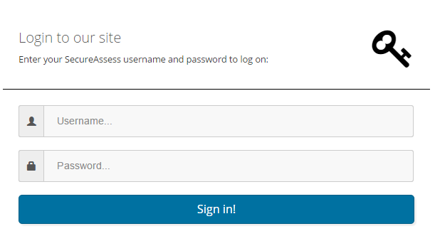
e-volve Centre Analytics USER GUIDE
Introduction
Welcome to e-volve Centre Analytics User Guide
This User Guide is designed to help you navigate through the City & Guilds e-volve Centre Analytics system. The following key features are available in a few clicks:
  Candidate attendance registers, profiles and score reports can be downloaded and printed
  Recent and archived test results can be retrieved and printed
  Calendar of scheduled and overdue tests
  Calendar of scheduled tests searchable by day, month, year, qualification
  Comparison of historical datasets over various date ranges
  Data presented in graphical and tabular formats
  Clear layout of data in colour-coded bar and pie charts
  Comparison of centre performance with City & Guilds pass rate global average
  Searchable candidate test history
  Candidate test activity profiles
  Candidate lists
  Access to qualification data
  You will only be able to access and report on your own centre’s qualifications and test data previously assigned to you within SecureAssess.
  Logging in
  Please go to the URL
  https://evolve.cityandguilds.com/analytics
  and enter your username and
  password in the pop-up window.
3
© Copyright The City and Guilds of London Institute 2015

Slide 4
e-volve Centre Analytics USER GUIDE
Introduction continued
Main Menu
  After logging in, you will arrive at the Home page. The Main Menu bar at the top of the screen is shown below.
Home
Welcome
to e-volve Centre
Analytics
Summary
of features
Test Calendar
Test status overview
Test schedule: centre, candidate, date
Attendance register
Candidate profiles
Test History
Comparison of historical data
Centre performance
Candidate profiles
Score reports
Candidates
Candidate
profiles
Score reports
User Guide
Link to PDF for user guide
Welcome
Personalised greeting for each user
Log Out
Log Out screen
-
-
-
-
-
-
-
-
-
-
-
-
Flow chart
Key outputs of the e-volve Centre Analytics system.
4
© Copyright The City and Guilds of London Institute 2015

Slide 5


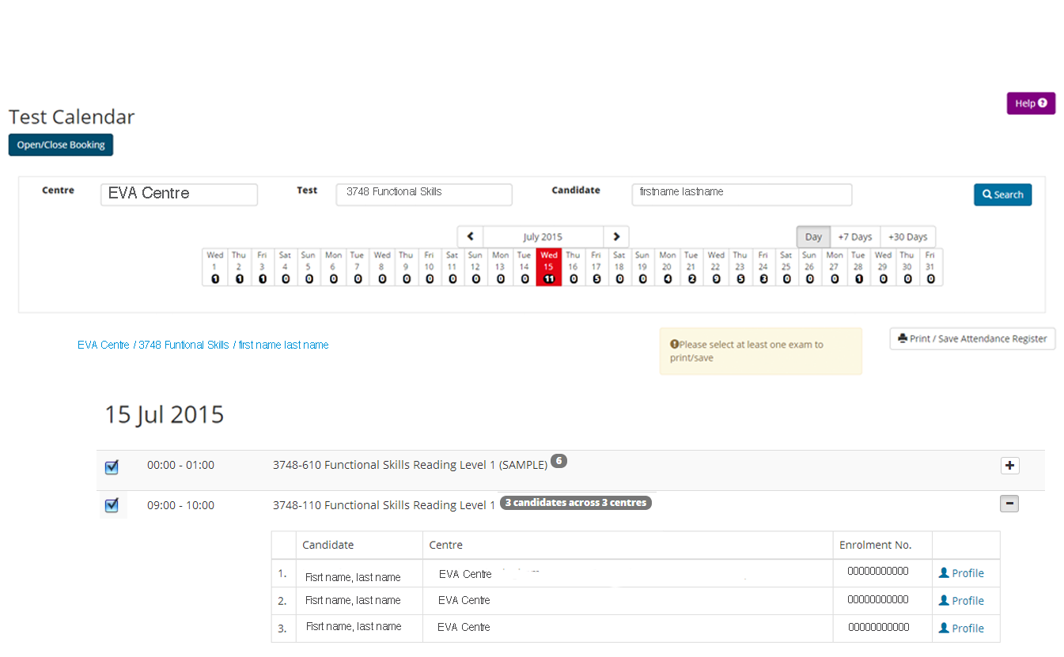
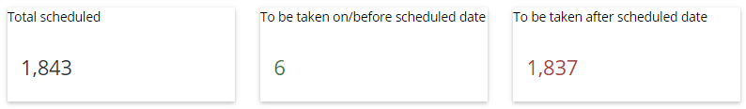
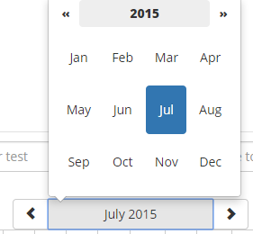
e-volve Centre Analytics USER GUIDE
Test Calendar: Default view
Here you can search for any tests by centre/test/candidate and by day/month/year using the calendar tool. The default view shows the status of tests across all installations and qualifications, i.e. the number of scheduled and overdue tests.
Help
Click on main Help icon in top right-hand
corner of screen to make mini Help icons appear below on page; click again to hide.
See page 20 for details
Centre Enter code or name in field
Test Enter code or name in field
Candidate Enter first name or last name in field
Click Search after each entry
SEARCH: Click after entering any new data to refresh page
Selecting day
Default is set at current date; click on +7 Days to view tests scheduled
1 week (7 days) in advance; click on +30 Days to view tests scheduled 1 month
(30 days) in advance
Calendar will always default to current date
Open/Close Booking
Click on Open/Close Booking to show/hide test status, i.e. number of scheduled and overdue tests
Calendar tool
Click on left or right arrow
to go back or forward in time
Click on month in bar and
pop-up window appears: select month/year required
See page 15 for more details
5
© Copyright The City and Guilds of London Institute 2015

Slide 6
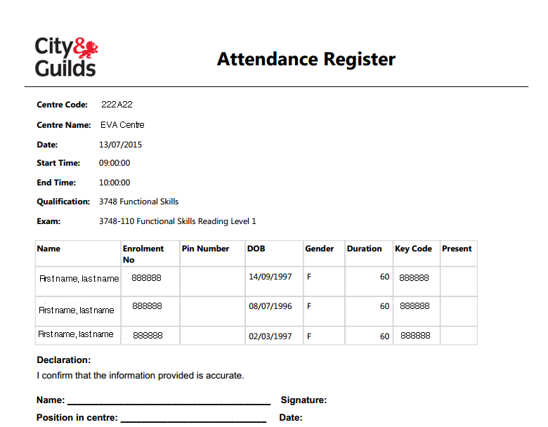
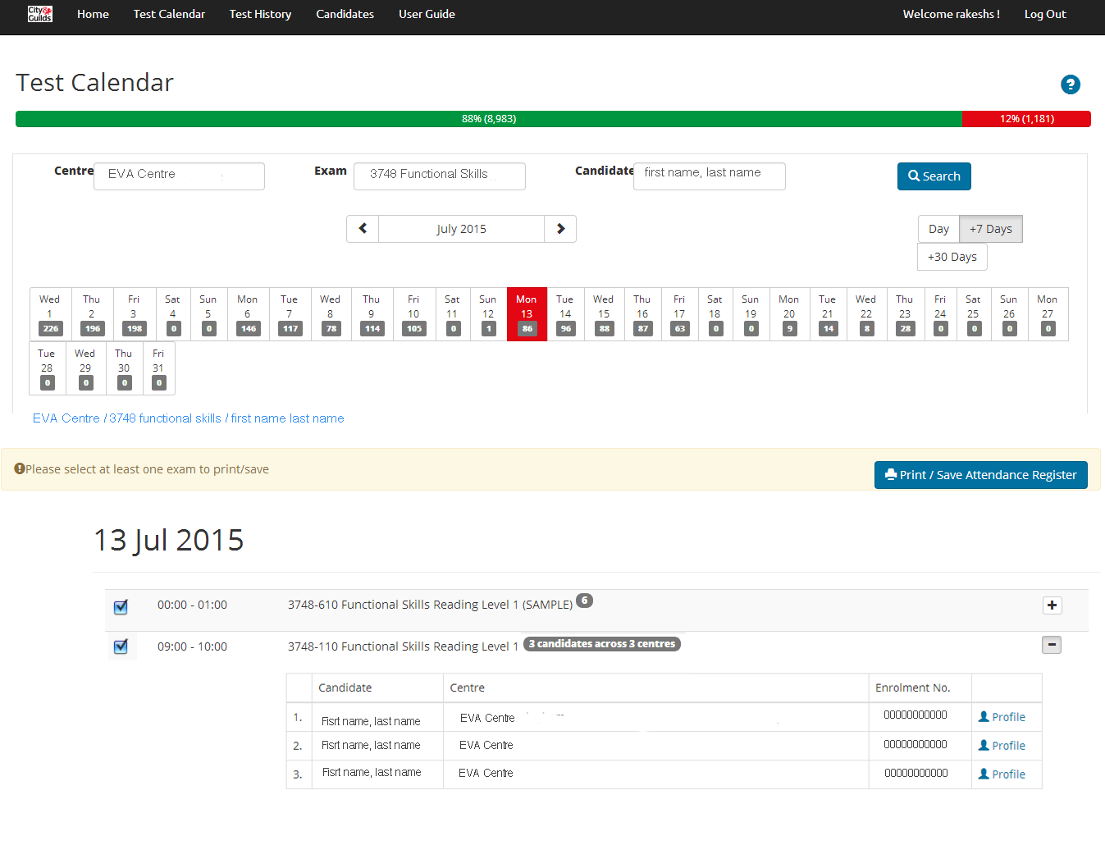
e-volve Centre Analytics USER GUIDE
Test Calendar: Candidate attendance
Here you can find out which candidates are taking which tests on which day. Attendance registers and keycodes for individual or groups of candidates can be downloaded and printed.
Print/Save Attendance Register
A Check box on left-hand side of list to select test; multiple boxes can be checked
B Click on Print/Save Attendance Register to download and save attendance register as PDF; this document can then be printed
Search string
Centre/Test/
Candidate search string is displayed
B
A
Number in grey circle
This shows number of
candidates taking this particular test in this time slot
Grey lozenge
This shows number of candidates taking particular tests across multiple centres
Scheduled test details
Click + to show dropdown table listing tests and candidates that have been scheduled for this time slot;
click − to close
Page 4
Page 4
6
© Copyright The City and Guilds of London Institute 2015

Slide 7

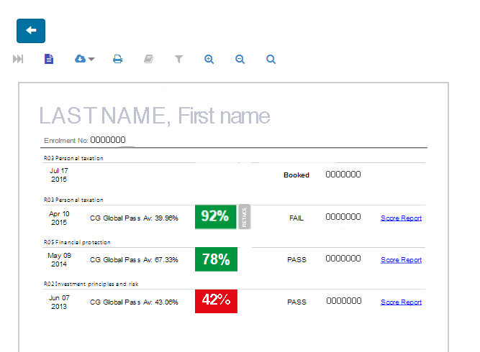
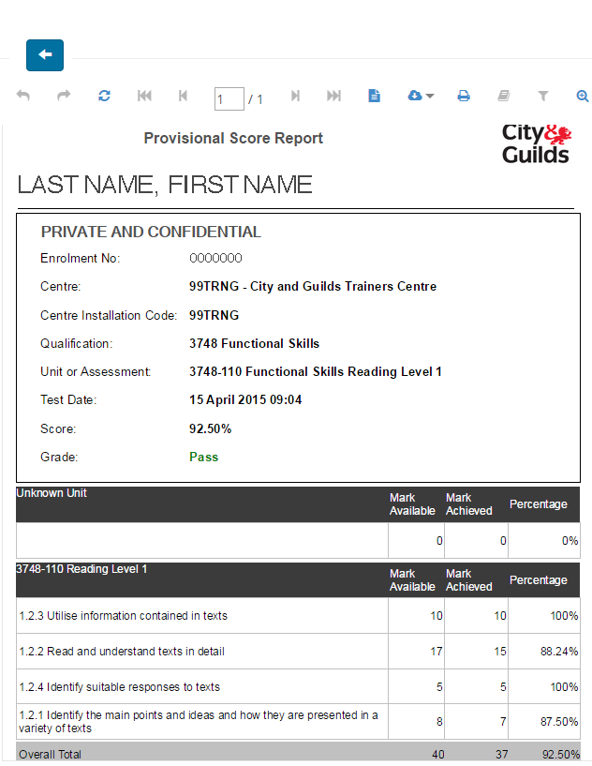
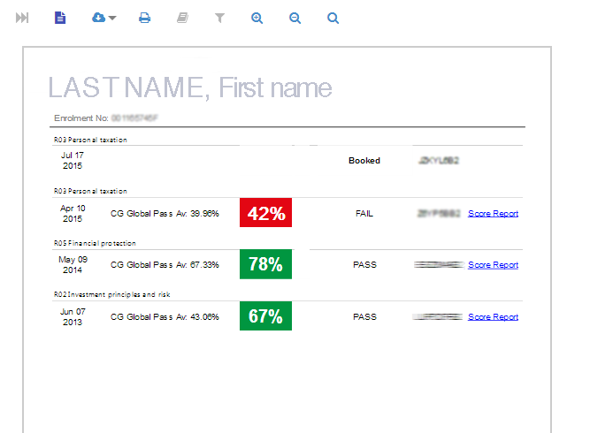
e-volve Centre Analytics USER GUIDE
Test Calendar: Candidate profile
It is also possible to view any scheduled candidate’s test profile history including score reports at this point.
Printing candidate profile
Click Profile icon to download document;
from menu on top click Print icon to print, then click Back button to return to previous page
Candidate profile
Candidate name and enrolment number
Qualification code and name
Test date
City & Guilds global pass average
Candidate percentage mark (colour-coded)
Retake notification if applicable
Grade: Pass/Fail
Test keycode
Score report hyperlink
Printing score report
Click on hyperlink in last column of Profile report to open Provisional Score Report generated immediately after test was completed. From menu on top click Print icon to print, then click Back button to return to previous page
Page 4
Page 4
7
© Copyright The City and Guilds of London Institute 2015

Slide 8
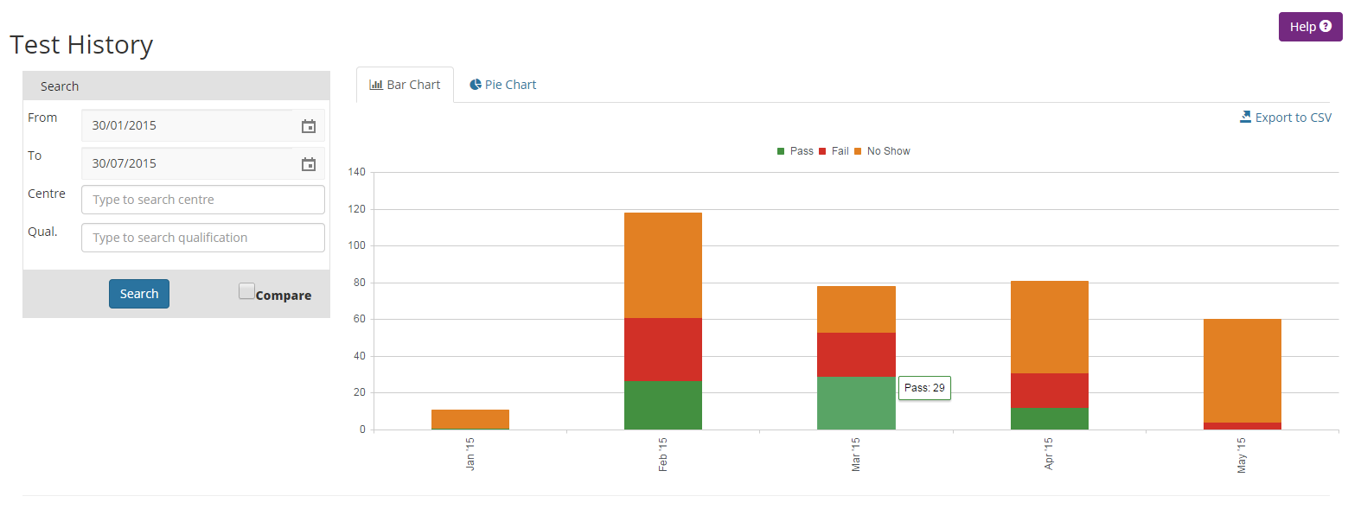
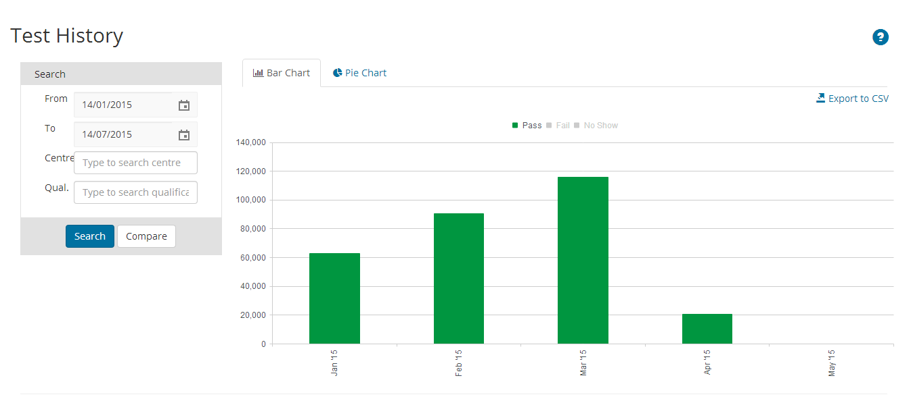
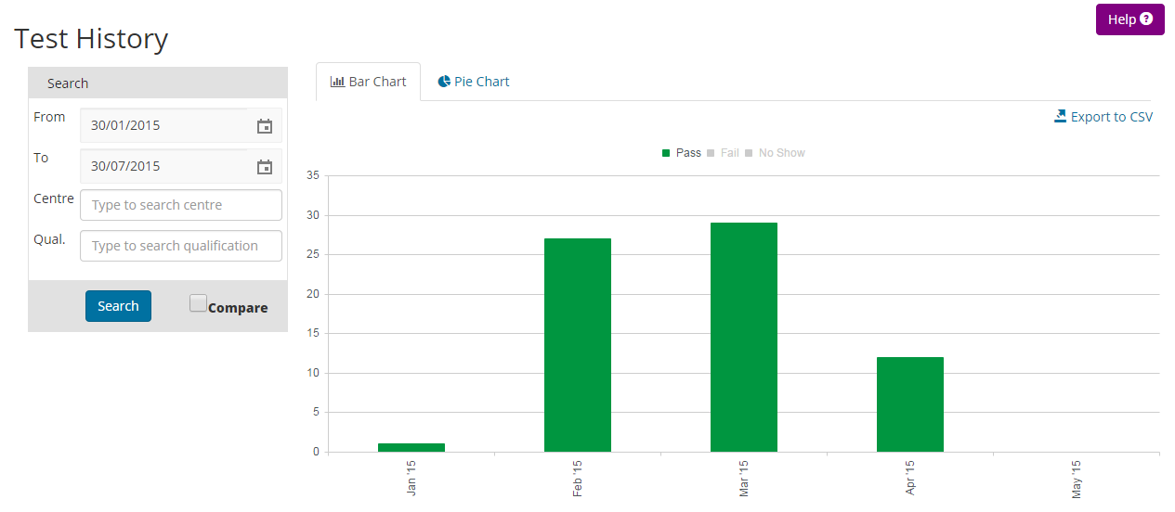
e-volve Centre Analytics USER GUIDE
Test History: Default view
The default view shows data across all installation IDs and qualifications for the past six months (from today).
Date range
Default view is six-month period prior to current date, showing colour-coded data in bar chart format
Bar chart legend
Colour-coded test grades
Green Pass
Red Fail
Orange No show
Help
Click on main Help icon in top right-hand
corner of screen to make mini Help icons appear below on page; click again to hide.
See page 20 for details
Note
For wide date ranges, please wait as system may take longer to upload large quantities of data
Highlight/Restrict data displayed
Click on any symbol to grey out and
temporarily remove result from bar chart; click again to make it reappear
8
© Copyright The City and Guilds of London Institute 2015

Slide 9

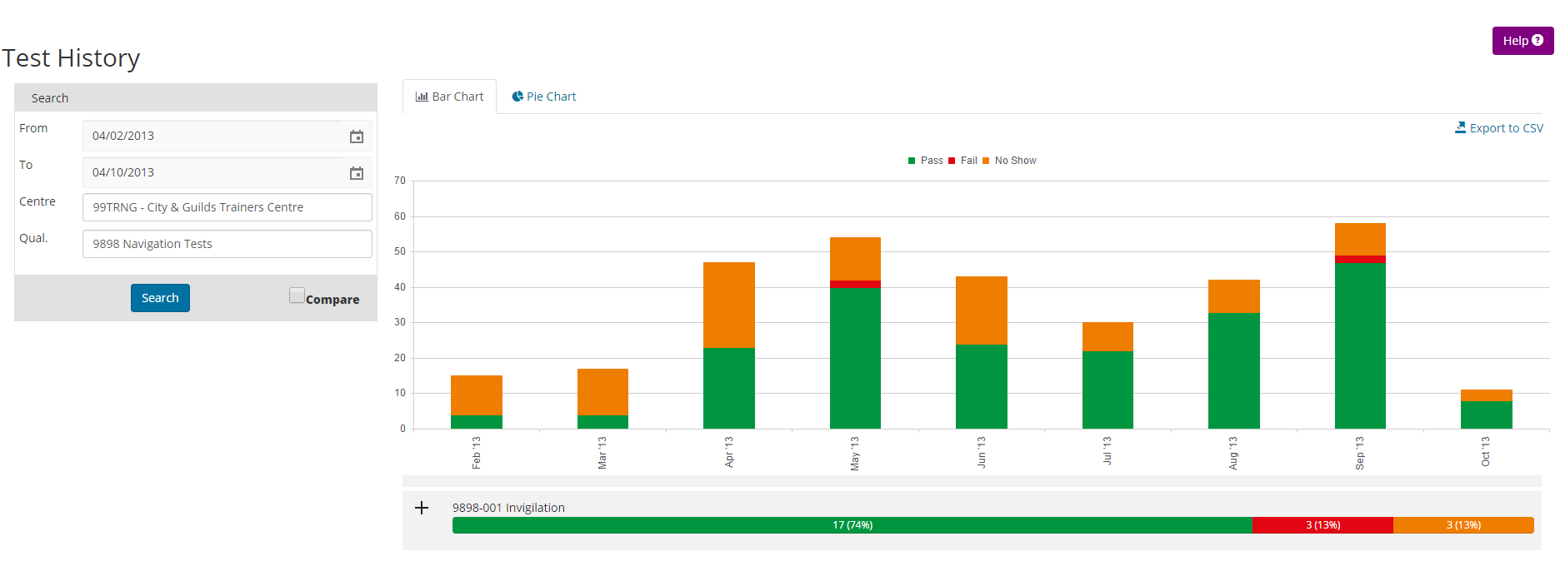
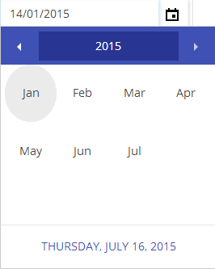
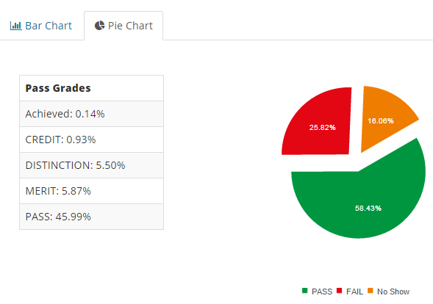
e-volve Centre Analytics USER GUIDE
Test History: Data search
Here you can view historical data for a particular centre and qualification by day/month/year using the calendar tool. You can also export data to CSV file then download and print out document.
Date range
To select range enter dates required in From/To fields or click on calendar icon to open balloon
Click to export data to CSV file then download and print ; document will open as spreadsheet – format will vary depending on software on your computer
See page 18 for details
Centre
Enter code or name in field and click Search
Qualification Enter qualification code or part of name in field and click Search
SEARCH: Click after entering any new data to refresh page
Horizontal data bar
Each horizontal bar represents each individual unit comprising that particular qualification shown in vertical bars above
Pie chart
Click here for Pie Chart view:
(right) pie shows data for selected centre and qualification;
(left) Pass grades are broken down into different types
Calendar
See page 15 for details
9
© Copyright The City and Guilds of London Institute 2015

Slide 10
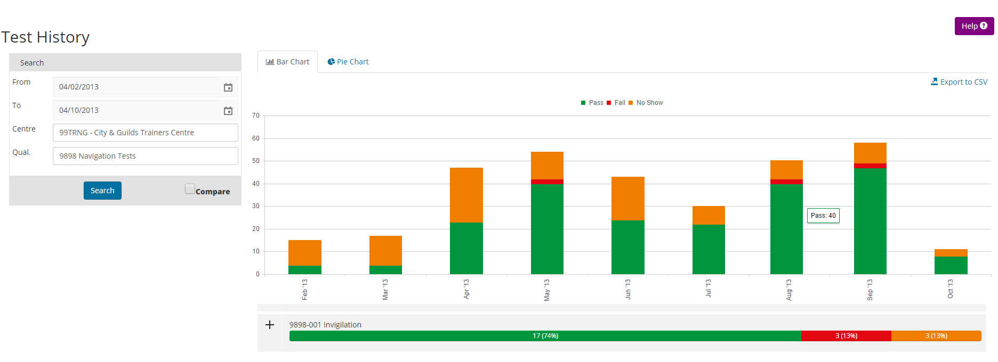
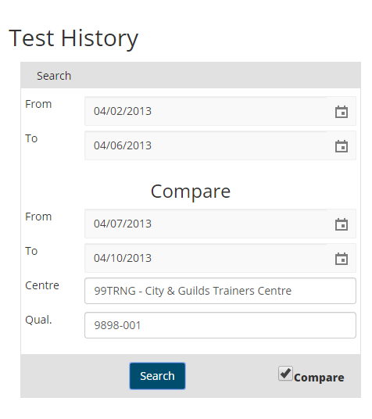
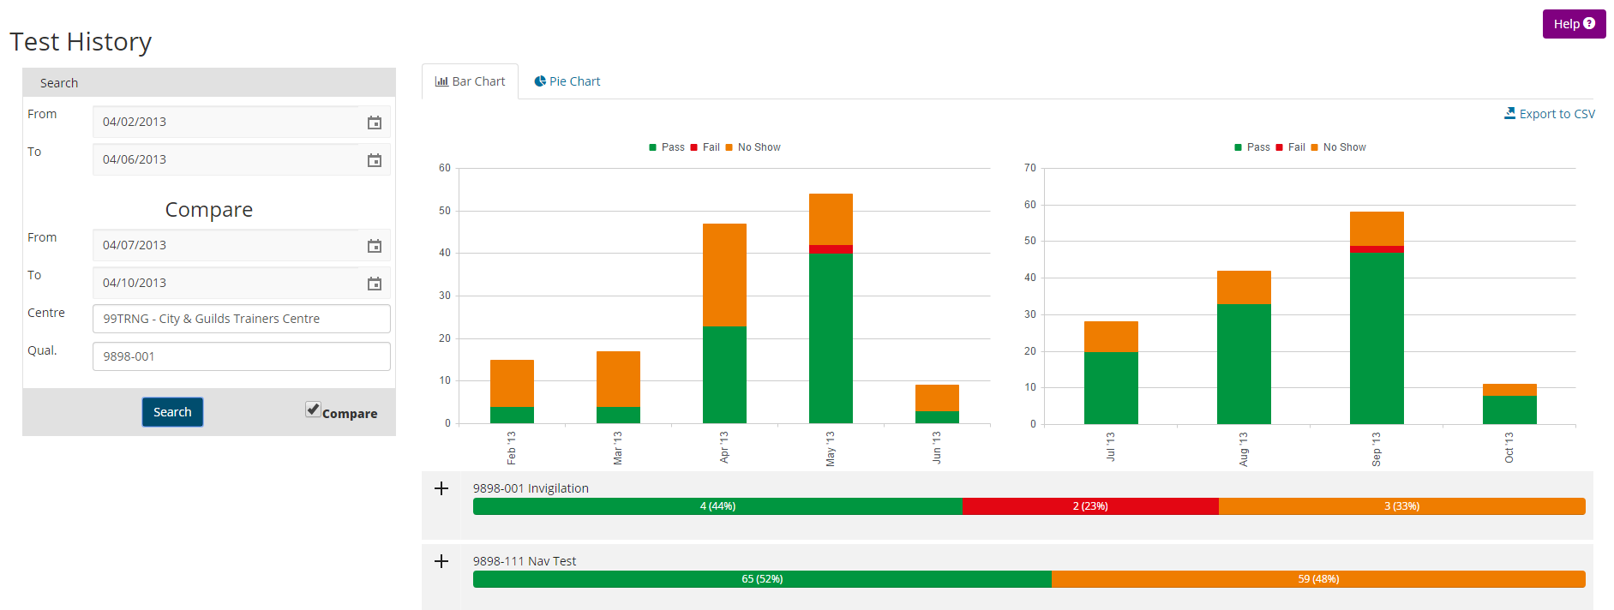
e-volve Centre Analytics USER GUIDE
Test History: Dataset comparison
Here you can search and compare historical data over two date ranges for any of your centres/installation IDs they have access to in SecureAssess. The two datasets can be viewed side-by-side in bar chart format.
Date range
To select range enter dates required in From/To fields or click on calendar icon to show balloon
Centre
Enter code or name in field and click Search
Qualification
Enter code or name in field and click Search
Numerical data
Hover cursor over vertical bar to show data in numbers
Compare two date ranges
Check Compare box to expand search pane (see left)
To select ranges in Compare pane enter dates required in From/To fields or click on calendar icon to show balloon
Click Search to show chart comparison view (see right); note this is only possible in bar chart format
Compare two date ranges
Check Compare box to expand search pane (see left)
To select ranges in Compare pane enter dates required in From/To fields or click on calendar icon to show balloon
Click Search to show chart comparison view (see right); note this is only possible in bar chart format
Note: In chart comparison view, it is not possible to export data to CSV
10
© Copyright The City and Guilds of London Institute 2015

Slide 11
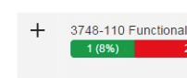
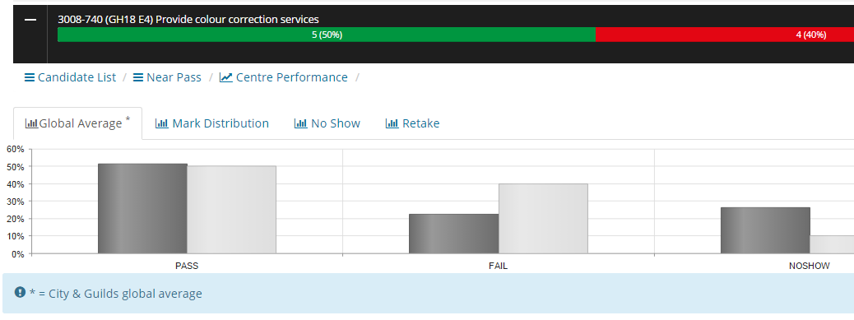
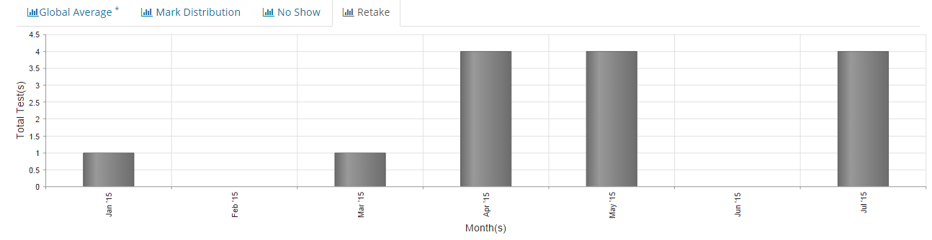
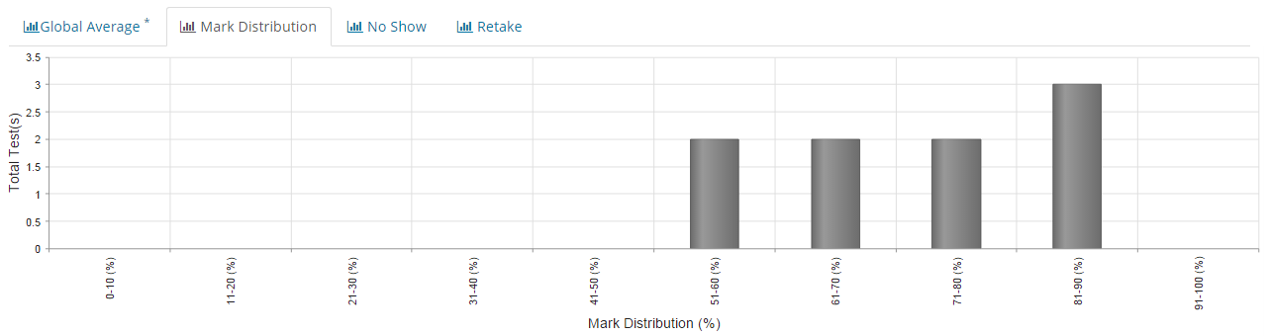
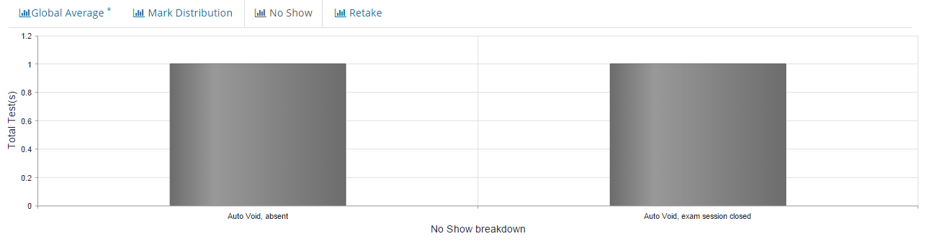
e-volve Centre Analytics USER GUIDE
Test History: Results breakdown
Here you can find out how your centre performs against the City & Guilds global average. The results for each test can be viewed by category in bar chart format: mark distribution, no-shows and retakes.
Results breakdown
Click on + to expand horizontal data bar; click on – to collapse
Numerical data
Hover cursor over vertical bar to show data in numbers
City & Guilds global
average
This chart compares centre test results with City & Guilds’ global average
Retake
Click here to find out how many candidates took selected test again
Mark distribution
Click here to
show results in percentage bands for selected test
No show
Click here to find out how many candidates did not take selected test
Pag 6
11
© Copyright The City and Guilds of London Institute 2015

Slide 12
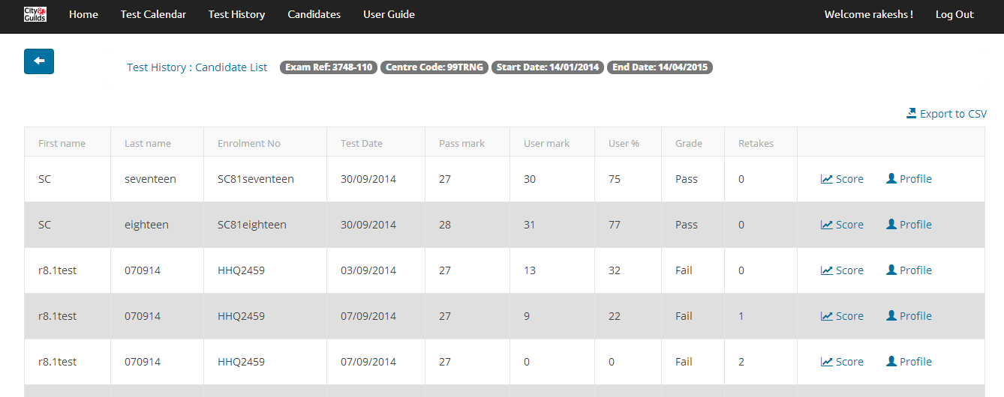
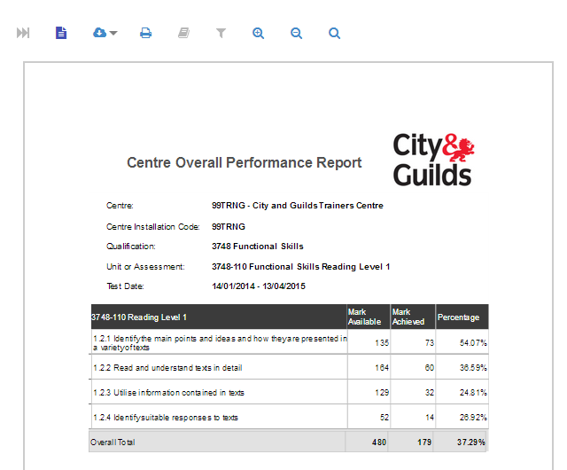
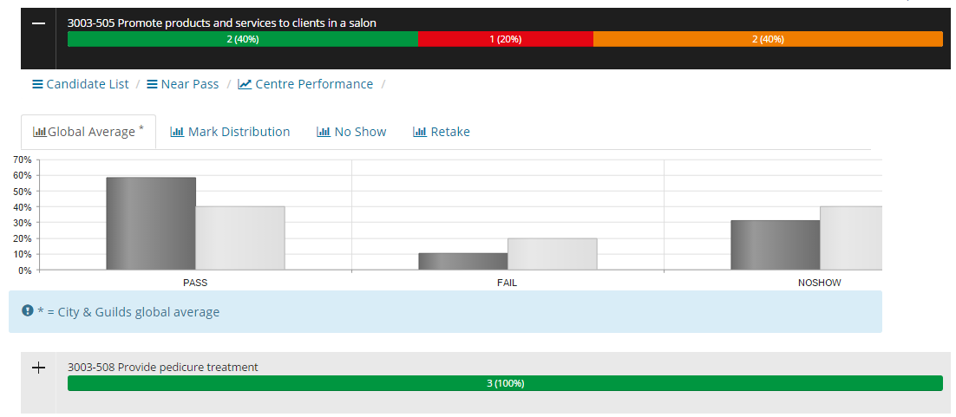
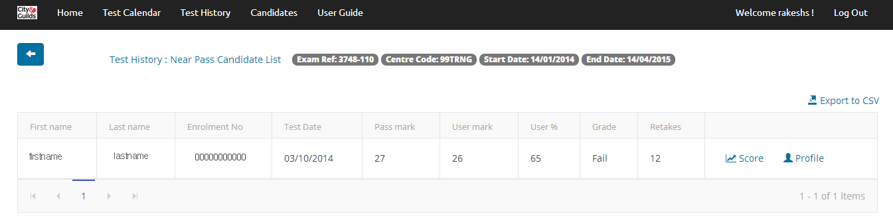
e-volve Centre Analytics USER GUIDE
Test History: Candidate/centre performance
Here you can view a list of candidates, near pass results and an overall centre performance for selected test. These can be downloaded and printed.
Search string
Candidate list search string is displayed at top of screen
CSV file
To print see page 18
Candidate list
Centre performance
Print
This report shows overall performance of particular centre; from menu on top click Print icon to print
Near pass
CSV file
To print see page 18
Search string
Candidate near pass results search string is displayed at top of screen
Pag 6
12
© Copyright The City and Guilds of London Institute 2015

Slide 13
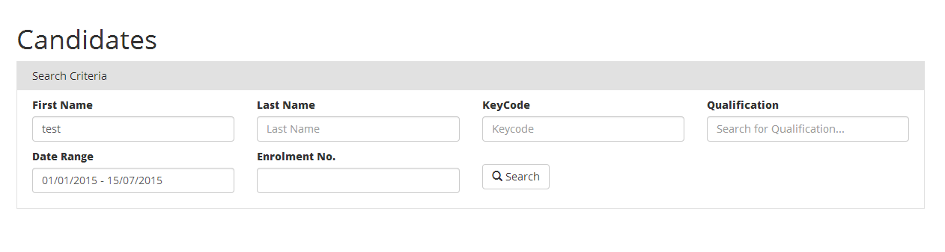
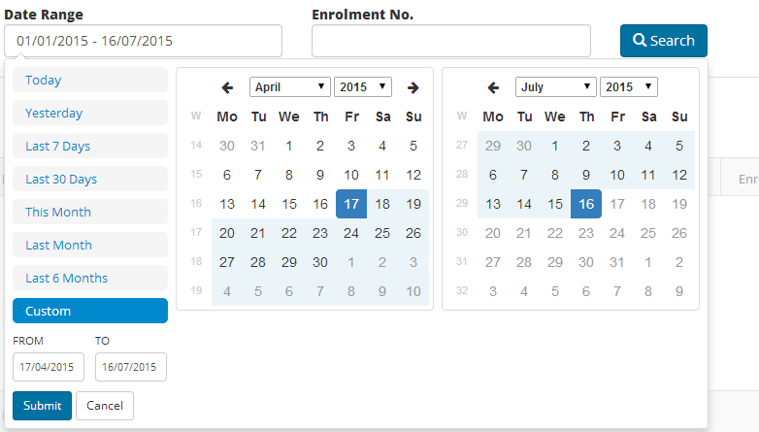
e-volve Centre Analytics USER GUIDE
Candidates: Default view
This is the default view. Here you can search for candidates using different criteria. Enter details in empty fields to generate candidate lists. Before a search can be carried out, one of these fields must be completed: First Name, Last Name or Enrolment No.
First Name
Enter name in field and click Search
Last Name
Enter name in field and click Search
KeyCode
Enter unique test code in field and click Search
Qualification
Enter code or name in field and click Search
Enrolment No.
Enter number in field and click Search
SEARCH: Click after entering any new data to refresh page
Date Range
Default view is six-month period prior to current date
Enter dates required manually or click to show calendar balloon
Date range
To select range enter dates required from two calendars
Customise range
Enter dates in FROM/TO fields and click Submit
Pag 6
13
© Copyright The City and Guilds of London Institute 2015

Slide 14
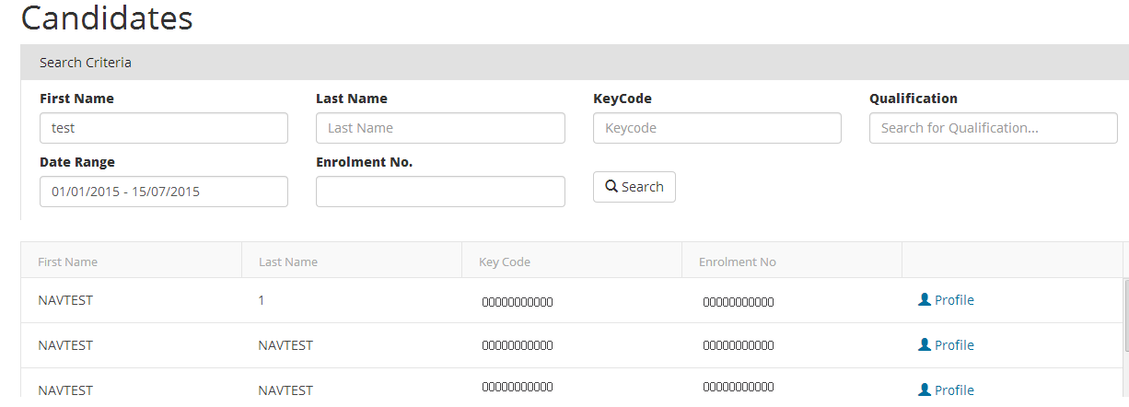
e-volve Centre Analytics USER GUIDE
Candidates: Example of candidate list
This page shows an example of a candidate list for selected tests. Here, candidate profiles and provisional score reports can be viewed, downloaded and printed.
Note: When searching for large groups of candidates, you may have to wait as system may take longer to upload large quantities of data
Printing candidate profile
Click Profile icon to download document; from menu on top click Print icon to print, then click Back button to return to previous page
SEARCH: Click after entering any new data to refresh page
Printing score report
Click on hyperlink in last column of Profile report to open Provisional Score Report generated immediately after test was completed. From menu on top click
Print icon to print, then click Back button to return to previous page
Pag 6
14
© Copyright The City and Guilds of London Institute 2015

Slide 15
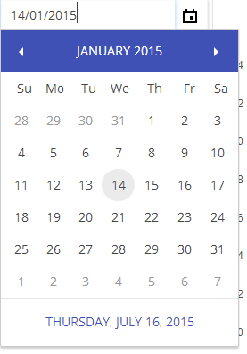

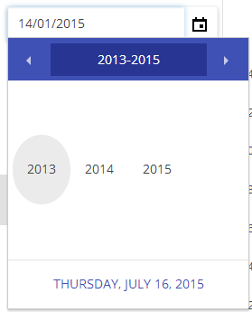
e-volve Centre Analytics USER GUIDE
Key Features
Data search: calendar tool
The calendar tool, which can be activated in all sections, provides a powerful means of searching recent and historical data. You can find out which candidates are taking which tests on which day and retrieve archived results for centres and candidates by day/month/year.
You can also simply type dates required directly into fields
A. Click on calendar icon to open calendar balloon showing month-to-view; select day
B. Click on month-year bar to open year-to-view; select month
C. Click on year bar to open decade-to-view; select year
Click on left or right arrow to go back or forward in time
D. Click on required
year
then month
then date
15
© Copyright The City and Guilds of London Institute 2015

Slide 16

e-volve Centre Analytics USER GUIDE
Printing documents
Attendance register with keycodes
Candidate profile and score report
Exported CSV file
Candidate list
Near pass
Centre performance
1. How to print attendance register with keycodes
This can be done in the Test Calendar section: select centre, test, candidate, date then download and print document as shown below.
B
A
A Check box on left-hand side of list to select test; multiple boxes can be checked
B Click on Print/Save Attendance Register to download and save attendance register as PDF; this document can then be printed
KeyCode
Each test is assigned its own unique code
16
© Copyright The City and Guilds of London Institute 2015

Slide 17
e-volve Centre Analytics USER GUIDE
Printing documents continued
2. How to print Candidate Profile and Score Report
This can be done in the Test Calendar, Test History or Candidates sections: select the test details (date/centre/qualification/candidate) required, then download and print documents as shown below.
Candidate profile
Click Profile icon to download document;
from menu on top click Print icon to print, then click Back button to return to previous page
Score report
Click on hyperlink in last column of Profile report to open Provisional Score Report generated immediately after test was completed. From menu on top click Print icon to print, then click Back button to return to previous page
17
© Copyright The City and Guilds of London Institute 2015

Slide 18
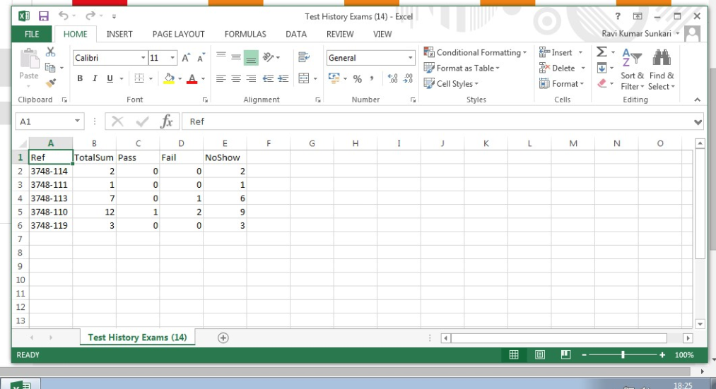
e-volve Centre Analytics USER GUIDE
Printing documents continued
3. How to print exported CSV file
This can be done in the Test Calendar, Test History or Candidates sections: select the test details required, then export data to a CSV file and print documents as shown below.
CSV file
Document will open as spreadsheet – format will vary depending on software on user computer; sample is shown below
Click to export data to CSV file for printing
18
© Copyright The City and Guilds of London Institute 2015

Slide 19
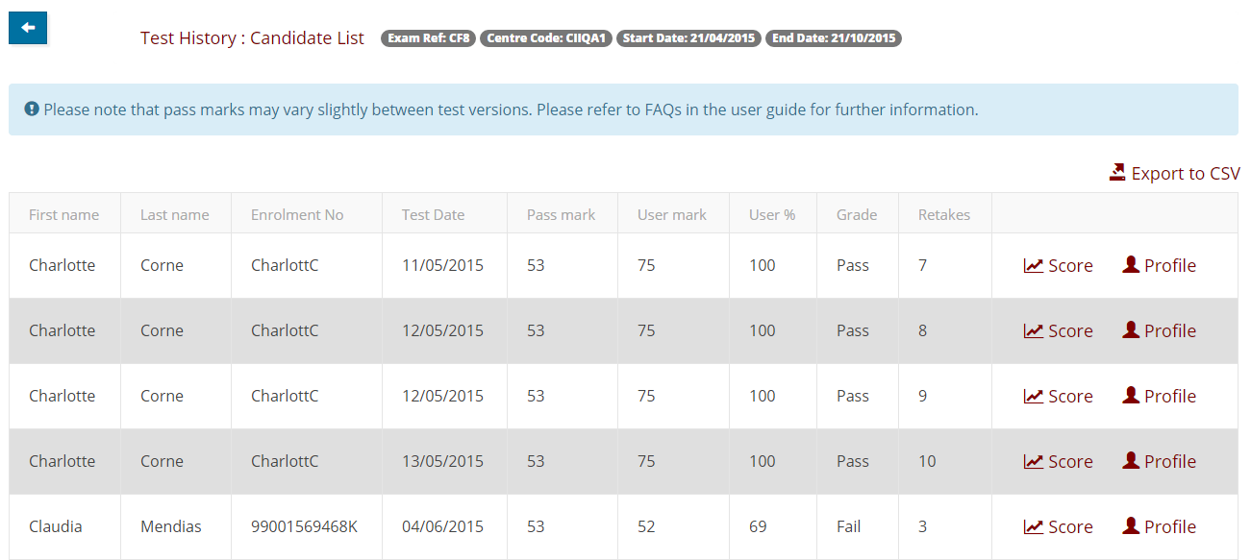
e-volve Centre Analytics USER GUIDE
Printing documents continued
How to print:
4. Candidate list 5. Near pass 6. Centre performance
This can be done in the Test History section: select the test details required, then print documents as shown below.
4. Candidate list
6. Centre performance
Print
From menu on top click Print icon to print
CSV file
See page 18 for instructions on how to print
5. Near pass
CSV file
See page 18 for instructions on how to print
19
© Copyright The City and Guilds of London Institute 2015

Slide 20

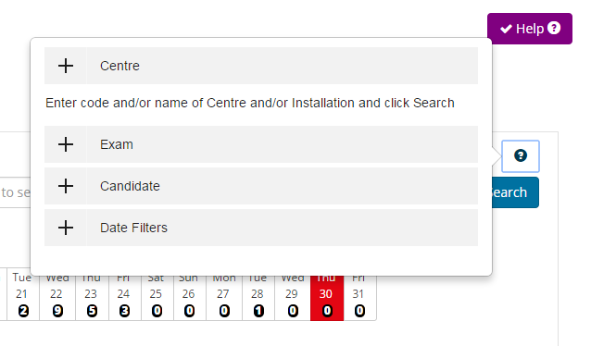
e-volve Centre Analytics USER GUIDE
Help
There are a number of Help menus available throughout the e-volve Centre Analytics system. The buttons are invisible by default but can be made visible by clicking the main Help button in the top right corner of the screen.
Help buttons
Help
Click main Help icon in top right-hand corner of screen to make mini Help icons appear
Click any mini Help icon to open menu in balloon; click again to close
Click + to show information; click + again to hide
User Guide
To access a PDF of this guide click on the link on the Main Menu bar.
User Guide
Link to PDF for this user guide
Customer Support
Further assistance is available from the Customer Support team as follows:
UK centres can contact Customer Services 08:00 to 18:00 Monday to Friday
E: evolvesupport@cityandguilds.com
T: 0844 543 0000
20
© Copyright The City and Guilds of London Institute 2015

Slide 21
e-volve Centre Analytics USER GUIDE
FAQs
Logon & Access
1 | If I put in the wrong login details, will my account be disabled? | The application does not take any action on the number of unsuccessful logon attempts so your account will not be disabled following incorrect attempts at logging in.
2 | Where can I change my e-volve Centre Analytics password? | Your e-volve Centre Analytics password is linked to your SecureAssess account and password. Any changes made to your SecureAssess password will be reflected in your e-volve Centre Analytics account overnight.
3 | Why can I only see information about one qualification and not the whole centre info? | You will have access to the same qualification results data you have access to within SecureAssess.
4 | If I am inactive for a period of time, will I be logged out of the system? | Yes, you will be logged out of e-volve analytics after 30mins of in-activity.
5 | How do I provide access to other staff members in my organisation? | All e-volve Centre Analytics accounts are linked to user accounts in SecureAssess. Therefore any new user will need to be created in SecureAssess by your e-volve centre administrator. The user will then be added to e-volve Centre Analytics application during the overnight refresh.
6 | Is there a particular browser I can use to access this? | Microsoft IE9 or above. Google Chrome 30 or above.
Test Calendar
1 | How are the values revealed by selecting the Open/Close test Bookings button derived? | Total tests scheduled = All tests scheduled under your ID within the -10 to + 30 day window. Tests to be taken on/before schedule date = Tests that can be taken on or up to 10 days before the date they were scheduled for. Tests to be taken after schedule date = Tests that can still be taken up to 30 days after the date they were scheduled for.
2 | In Test Calendar can I search by ENR? | It is not currently possible to search by ENR in Test Calendar.
3 | Why am I not able to view future Bookings in the calendar? | It is only possible to view scheduled exams in the test calendar window up to 10 days into the future. This is in keeping with the scheduled exams visible via the SecureAssess system.
4 | I am unable to export data to a CSV file. What can I do? | Confirm the CSV has not downloaded in the background behind the current screen. You can try Ctrl + J to view hidden downloads if viewing with IE or Chrome.
21
© Copyright The City and Guilds of London Institute 2015

Slide 22
e-volve Centre Analytics USER GUIDE
FAQs
Test History
1 | What is the City & Guilds global average? | The C&G global average query currently displays the average passing percentage of all exams selected in the filter criteria. This is displayed alongside the querying centre’s passing average for this exam. The querying centre's results will be included in this dataset.
2 | How far back can I search for data? | You can search through all your e-volve test result data going back to May 2011 when e-volve was launched.
3 | Why can pass marks sometimes vary on the same test for same/different candidates? | Examiners use a variety of evidence in setting pass marks for assessments (tests). Tests are reviewed regularly using statistical evidence of candidate and test performance. Many of the qualifications offered by City & Guilds deliver tests flexibly to facilitate ‘when ready’ and ‘on-demand’ assessment. To facilitate this, the tests are drawn from banks of assessment material. This allows for different versions of the test be available. Pass marks may vary slightly from one test version to another. Where there is a variation, this is to ensure that no candidate is disadvantaged owing to the slight variations in demand which may exist from one test version to another.
4 | What is the percentage set for Near Passes? | The near pass percentage is set to 10% below the pass mark for the test paper. Any candidate within this range will be picked up in this report. e.g If the total marks for the test is 100 and pass mark is 35. Then all the candidates who got 25 to 34 are selected. As 10% of 100 is 10.
5 | Can I see a breakdown of results performance across multiple qualifications? | No, it is only possible to view breakdown of single qualifications.
6 | How is the centre performance report calculated? | Each learning outcome in a centre performance report is the sum of all the corresponding learning outcomes from the candidates score reports for the selected timeframe, Qualification and Exam.
General
1 | How often does the data get refreshed? | The test booking and results data in e-volve Centre Analytics is refreshed every 24hrs overnight and ready for use before 0800 GMT.
2 | How do I access the online help? | Select the help button which appears at the top of each screen. Clicking on the question mark will provide you with useful hints and tips.
3 | Who can I contact for further help and support? | City & Guilds Customer Services +44 (0) 844 543 0000 (8am-6pm Monday to Friday - UK time) or email centresupport@cityandguilds.com. *Calls to our 0844 numbers cost 5 pence per minute plus your telephone company’s access charge.
22
© Copyright The City and Guilds of London Institute 2015

