Slide 1
Assessment Mitigation Guidance for Teaching and Learning Qualifications 2020/21
October 2020

Slide 2
Agenda
Support
Background
Mitigation guidance and processes
Q&A
Further information

Slide 3
We are here to support you
Updated communications and guidance for 220/21 - https://www.cityandguilds.com/covid-19/mitigation-approaches-for-vrqs-nvqs/adaptations, including sector specific guidance
Regular updates and links to relevant information – Regulator information and guidance
List of qualifications with primary mitigation:
Calculate
Adapt
Delay
No mitigation required
Assessment mitigation centre guidance for NVQs & VRQs, including summer 2020 guidance https://www.cityandguilds.com/covid-19/mitigation-approaches-for-vrqs-nvqs
Continued support through range of webinars

Slide 5
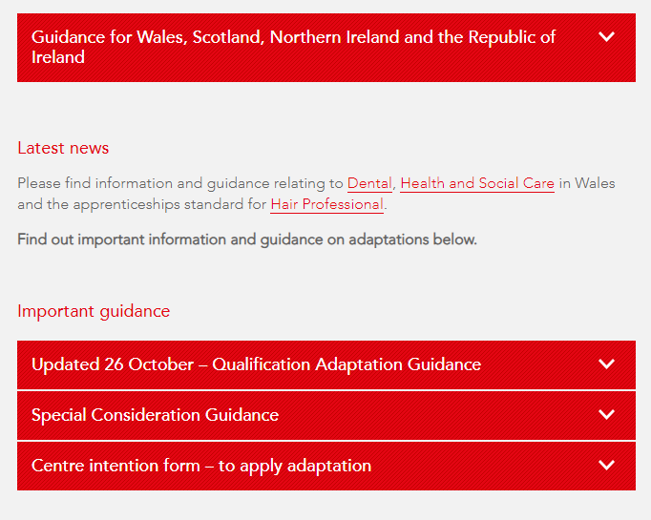
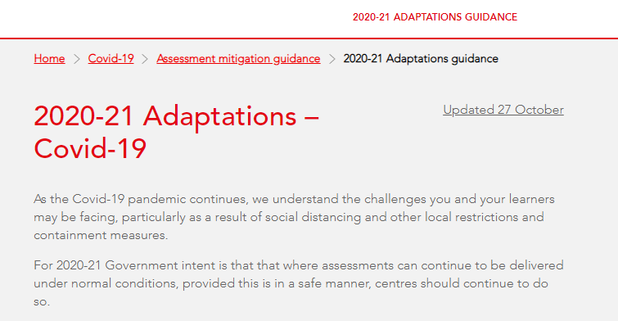

Slide 6
Assessment guidance

Slide 7
Mitigation approach to VTQs – 2020/21
This guidance covers the assessment and mitigation processes that will be applied to the qualifications in this sector.
These include:
• Calculated results
• Adaptation
• Delay
• No mitigation required
Scope of Learners
Registered learners expecting to complete during 2020/21 academic year, learners on two year programmes and learners unable to complete during the March-July period

Slide 8
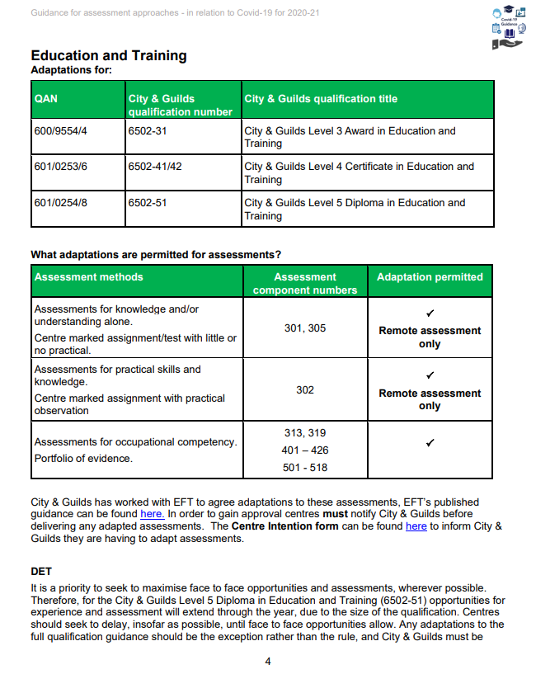
Mitigation approach to VTQs – 2020/21
Sector Guidance document
Sector assessment mitigation guidance documents

Slide 9
Adaptation

Slide 10
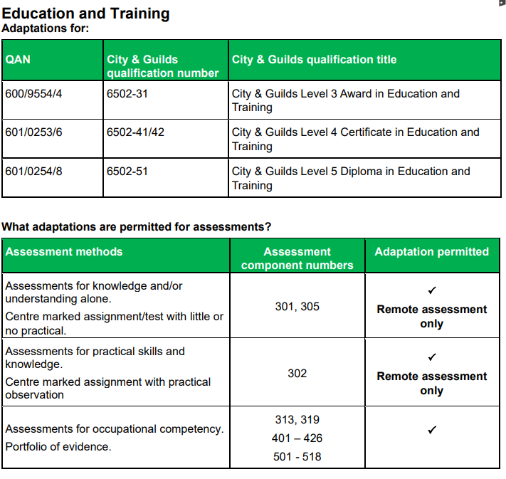
6502 Education and Training
City & Guilds has worked with ETF to agree adaptations to these assessments, ETF’s published guidance can be found on the 6502 documents webpage. In order to gain approval centres must notify City & Guilds before delivering any adapted assessments – centre intention form.
Centres are strongly advised to wait for appropriate face to face assessment opportunities
Live remote assessments are allowed
Notify your EQA
https://www.cityandguilds.com/qualifications-and-apprenticeships/learning/teaching/6502-education-and-training#tab=documents Covid-19

Slide 11
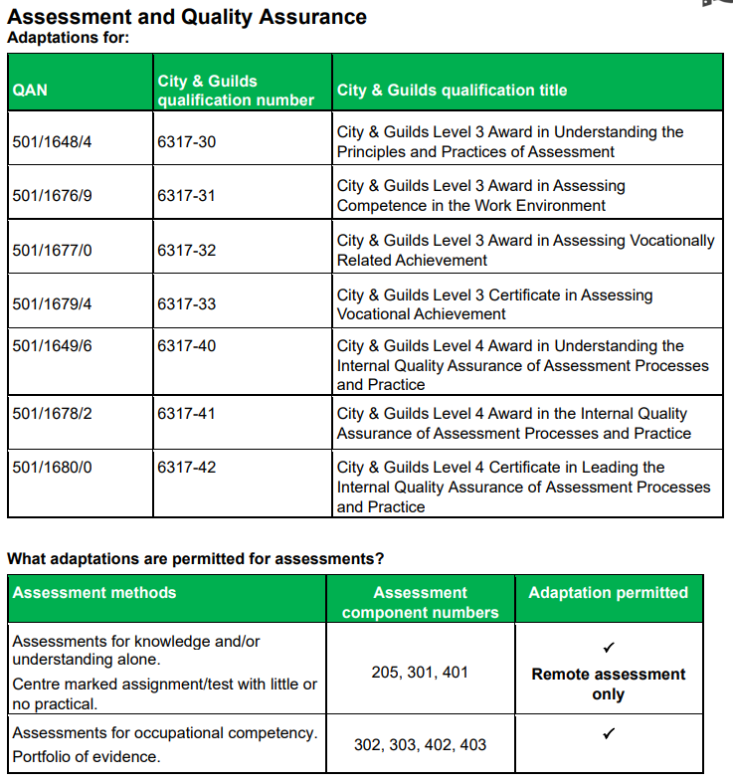
6317 Assessor and QA (TAQA)
City & Guilds has worked with ETF to agree adaptations to these qualifications, ETF’s published guidance can be found on the 6317 documents webpage
Centres are strongly advised to wait for appropriate face to face assessment opportunities
Consider delivery and assessment of knowledge first
Live remote assessments are allowed
Centres must plan and be confident that all assessment outcomes can be covered
The adaptations are for 2020/21 and for the current Covid-19 situation only
Notify your EQA
https://www.cityandguilds.com/qualifications-and-apprenticeships/learning/training-and-development/6317-assessment-and-quality-assurance#tab=documents Covid-19

Slide 12
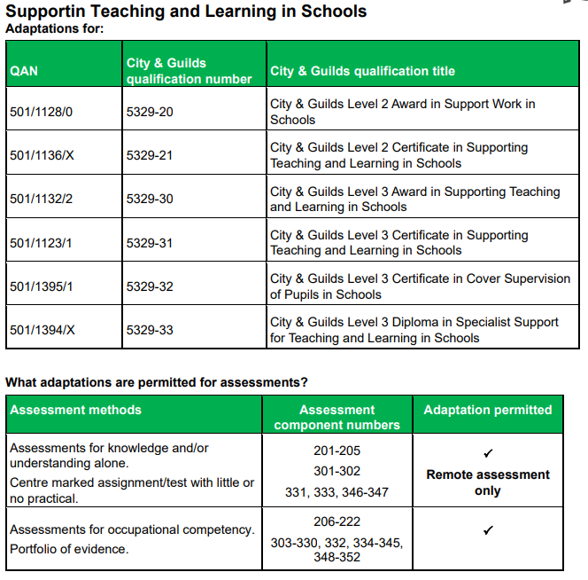
5329 STLS
Centres are strongly advised to wait for appropriate face to face assessment opportunities
Consider delivery and assessment of knowledge first
Live remote assessments are allowed, where permitted
Only if face to face or remote observation is not possible should EWT be used
If EWT has to be used, it should only be used as outlined in the qualification handbook
Notify your EQA

Slide 13
Please be aware
Centres are strongly advised to wait for appropriate face to face assessment opportunities
Consider delivery and assessment of knowledge first
Live remote assessments are allowed
Centres must plan and be confident that all assessment outcomes can be covered
The adaptations are for 2020/21 and for the current Covid-19 situation only
Please consider the experience of your learners, and what they are being prepared for when they are employed in relevant positions

Slide 14
Centre intention to apply adaptations to assessment
All centres need to complete the centre intention form to apply adaptations to assessment form to confirm the following information:
Now an online form
Centre name and number
Qualification names and numbers – confirming where Adapted assessments are being used
The form must be completed and submitted by the Head of Centre or someone who has permission to act on their behalf

Slide 15
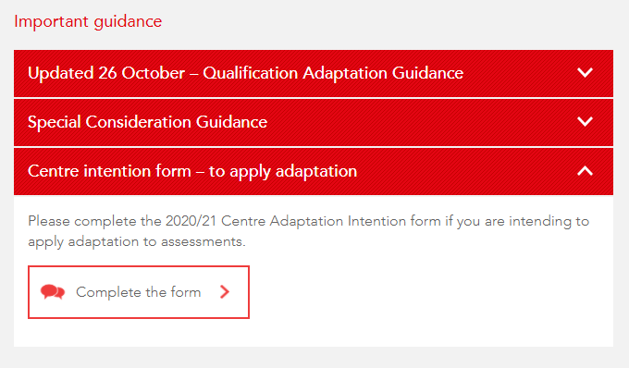
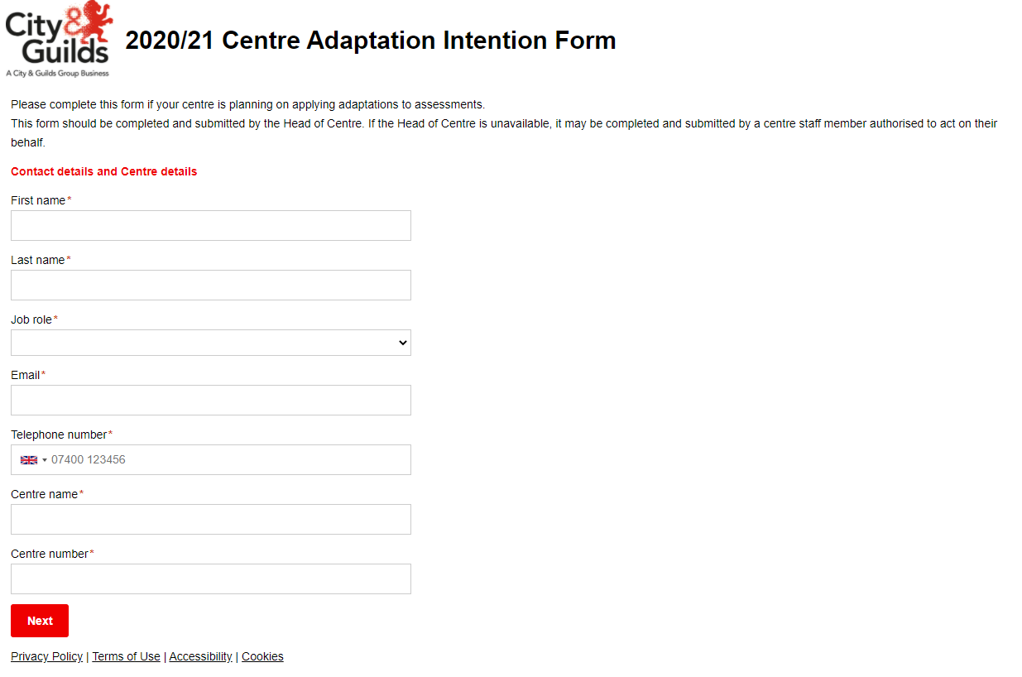
Submission and quality process
Please also inform your EQA that you are going to do so

Slide 16
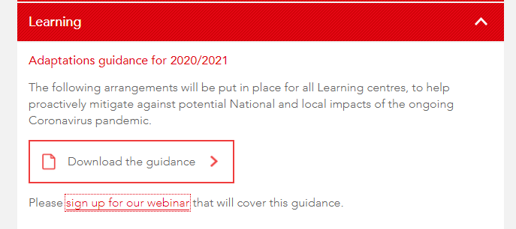
Sector webinars – 2020/21

Slide 17
Appeals Process
Appeals for adapted assessments
Please follow the standard appeals process for adapted assessments.
An appeal cannot be made for what has been adapted, but an appeal can be made about the final result.

Slide 18
Q&A

Slide 19
Further advice and information
For all queries relating to this guidance and arrangements, contact the Customer Support Team at City & Guilds. Who are available Monday to Friday 9am to 5pm excluding UK public holidays.
adaptation.quality@cityandguilds.com
or
centresupport@cityandguilds.com
0844 543 0000*
*Calls to our 0844 numbers cost 7 pence per minute plus your telephone company’s access charge.
Related documents, Ofqual guidance and updates can be found on our website here https://www.cityandguilds.com/covid-19

Slide 20
Thank you

